Slide 1



Le Lan Michel
Marketing director

Slide 2
Introduction
Electronic patient data management systems (PDMS) were clinically used for the first time in the 1970s.
Document vital parameters sampled by monitors and to replace handwritten medical files.
The continuous development of computer technology, however, demands on PDMS have increased immensely.
PDMS are currently assisted clinicians at every level of intensive care, i.e., at the strategic level of physicians’ orders, at the operational level, and at the administrative level.

Slide 3
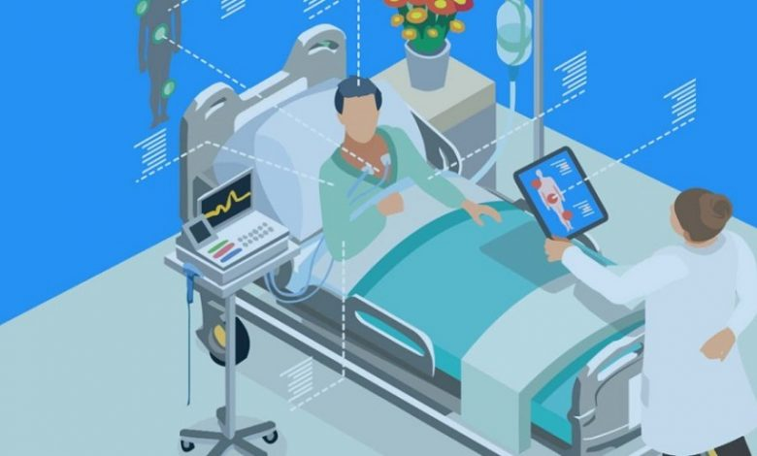
PDMS Definition
Patient Data Management Systems formed the amalgam between the patient monitoring system and hospital information system (HIS).
PDMS automatically collects and stores vital parameters from the patient monitor, provides a digital patient chart
It is considered as the primary system for nurses and physicians in the intensive care setting

Slide 4
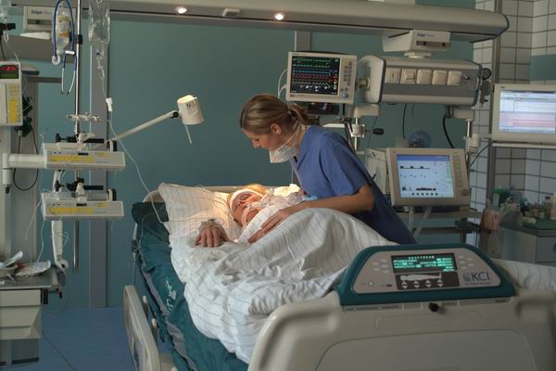
Challenges in Intensive Care
Patients in intensive care, critical or continuous care units are generating a considerable amount of data due to the complexity of their treatment.
Several parameters influence the nature of these data, such as age, morphology, contracted diseases. For each patient, it is approximately 8000 data collected daily.
The implementation of a dedicated Clinical Information System (CIS)/PDMS within a critical care structure is the appropriate response to ensure the collection of medical information, traceability of prescriptions/medical orders, confidentiality duties, the security of the medical record and optimization of patient care.

Slide 5
Challenges in Intensive Care
Patient Care
  Critically ill patients with multiple organ dysfunction and comorbidities
  Complex diagnostic, monitoring and therapeutic methods
  prevention of medical errors
Data management
  Analysis of patient related data
  information, and communications
Cost control
  Reimbursement, charge capture, DRGs, etc.
Quality control
  Medico-legal documentation

Slide 6
A complete system should include
data acquisition,
data base management and archiving of data, documentation, statistics engine..
PDMS required to couple with a hospital information system and the possibility of data exchange is mandatory.

Slide 7

Objectif implement a paperless patient record
Clinician working with a paper chart and Paper Flowsheets

Slide 8

Intensive Care patient documentation

Slide 9

Intensive Care Data Base

Slide 10


Slide 11
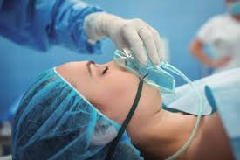
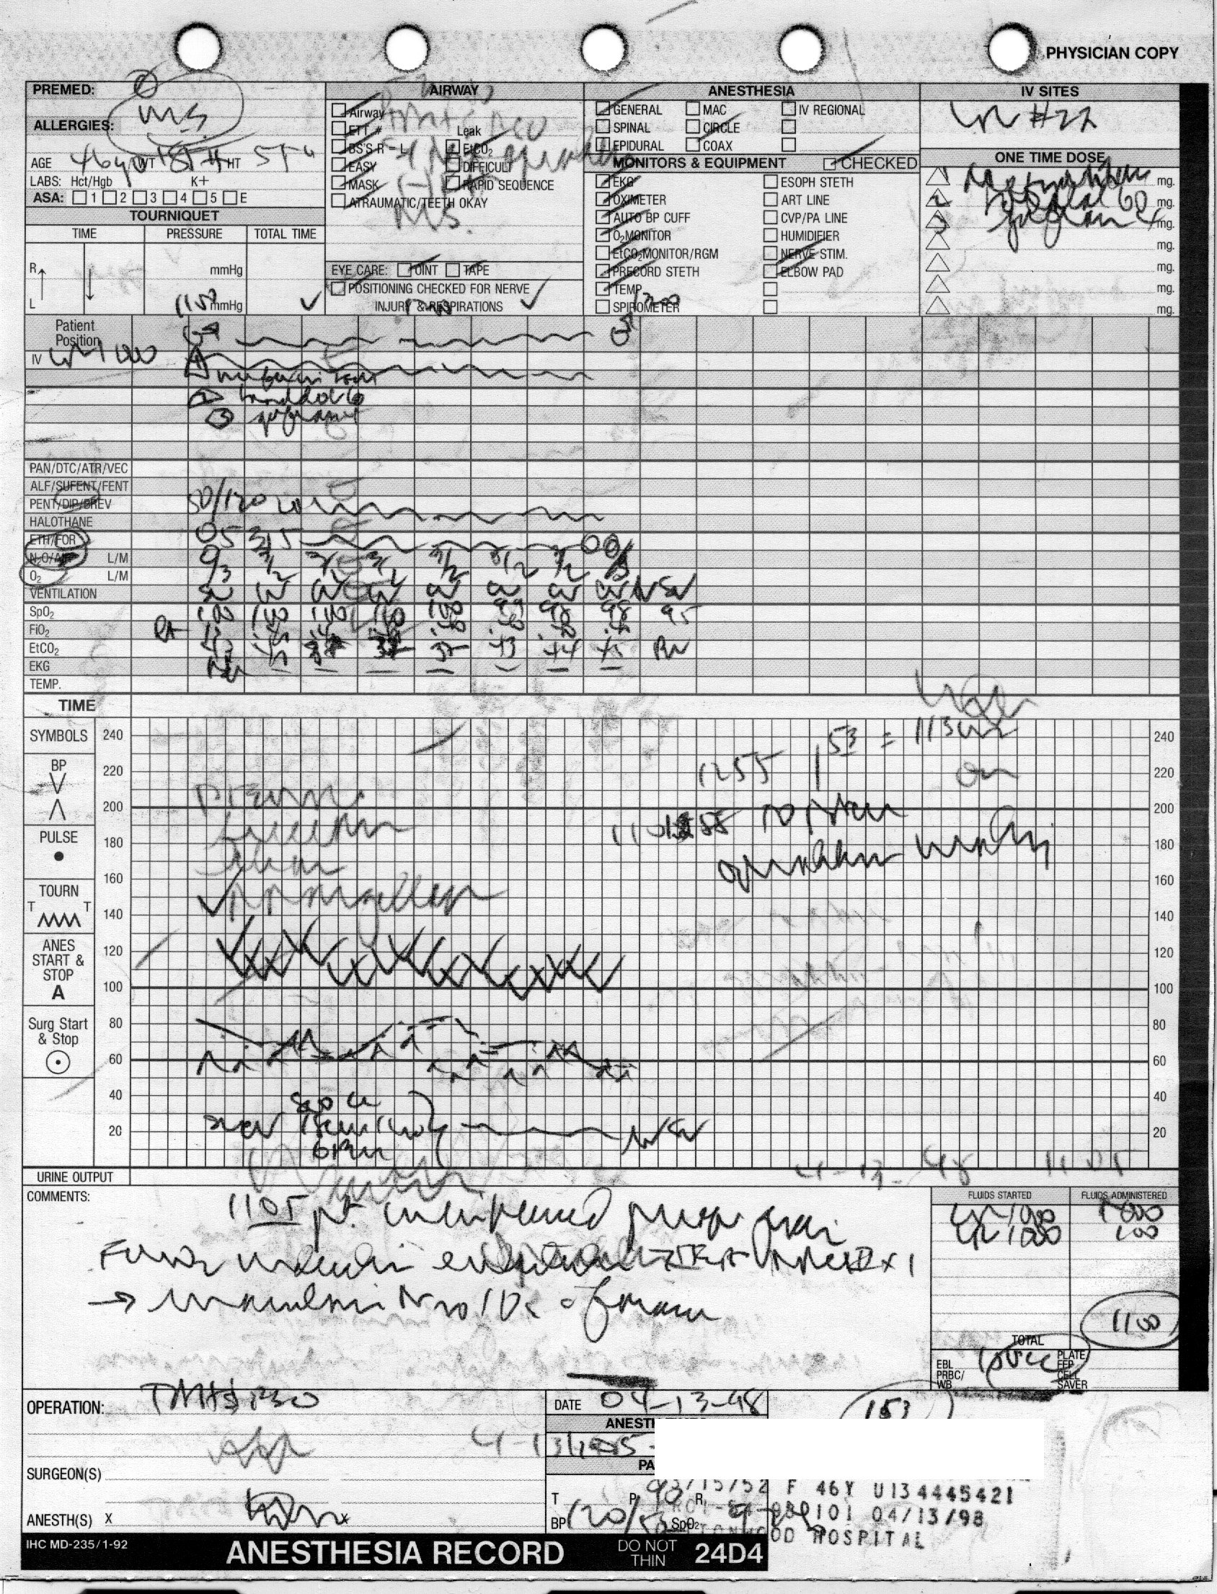
Anaesthesia Patient Record Encrypted ?

Slide 12
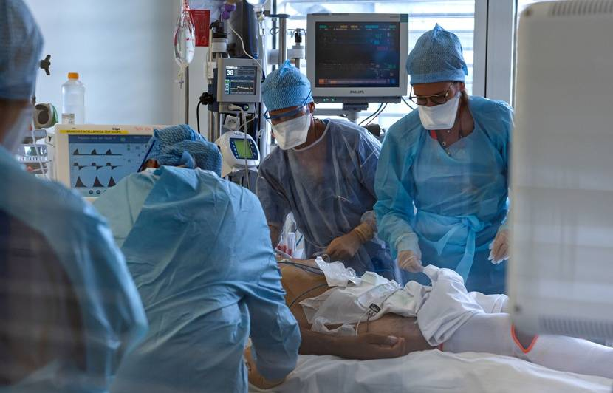
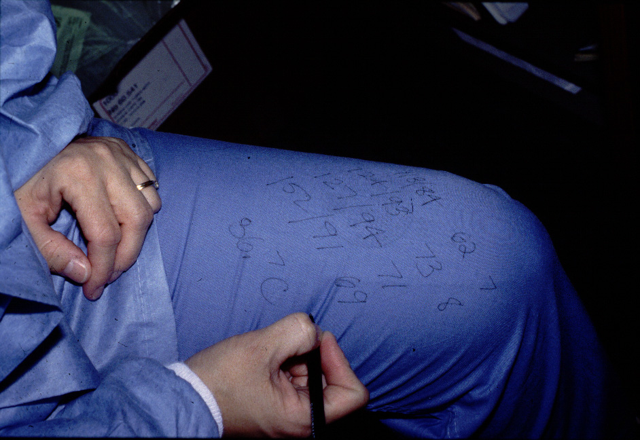
Intensive Care patient record back up

Slide 13

A Software solution for Critical Care, Perioperative Care Areas
Used during anesthesia assessment, operating theatre , anesthesia, recovery room
  Documented electronically
  Increased accuracy, increased efficiency and enhanced patient safety

Slide 14


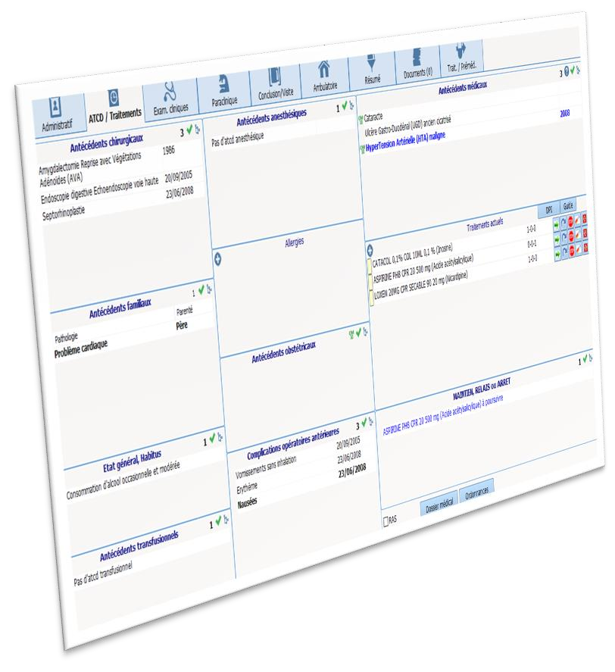
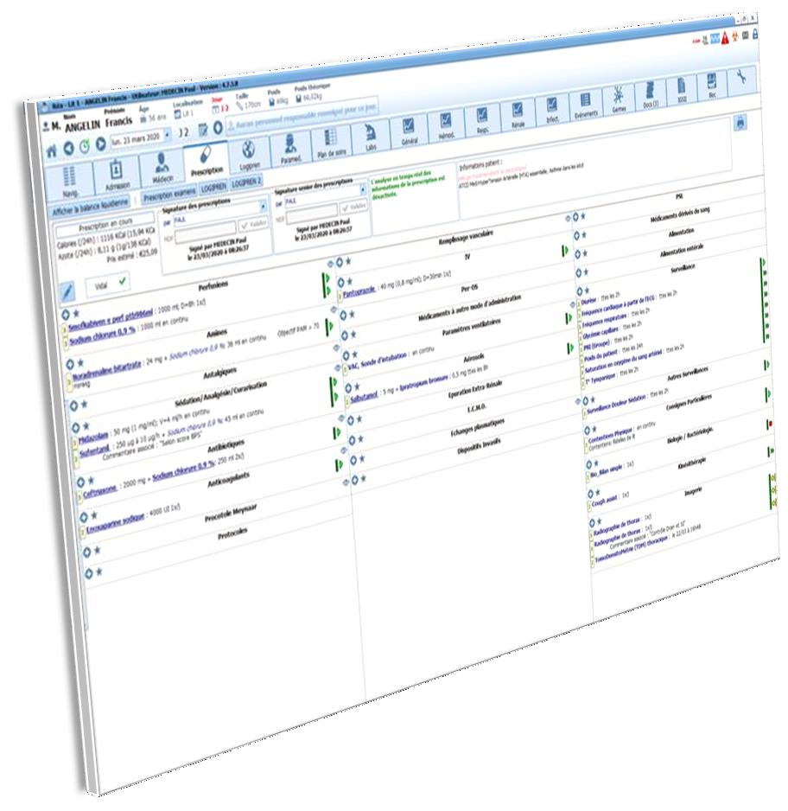
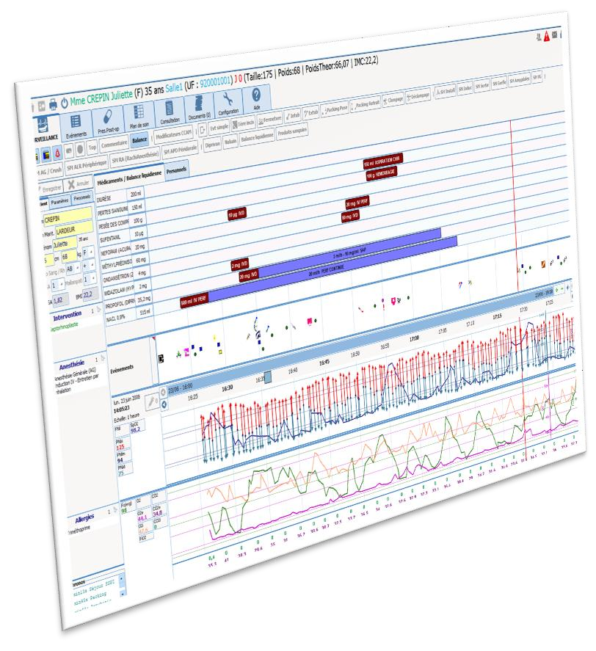
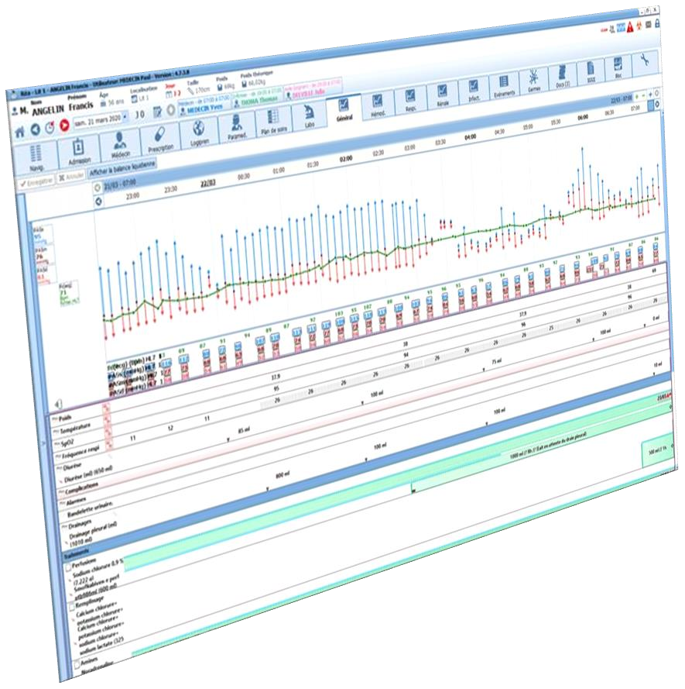






Assessment
A unique data base for ICU & Anaesthesia

Slide 15
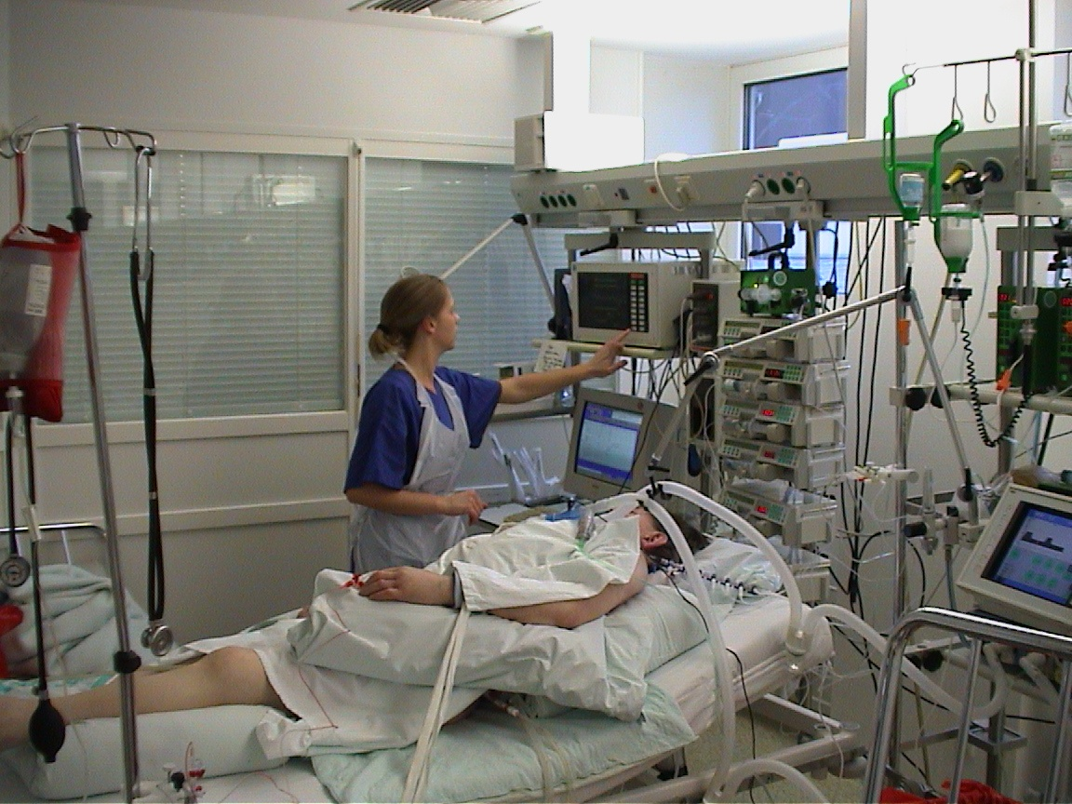
Vital Signs

Slide 16
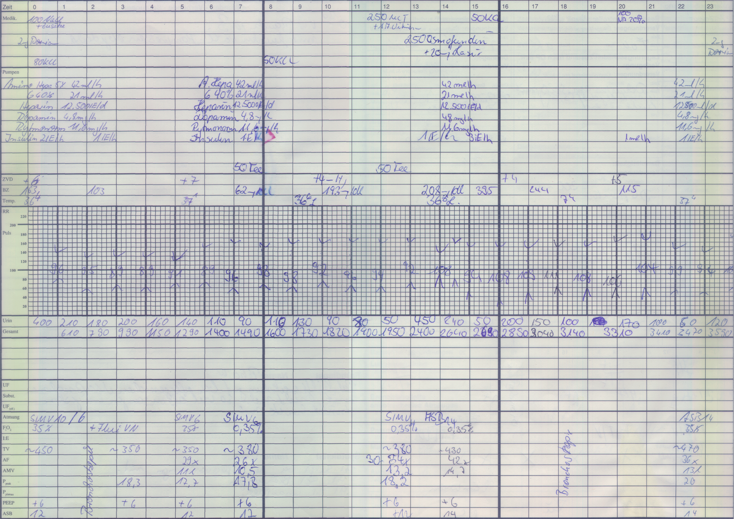
Manual Flowsheet
Bolus Medications
Drips / IV devices
Vital Signs
Fluid Outputs
Ventilation

Slide 17
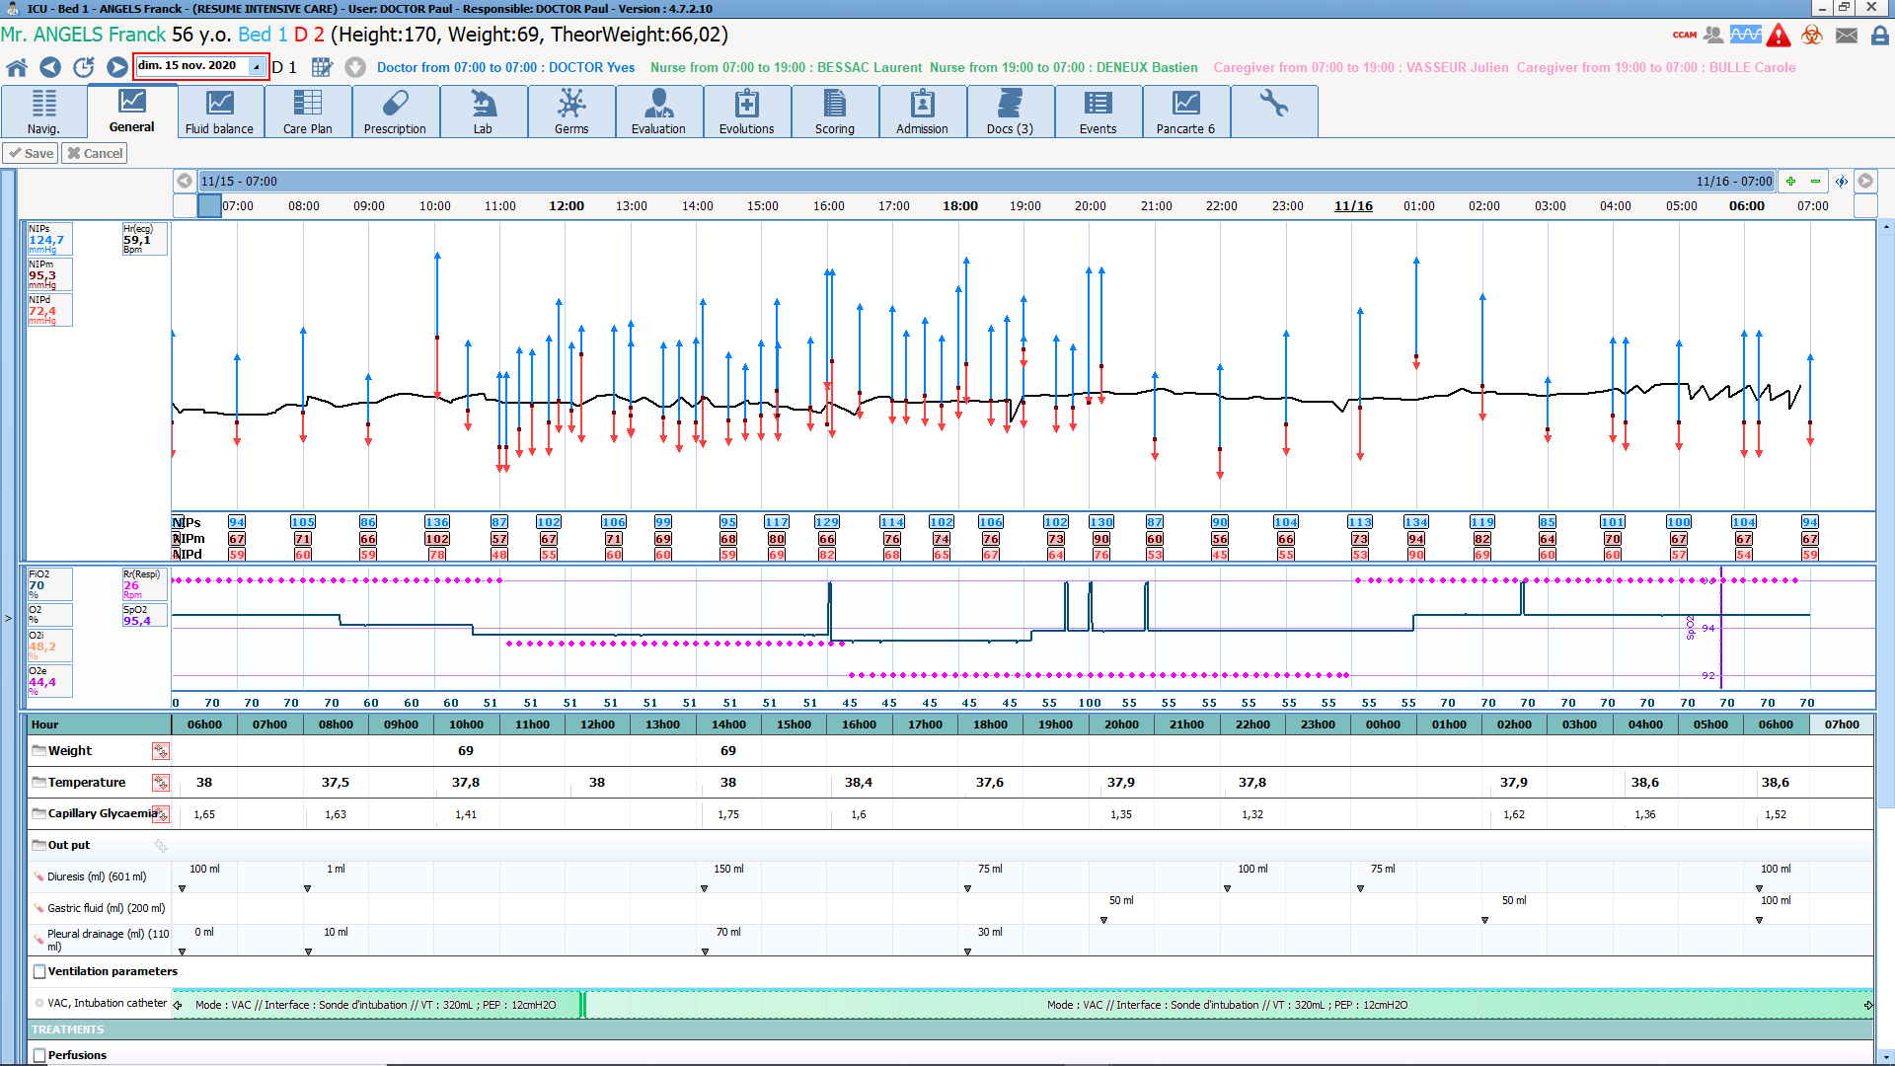
Diane vital signs views
Notes:
Show how effective the views are for cross-referencing and studying patient changes.
All these views are provided by default and they can adapt them as they wish to their specialties, protocols, etc.

Slide 18
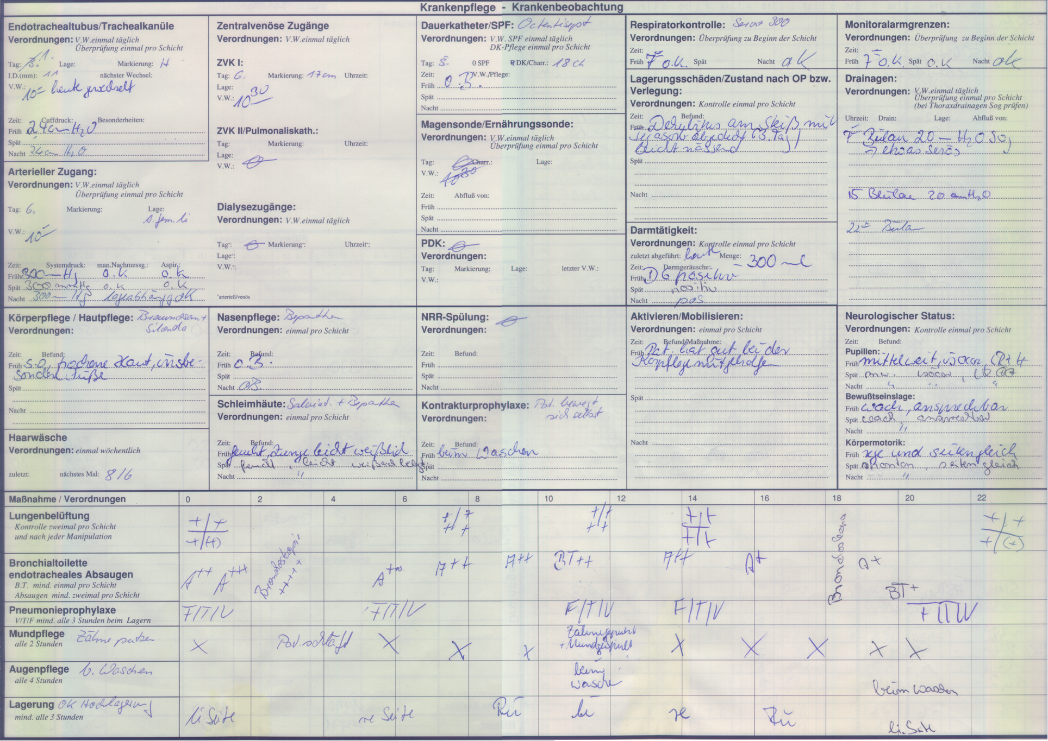
Manual Nursing Chart
Patient Observation
A-lines, V-lines, Tubes
Basic Care
Nursing Procedures

Slide 19
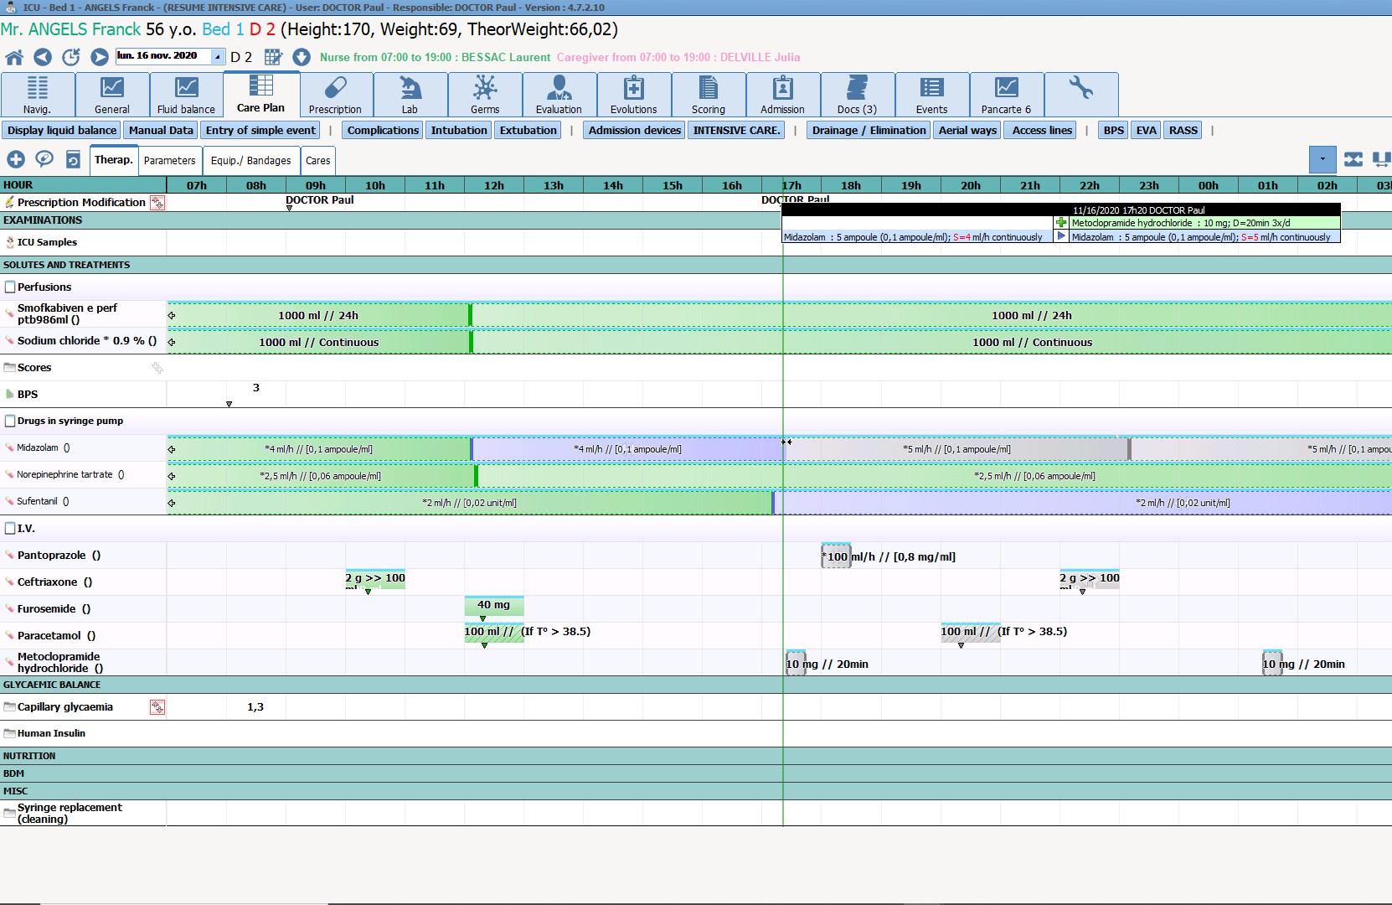
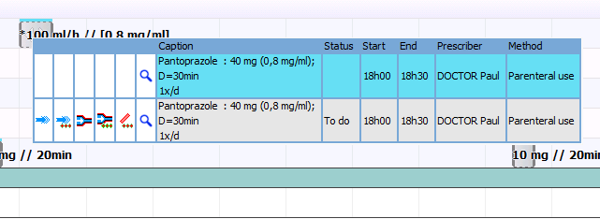
Diane nursing chart
Notes:
Talk about the clear and comprehensive care plan display.
The main message to get across here is that we have a simple view of the care plan to quickly understand what needs to be done.
It is designed to be easily used, to document the real situation, and therefore have a reliable record that can be studied in detail.

Slide 20
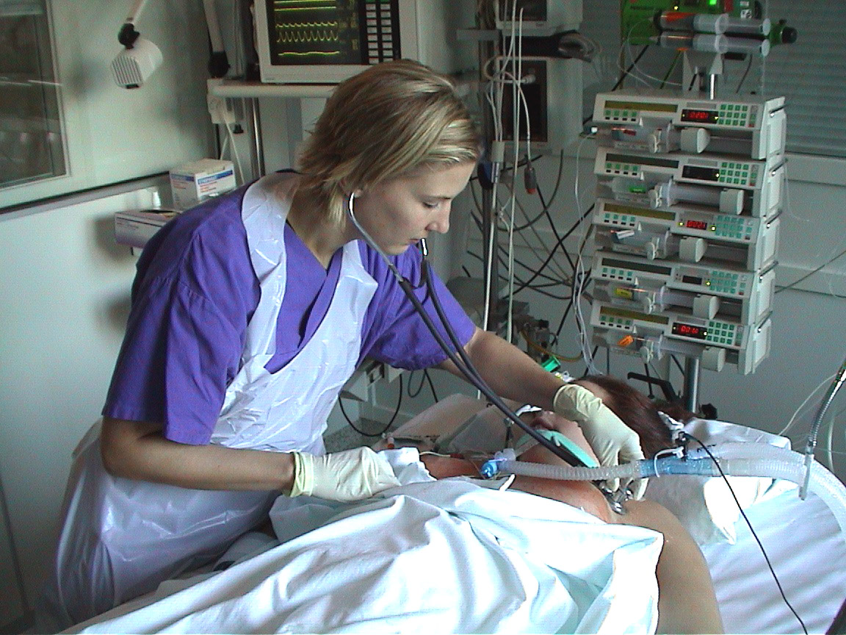
Nurse Action/Procedure

Slide 21
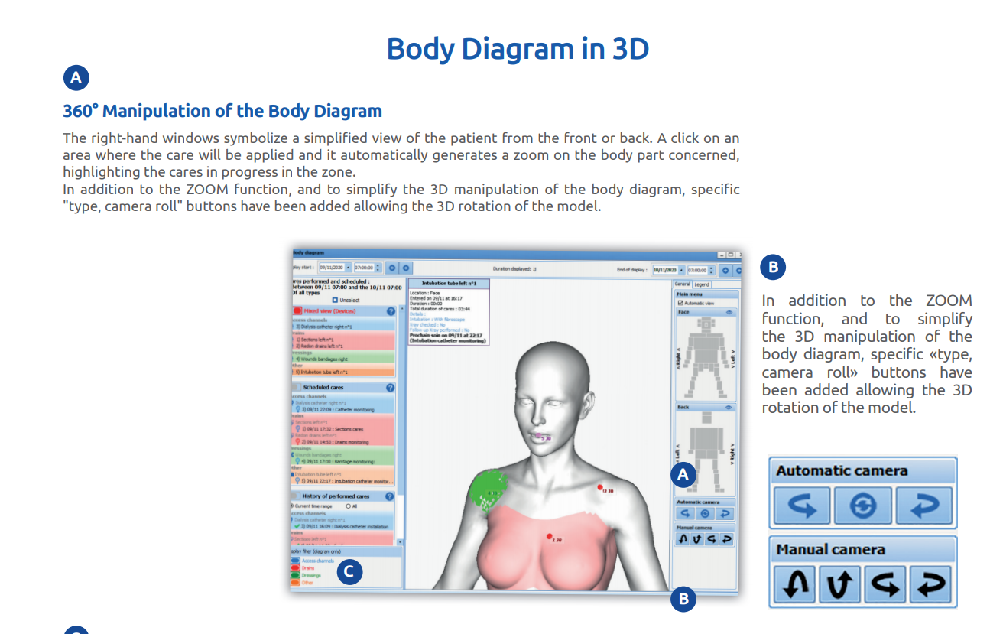
Nurse Action/Procedure
Notes:
The important features to highlight here are:
An overview of the devices and dressings allocated to patients
Changes over time, with the cursor to move from one day to another
Quick access to the details of each item (duration, photos, comments, etc.)
Related care protocols to automate the nursing schedule
Quick and detailed view of interventions needed
Pace of care flexible according to needs and changes
Information sharing to view and enter care both from the diagram and the care plan.

Slide 22
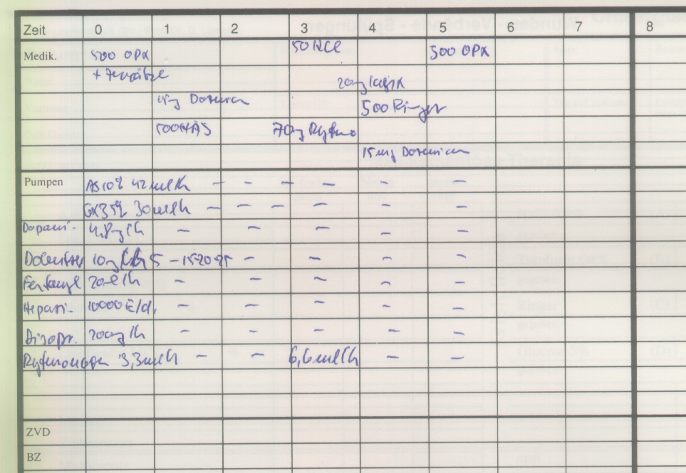
Manual Documentation
500 ml Tutofusin OPX

Slide 23
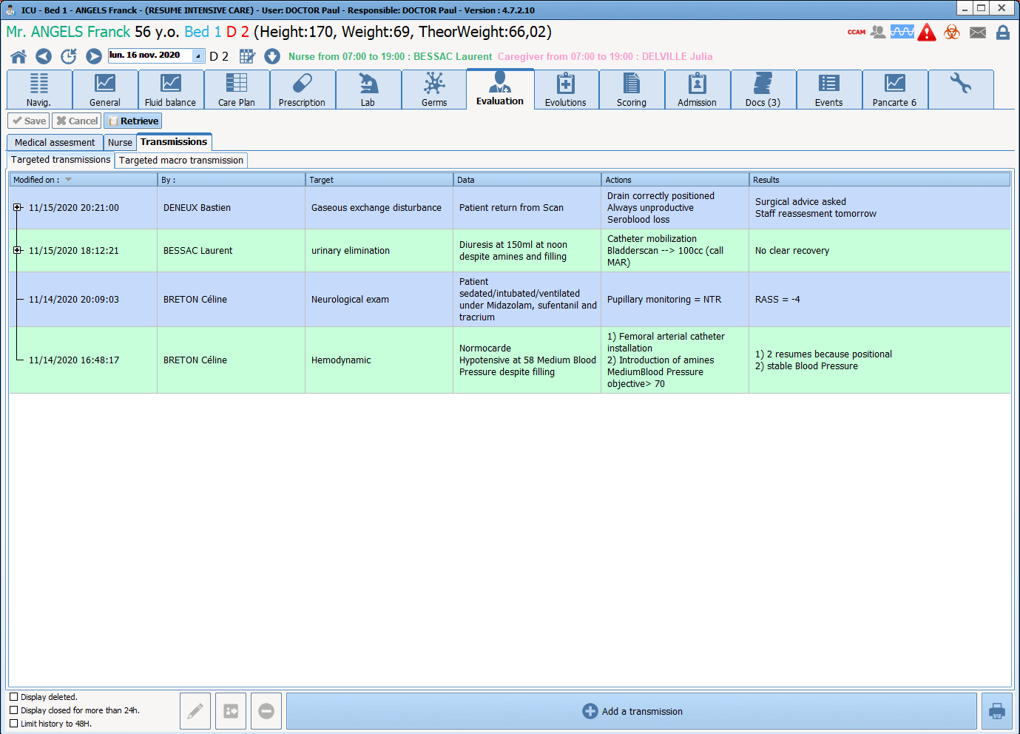
Manual Documentation

Slide 24
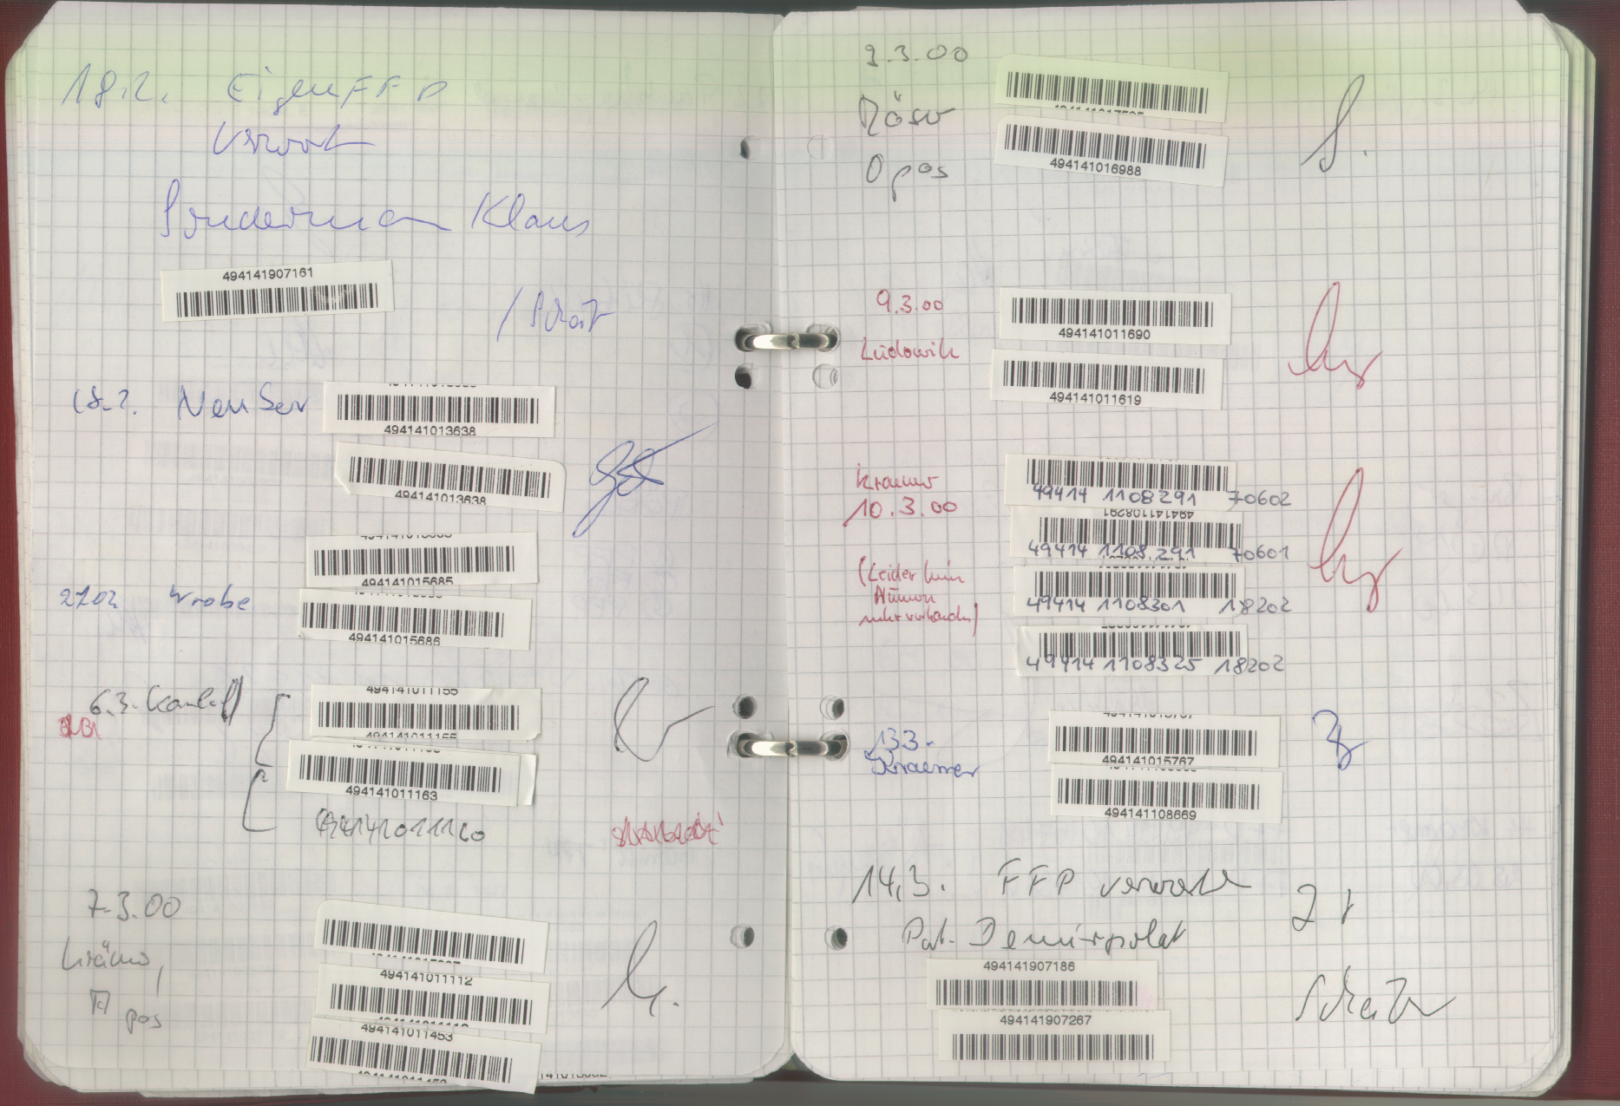
Blood Products – Manual
Documentation in BP book

Slide 25
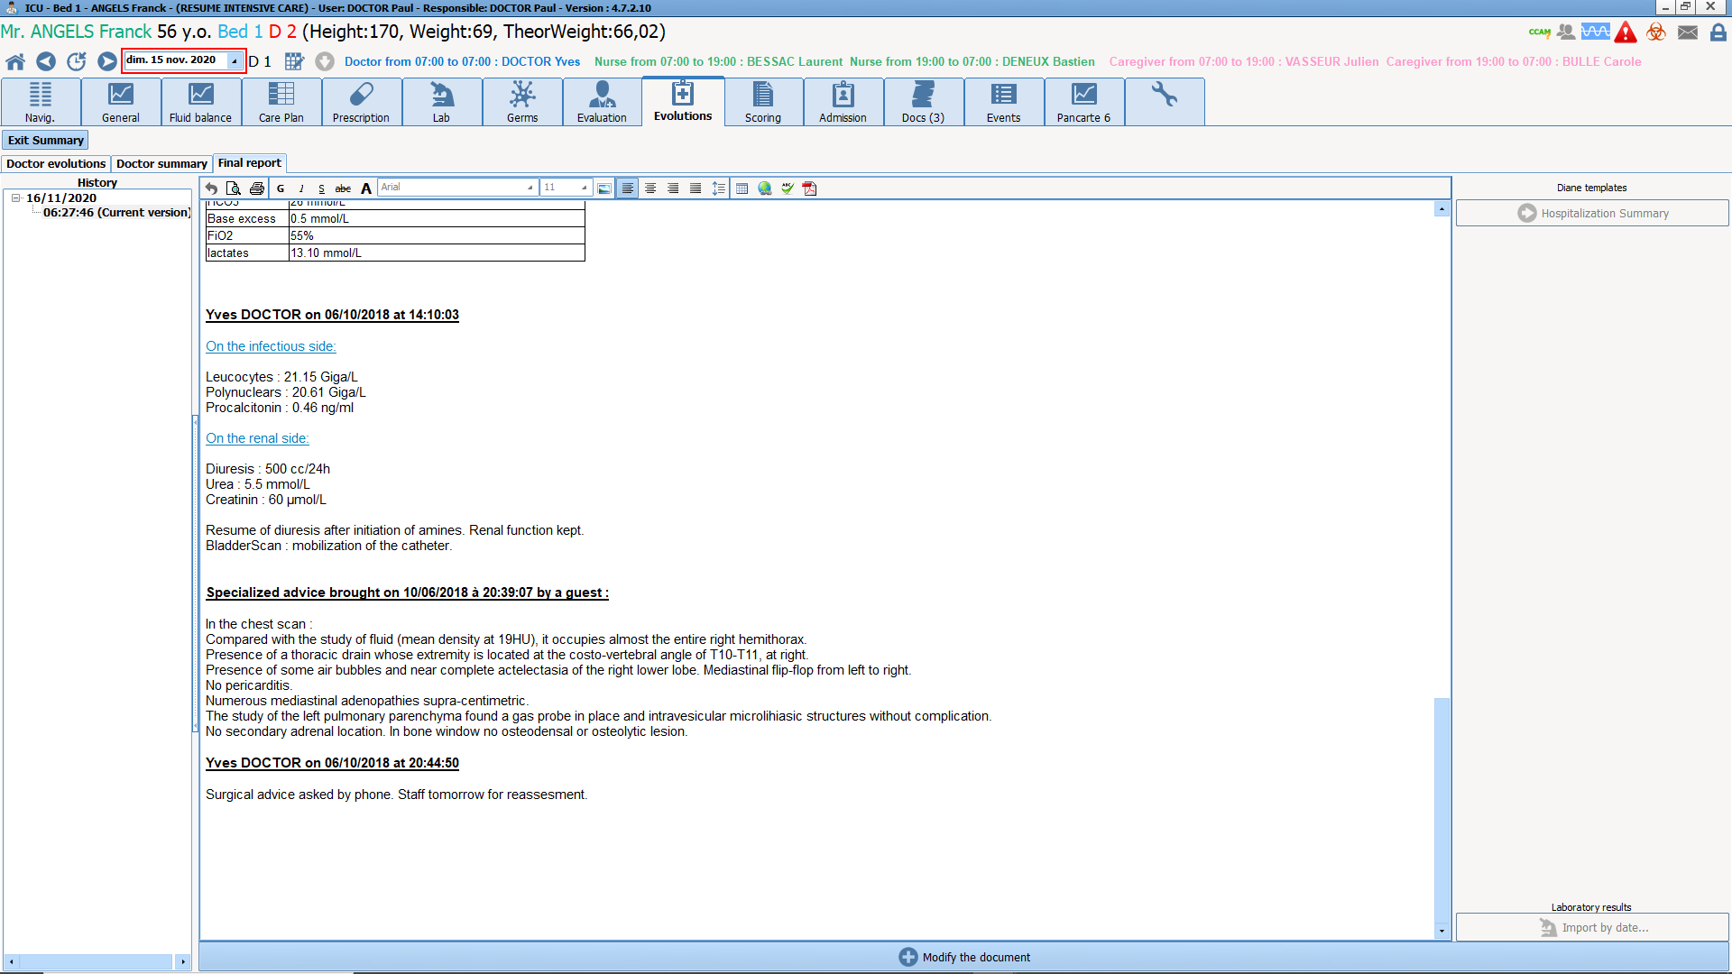
Report
Notes:
DIANE lets you generate almost all the data in the record, then export it to the EHR or print the documents.

Slide 26













➢
➢
➢

Slide 27














Making easier for the anaesthesia assessment
Collect biomedical data automatically
Collect biomedical data automatically
Improve coding medical acts
Making documentation easier
for the anesthesia phases
Generating the documentation of he Peroperatory phase
Generating the documentation
of the recovering phase

Slide 28

Allows patient follow-up in critical care services
Brings all relevant information to the healthcare team
Includes advanced tools for intensive care.

Slide 29

Statistical analysis of activity,
infections, mortality...
Ergonomic computerized sheet for a clear and complete view of the patient data
Quick access to all areas of the service
A structured and shared patient recording file with all teams
Ease of use and efficiency in intensive care service
An ergonomic and secure medication order module with protocols and safeguards
Access to the patient recording file by
contextual call
A secure Data traceability with automatic reporting
Biology and media devices automatic integration o
CCAM and CIM10 quotation acts
A working environment that complies with the hospital's certification

Slide 30
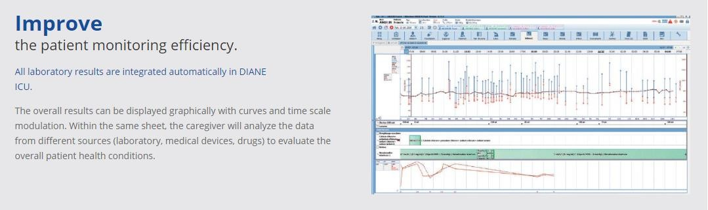

Slide 31
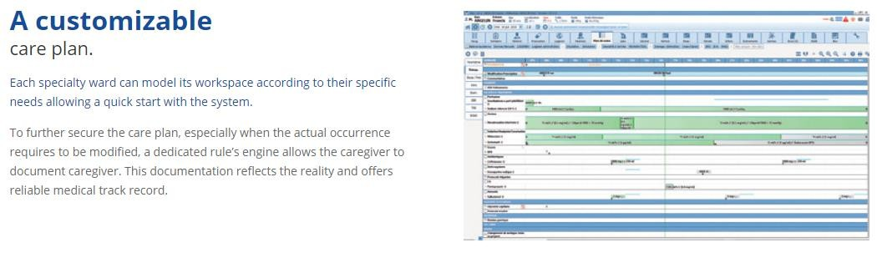

Slide 32
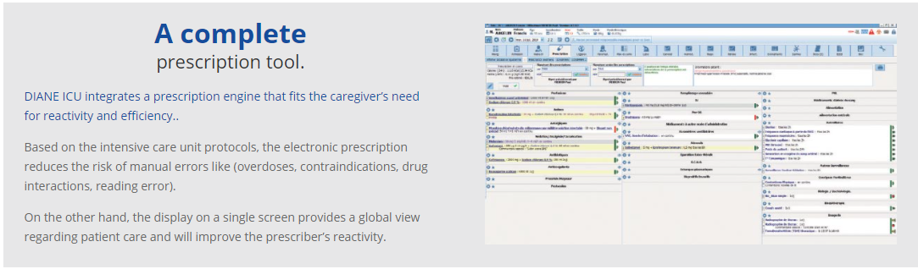

Slide 33




STABILITY :More than 650 beds already equipped in intensive care
FLEXIBILITY :Pilot the critical care process.
ERGONOMICS :Designed to replace 80% of data entry with only one simple process.

Slide 34




RULES’ ENGINE
Architecture around a protocols’ library and a rules’ engine.
INTEROPERABLE
Connected to more than 410 medical devices.
MEDICAL DEVICE CE CERTIFIED
DIANE ICU prescription engine is certified as medical device, manufacturer in the sense of the Directive 93/42/EEC.

Slide 35



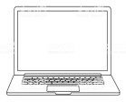



























Slide 36



















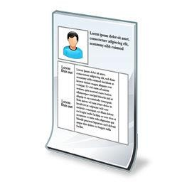


















➢
➢
.dat
Diane server
Diane server

Slide 37

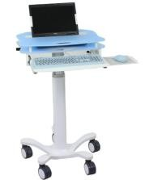























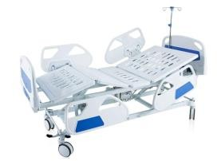



Slide 38






































Device connection (410 drivers)

Slide 39





























Slide 40










Features | Communications Standard

Slide 41


Connection type | Benefits | Risks
RS-232 | Out of network, cheap, easy | Wires, spaghetti syndrome, length, specific.
RS-232 via serial port server | scalable, no need to be next to the device | Expensive, installation and configuration, no network - no data
Ethernet via gateway | Economic if homogeneous, compatible Citrix/TSE. | Uneasy to change, gateway cost. no network - no data,
Ethernet (direct connection) | Cheap, easy to set, independent of network. | Second board, adapted device (rare).

Slide 42
Places to equip
  Pre-anesthetic consultation: method of consultation, places, pre-anesthetic visit, preliminary questionnaire
  In anesthesia: induction rooms, operating room, recovery room
  In intensive care: intensive care, intensive care, continuous monitoring beds
  Additional places: treatment stations, corridors, doctors' office, staff room, etc.

Slide 43
Benefits
Comprehensive data
Data transfer/exchange
Data in electronic format
Information integration from different sources
Data security and confidentiality
Decision Support (availability of data, electronic rules engines)
Electronic Prescription
Better documentation (proven)
Better quality of care (proven)
Reduction of errors (possible)
Cost effectiveness of documentation
(unproven and unlikely)
Cost effectiveness through better process control
(unproven but very likely)
Data Analysis

Slide 44
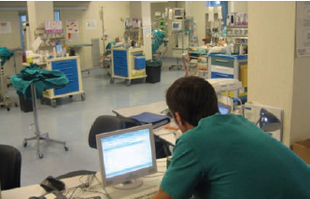
Summary
Many Intensive care organizations have to come up with quality measures that are used to quantify how good is an ICU in term of value
Set-up metric regarding patient safety and quality of care
Gathering information from all bedside devices,
Saving nursing time from writing down data, respect strict data coding standard
Reducing number of adverse drug events
Calculate patient medical scores and reducing number of duplicate tests.
Automatic calculation with Clinical Information systems

