Slide 1

Obstetrics

Slide 2
CONTENTS
    Obstetrics
      Opening the record and consultations
      Pregnancy monitoring
      Monitoring patients at home
      Delivery room
      Postpartum
  Family planning
      Family planning monitoring
          Gynaecology
      Gynaecology monitoring
      Gynaecology admissions
Notes:
Presentation of the DIANE Anaesthesia software: the process runs from the start of the operating theatre until the record is closed. We will see the general view of the patient’s record but also the different types of data entry.

Slide 3
Opening the record and consultations

Slide 4
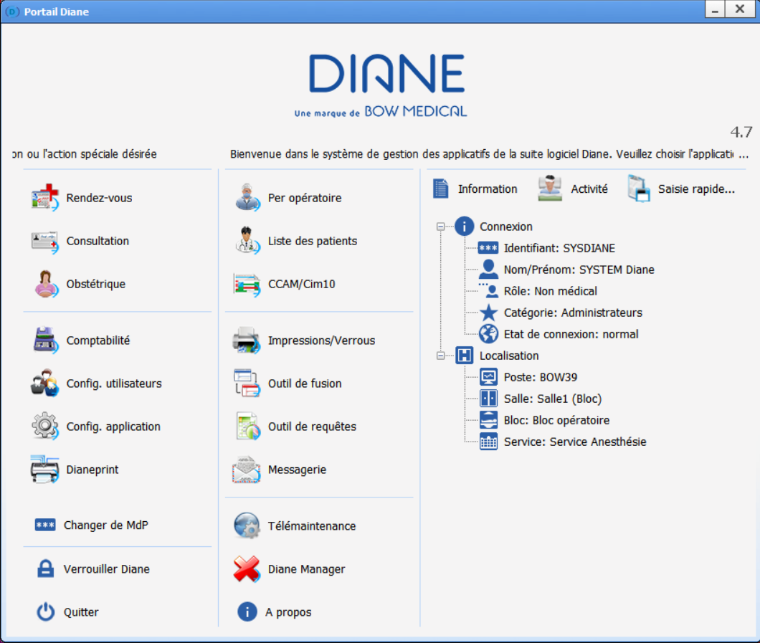
SC
STARTUP
obstetrics
Notes:
When starting up the software, you arrive on the home page.
We can see WHO is logged on and WHERE the computer is on the tree structure.
Click on Obstetrics to open the obstetrics module.

Slide 5
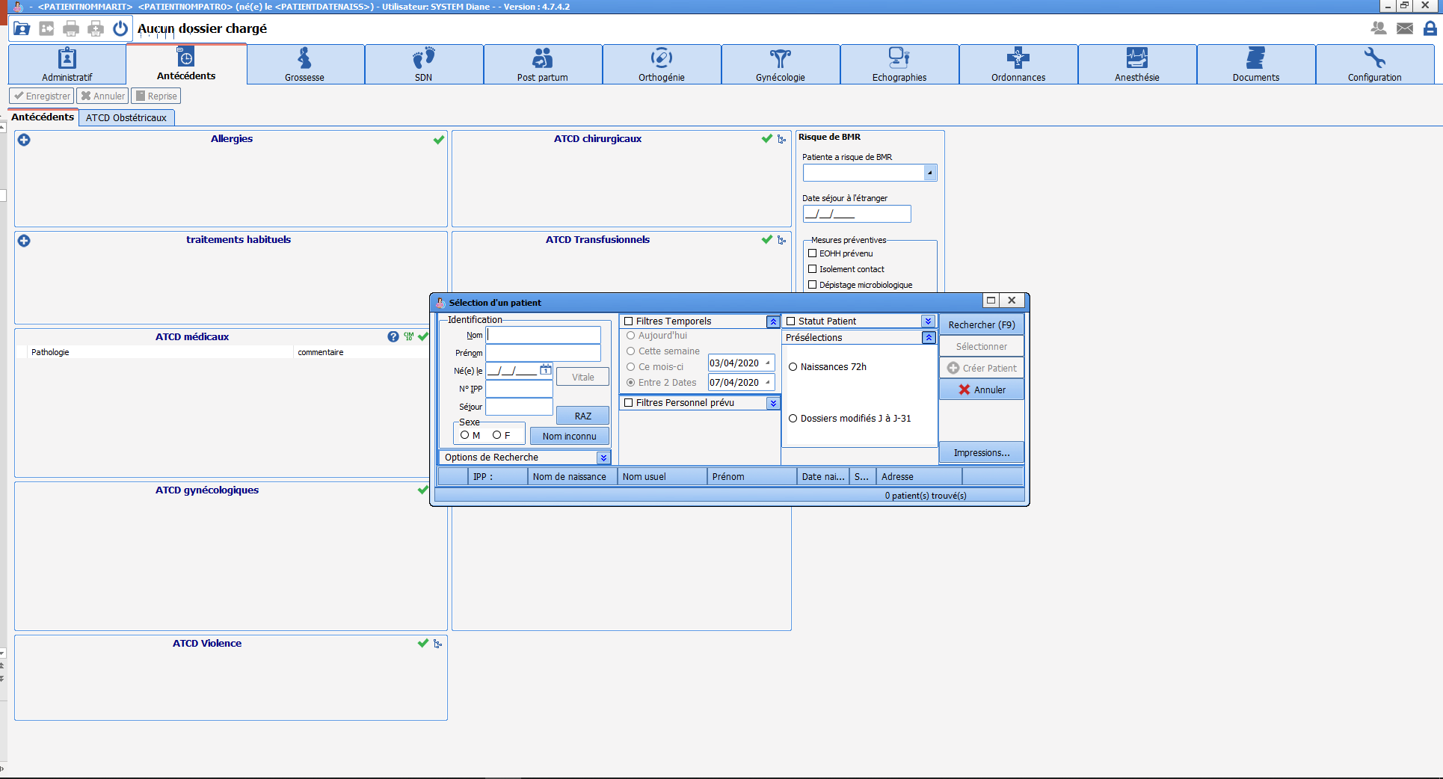
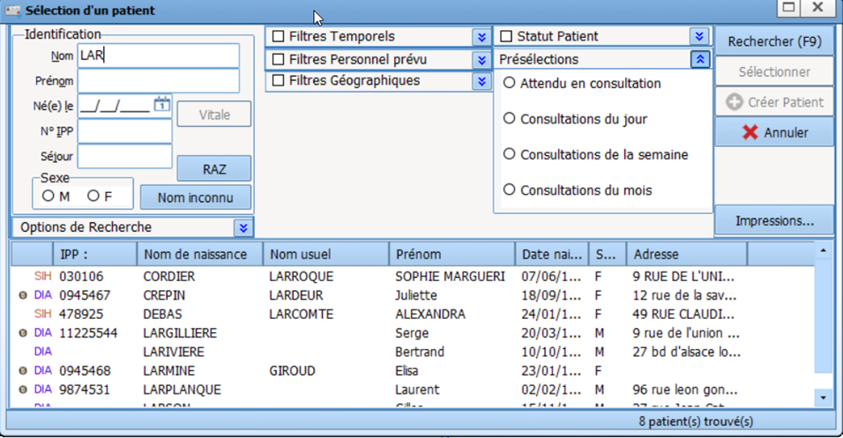
PATIENT SELECTION
SC
SEARCH using:
- Date of birth
or
- The UPI
or
- The first letters of the last name
Notes:
You are then prompted to select the patient.
This generates the corresponding list.
After selecting the patient, you will choose the relevant record.

Slide 6
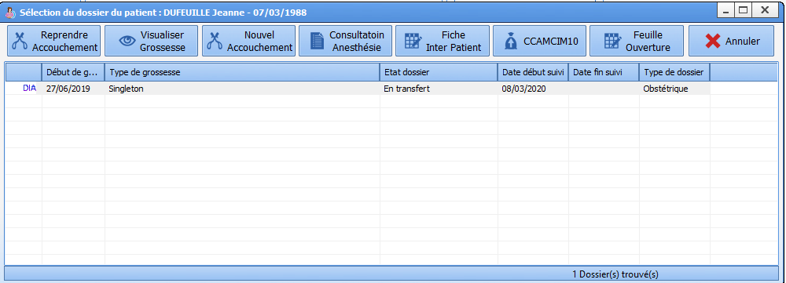
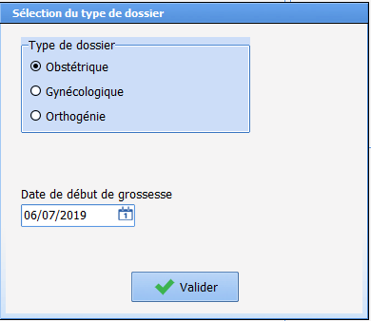
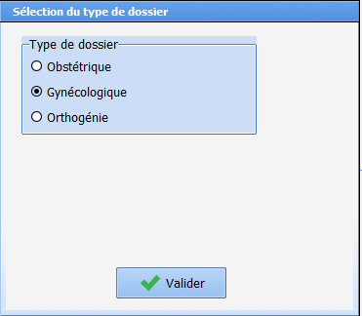
RECORD SELECTION
SC
Opening the record
Choice of record type when creating it
Notes:
When selecting the record, there are several possibilities:
- Resume delivery: lets you resume monitoring in progress
- View pregnancy: lets you open the record in visual mode
New delivery: lets you open a new record (there are checks: for example, only a gynaecology record can be created if an obstetrics record has monitoring in progress)
When creating an obstetrics or family planning record, it is mandatory to enter the date of conception. This data entry is not proposed if you open a gynaecology record.
Selecting the type of record will change the tabs proposed in the application.

Slide 7
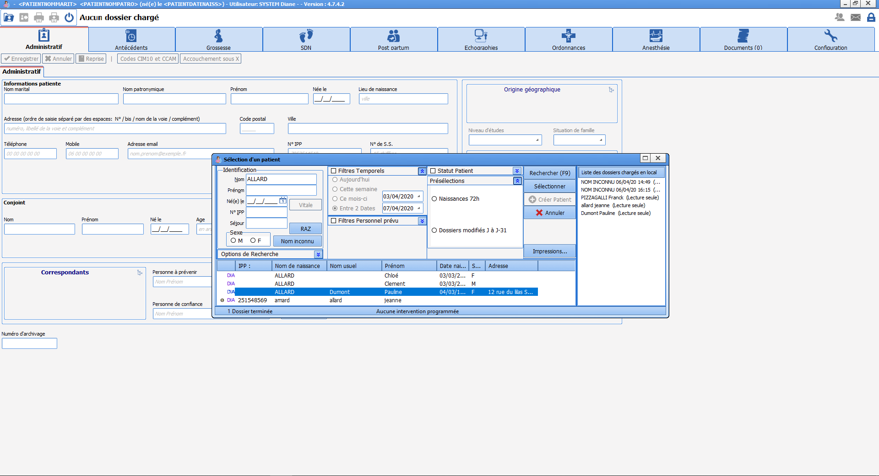
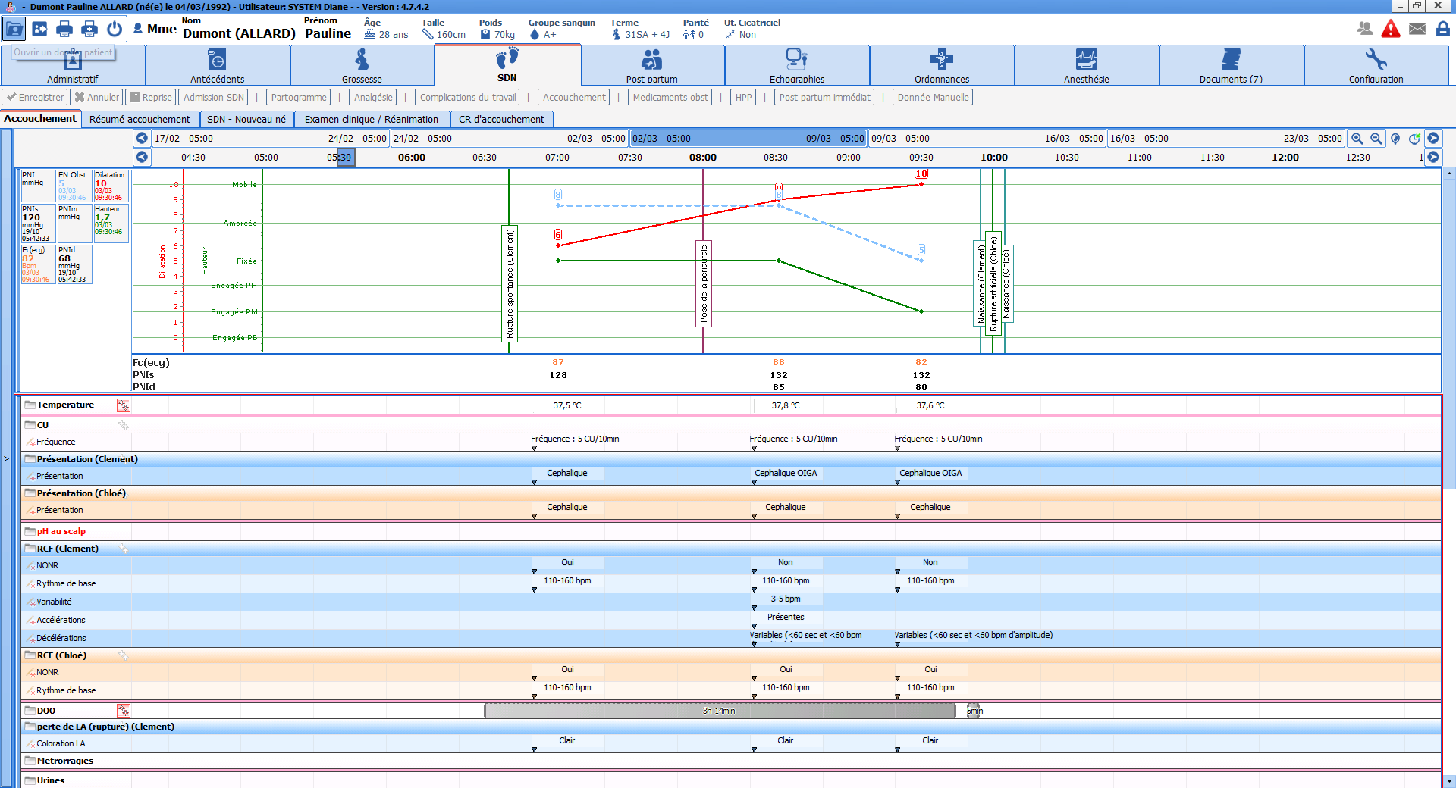
RECORD SELECTION
SC
Notes:
To view a previous record, just select it and you will have access to ALL the information in the record for the pregnancy selected.

Slide 8
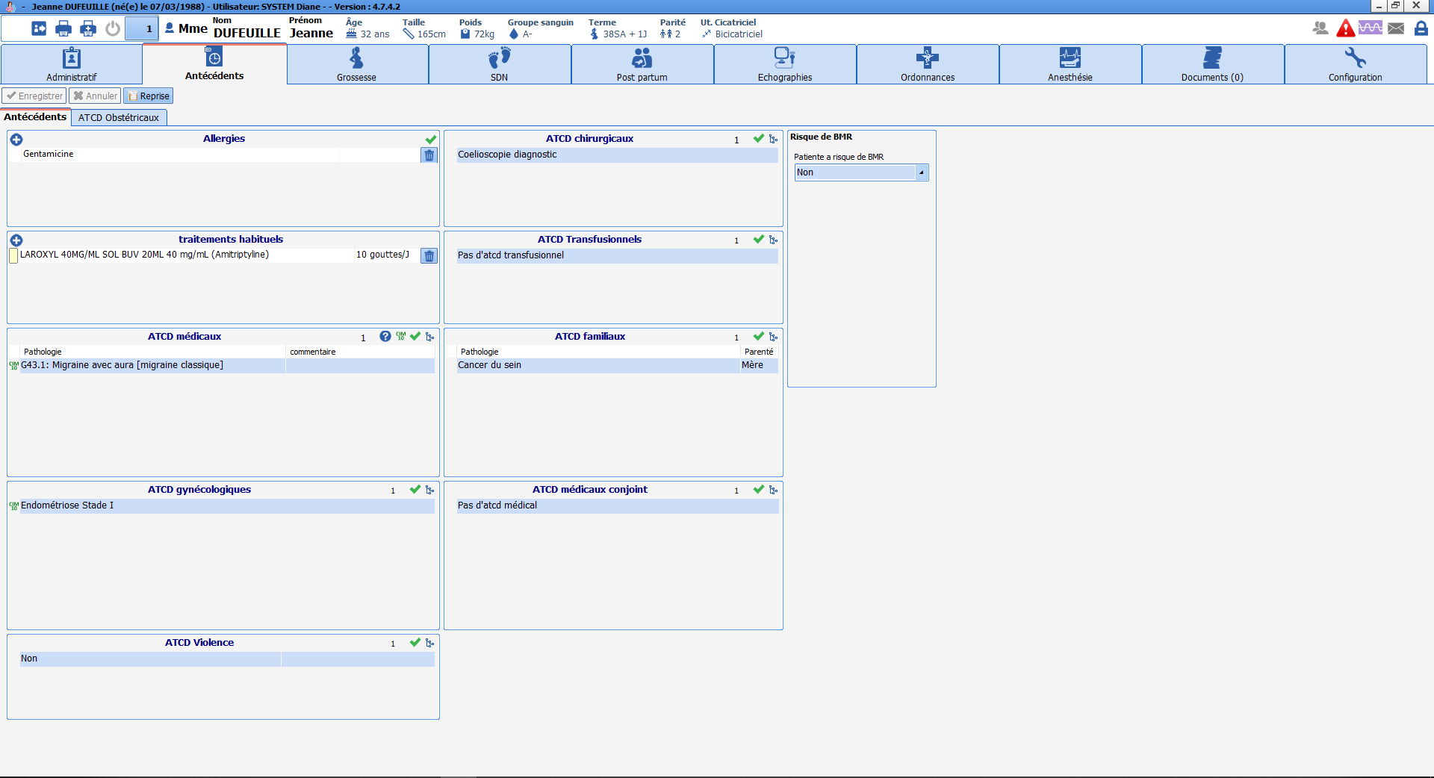
General appearance
SC
Information pane
Tabs
Input box
Notes:
With the exception of the labour curve, the record consists of
a top ribbon to view important record data or certain alerts
the list of different tabs that lets you enter information depending on the stage of pregnancy
an input box where you can fill in the record data

Slide 9
Top ribbon
SC
Civil status of the patient
Alerts
Automated clinical data
→ The top ribbon gives permanent access to clinical data
Notes:
The top ribbon gives permanent access, wherever you are in the record, to certain pieces of significant information allowing safe care at all times.
For example, we can always know the due date, the number of uterine scars, the blood group and allergies. This data is imported and calculated in real time from the information entered in the record.
Permanent access to this data ensures safe care adapted to each particular clinical context.

Slide 10
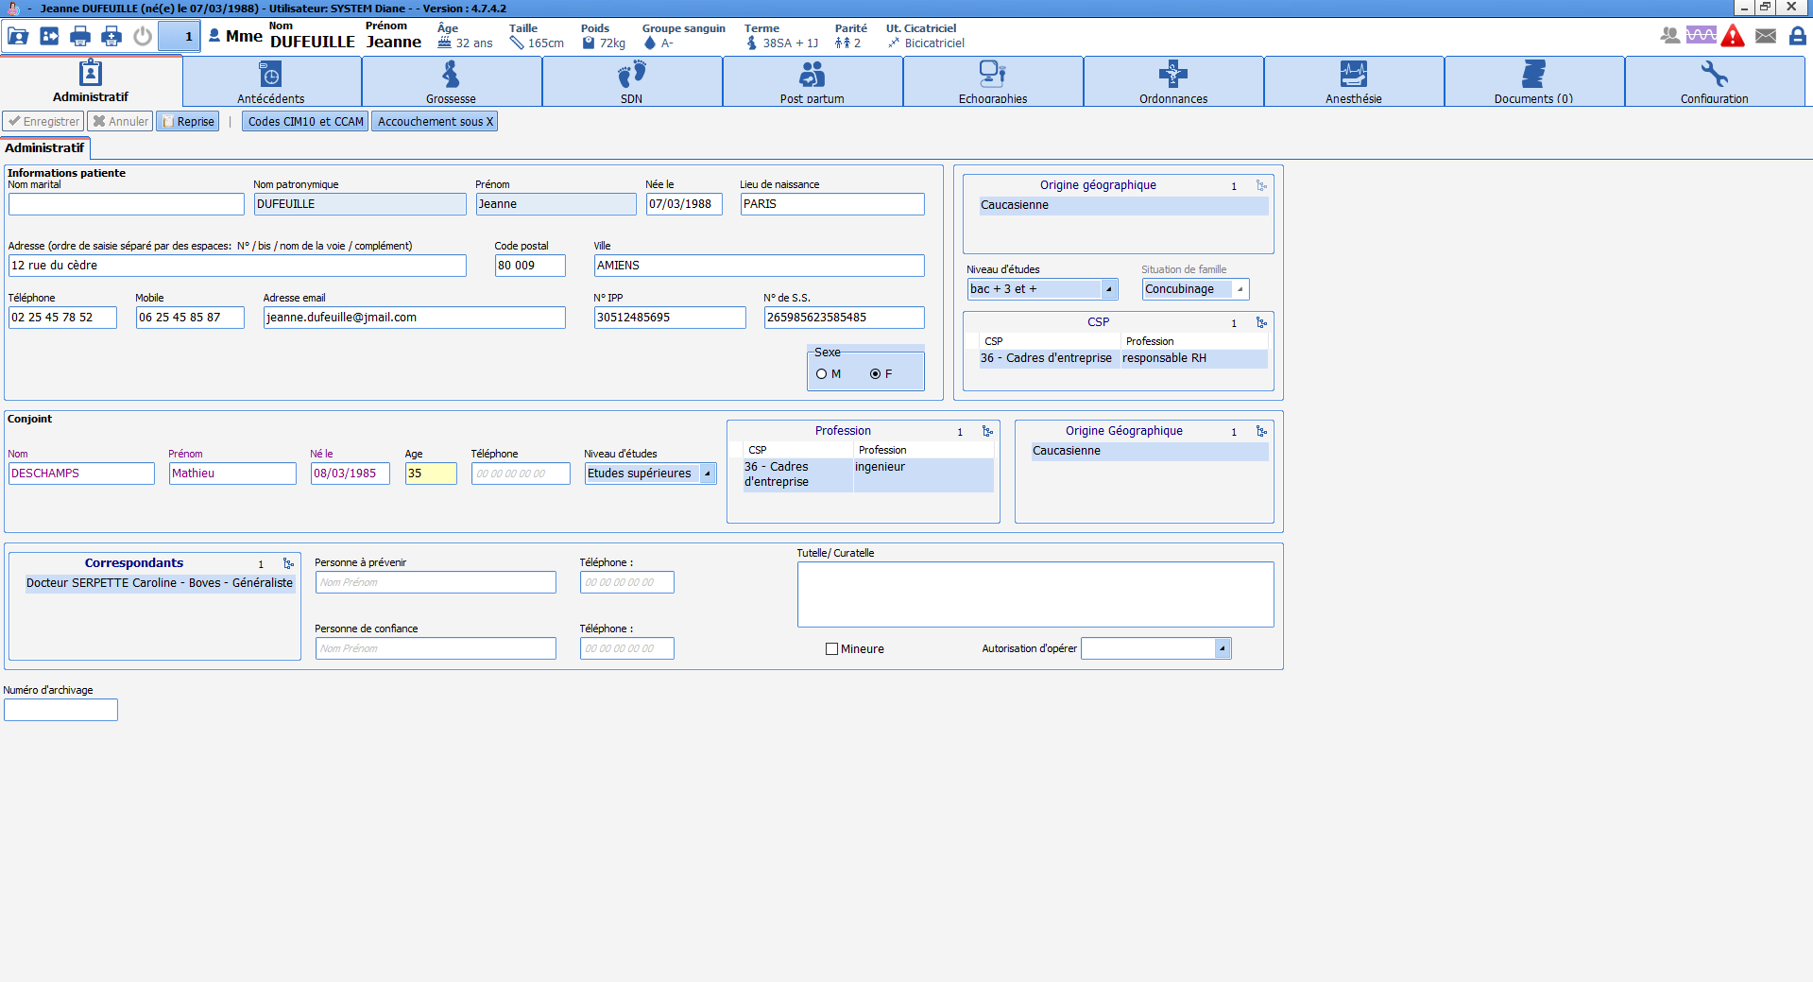
Administrative tab
SC
Information about the mother
Information about the father
Notes:
This tab lets you enter administrative data about the patient and her spouse.
Much of this information is usually pre-completed from the EHR.
Some data is automated: the age is calculated automatically from the date of birth and the ‘Minor’ box is automatically ticked if the age is <18 years.

Slide 11
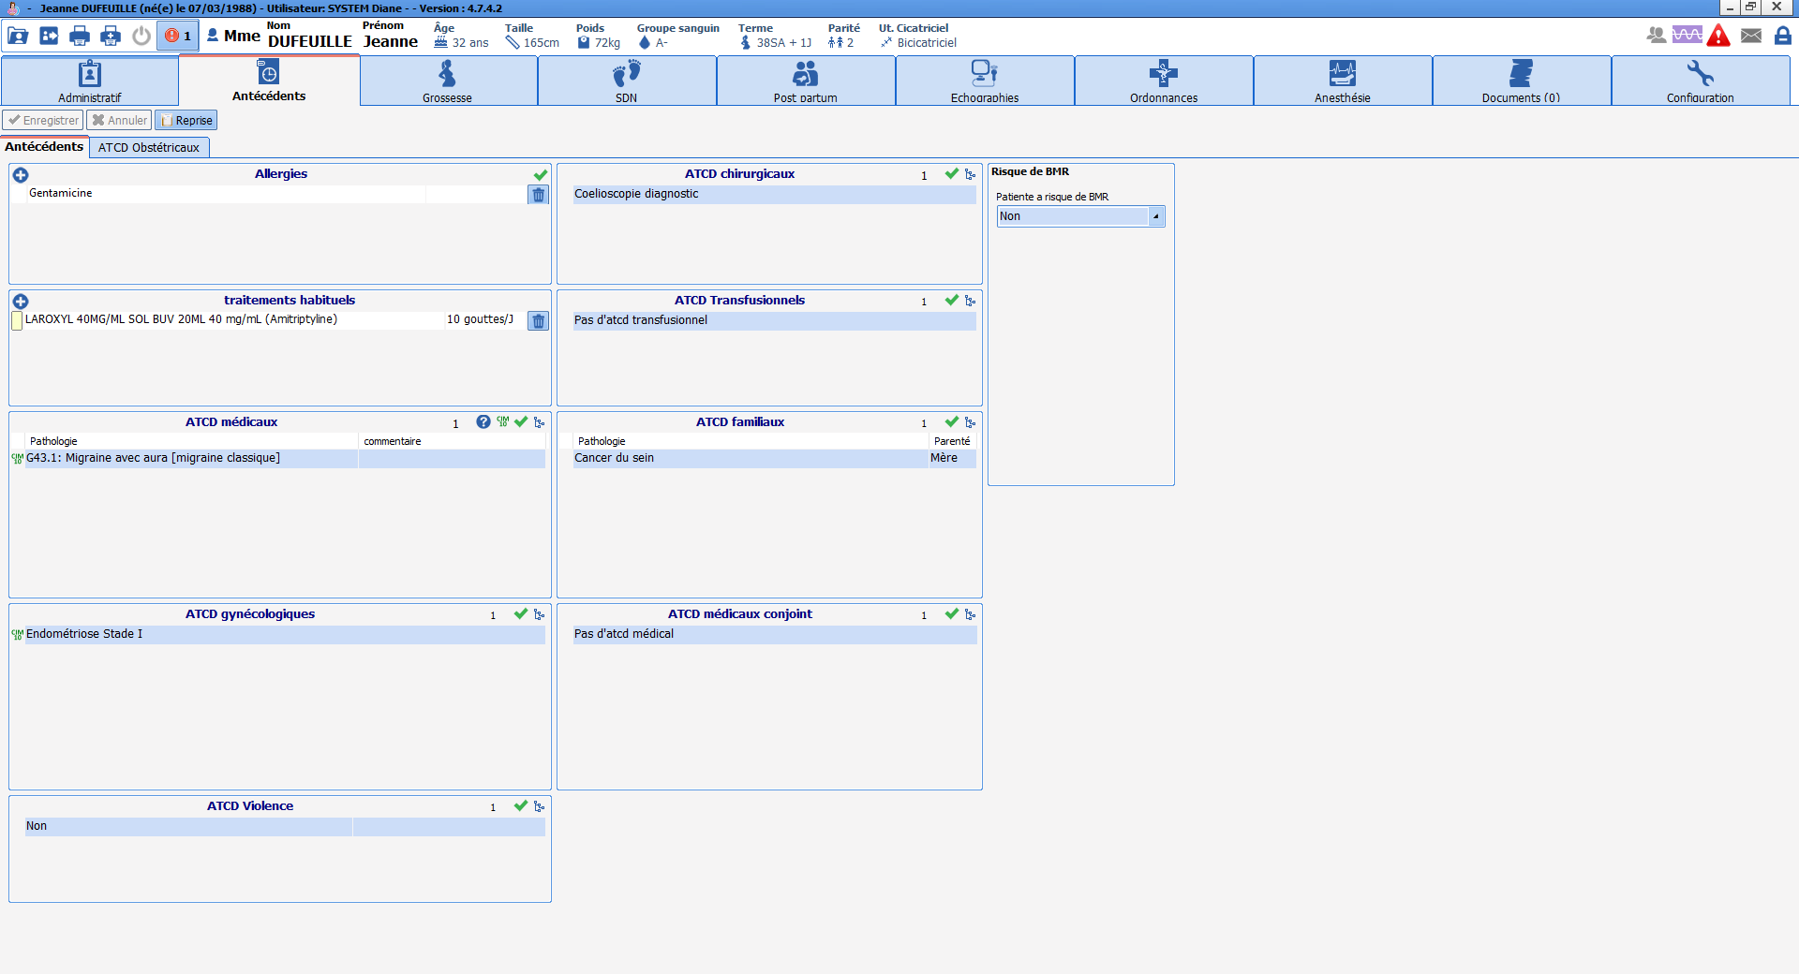
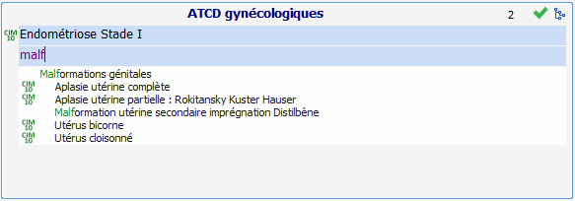
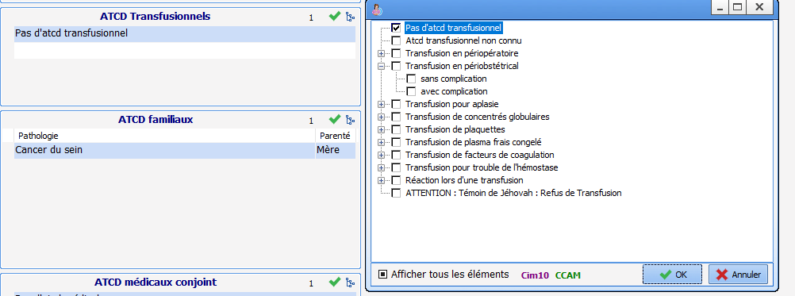
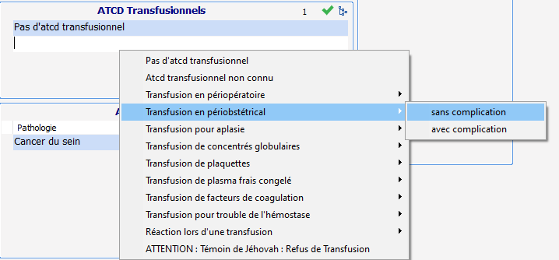
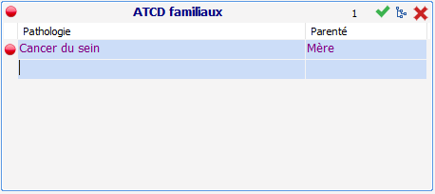
Intuitive search based on the first letters
SC
HISTORY tab (1) – Medical HISTORY sub-tab
Access to the list via the icon:
Access to the list with a right click
Important data in the record highlighted
Notes:
This tab lets you enter the patient’s medical and surgical history.
Pre-prepared lists make it easier to enter data and access: either by writing the first letters of the condition, which will trigger an automatic search, or by right-clicking on the input box, which gives access to a tree structure, or by clicking on the 'list' icon at the top right of each component, which gives direct access to the list of conditions. It is also possible to enter free text.
When you click in front of history data that you have just entered, a ball appears and changes colour when you click on it again. This function is used to highlight data in a record that is deemed particularly important.

Slide 12
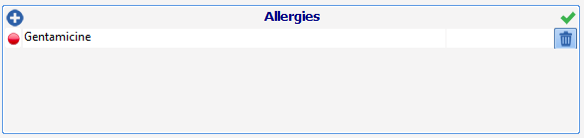
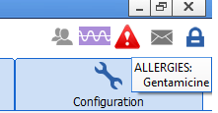
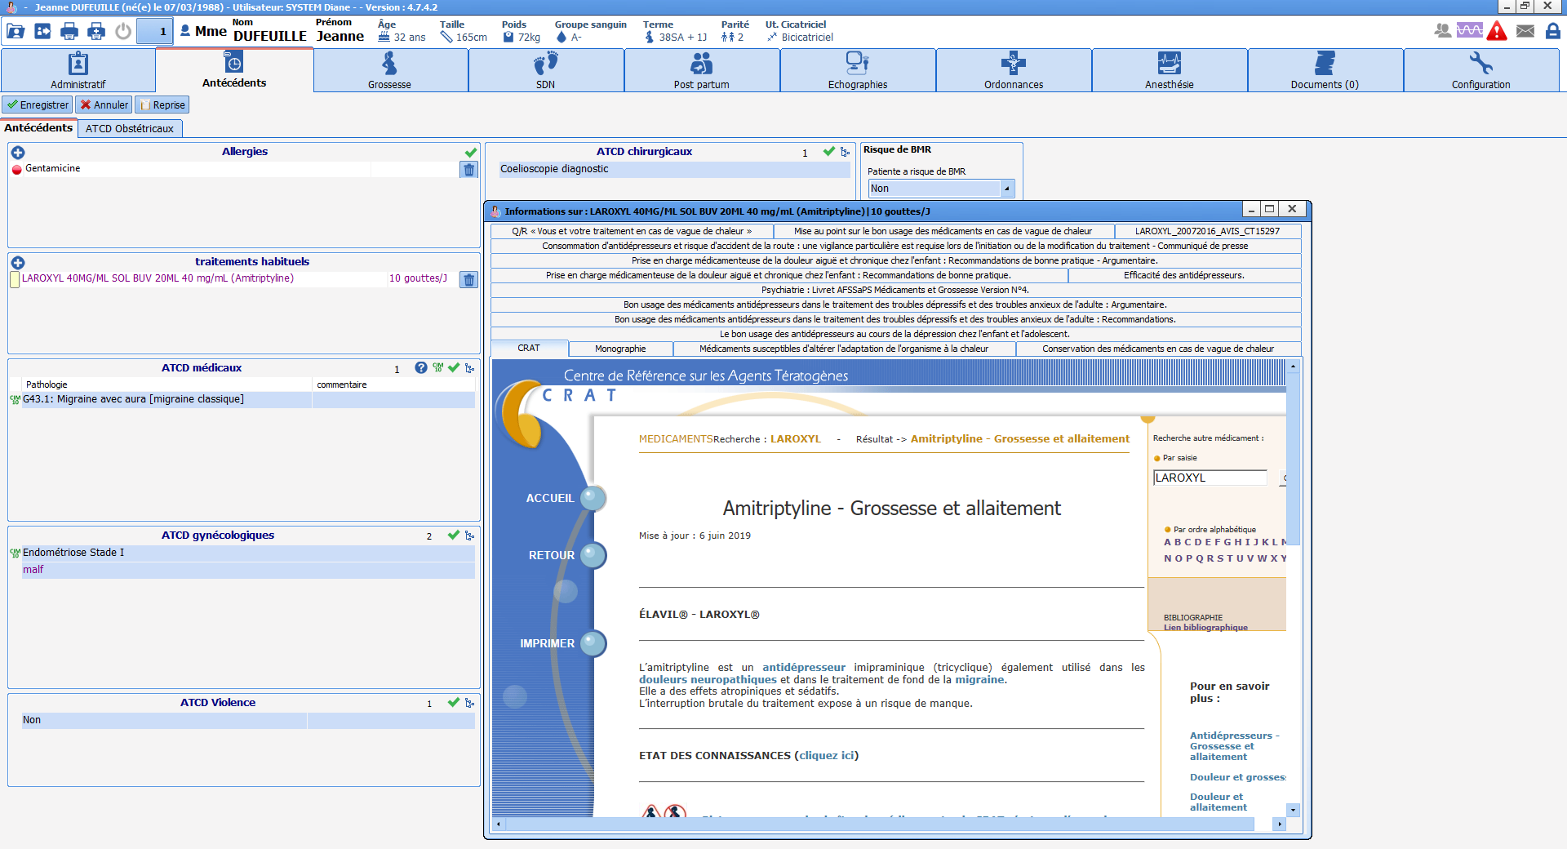
SC
HISTORY tab (2) – Medical HISTORY sub-tab
Allergy alert
Access to the list with a right click
Connection to the Reference Centre for Teratogens
Notes:
The allergy component lets you enter the patient's allergies and triggers a series of alerts and checks. For example, an alert will always be visible in the top ribbon and the type of allergy will be visible when the mouse hovers over it. Likewise, a warning will appear if an attempt is made to prescribe this treatment.
Regarding the ‘Usual treatment’ component, clicking on the yellow rectangle to the left of the treatment entered will trigger a connection to the drug bank monograph and the Reference Centre for Teratogens (CRAT).

Slide 13

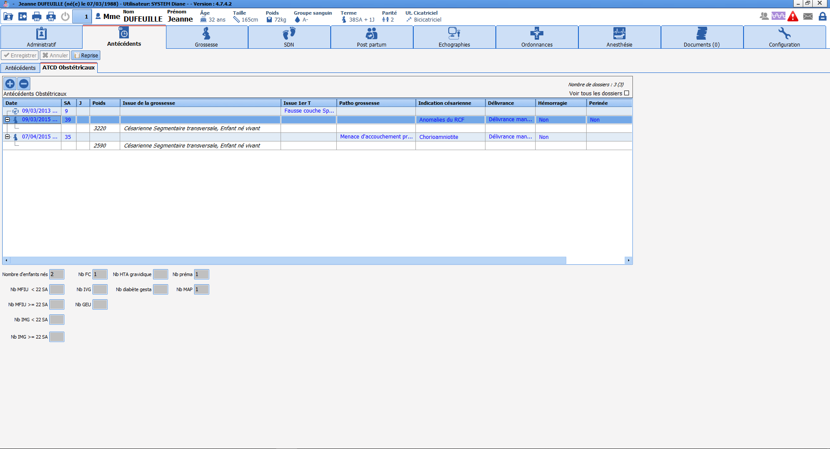
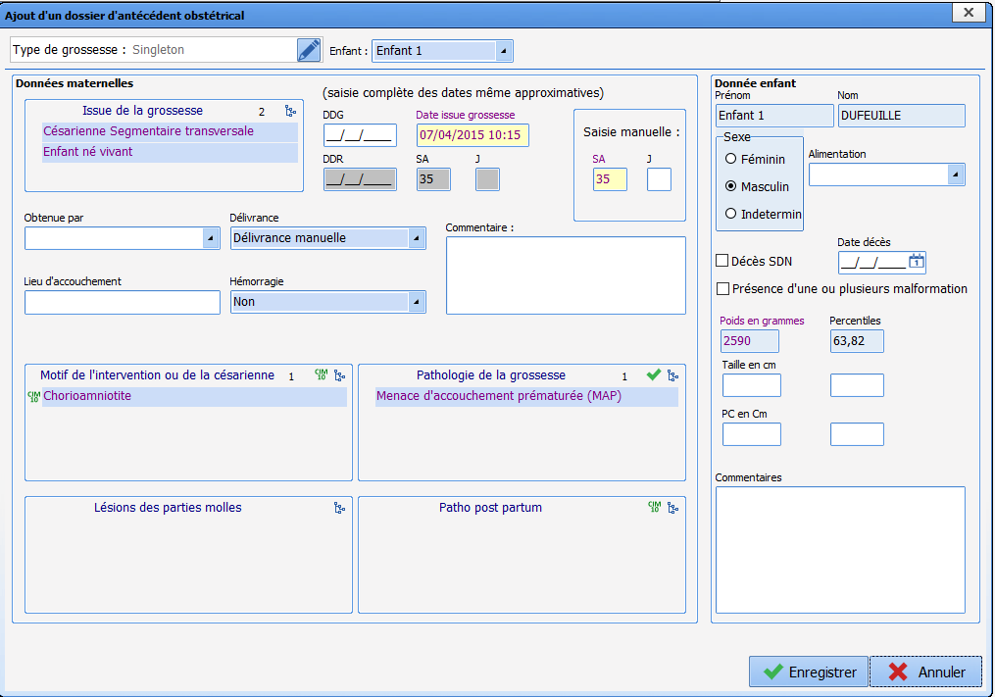
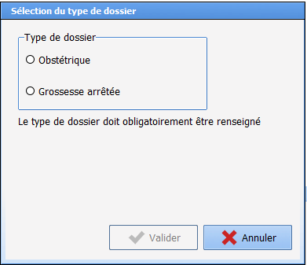
SC
HISTORY tab (3) – Obstetric HISTORY
History summary table
Automated calculation areas
Window to choose type of history
Window to enter history
Notes:
The ‘Obstetric History’ sub-tab consists of a summary table providing a quick overview of all items relating to previous pregnancies.
Under this table there is a set of calculated fields showing the number of specific history items (e.g. number of miscarriages, number of threats of premature birth etc.).
The + sign at the top left of the table is used to create a new history item. A window appears and lets you create either an obstetric history item (with pregnancy outcome >22 weeks) or a history that concerns a pregnancy ending before 22 weeks (miscarriage, late miscarriage, molar pregnancy, ectopic pregnancy or abortion).
The - sign is used to delete a selected history (pregnancies entered in DIANE are resumed automatically and cannot be deleted).
Once you have chosen the type of history you want to create, a window appears that lets you enter data from a previous pregnancy. All you have to do is fill in the window and click on ‘save’ for the data to be displayed in the summary table.
The information entered in this window will be used to calculate the parity and the number of uterine scars, which will be displayed in the top ribbon.

Slide 14
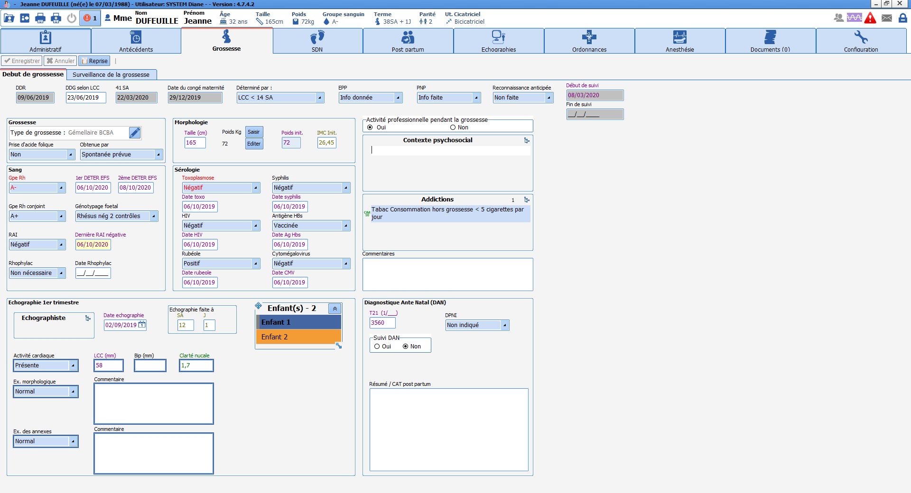
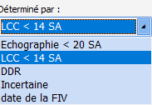
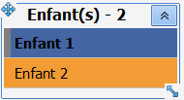
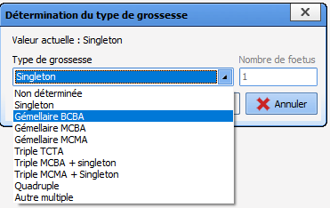
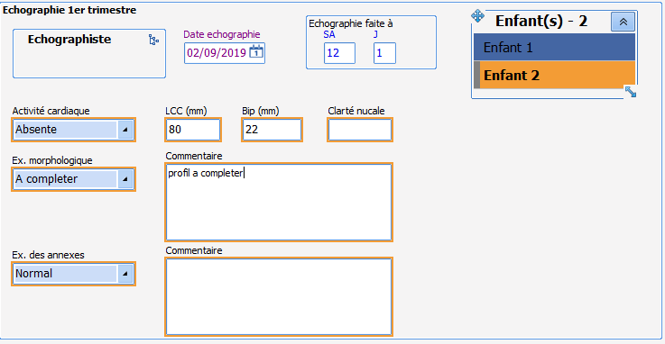
Pregnancy tab - ‘Start of pregnancy’ sub-tab
SC
Automated calculations:
LMP, due date, date of maternity leave
Notes:
This tab lets you enter certain information when you first meet the patient such as the type of pregnancy, morphology at the start of pregnancy, data related to blood group, serology tests or the first ultrasound.
Special components:
Type of pregnancy: lets you enter the number of foetuses and the chorionicity. In the event of a multiple pregnancy, the information concerning the foetus will have a dark blue outline. When you want to enter the data for the second foetus, all you have to do is click on ‘child 2’ in the relevant component. The data concerning the second foetus will have an orange outline.
This principle applies throughout the application.
Calculation of the due date: if the first ultrasound was done between 11 weeks and 13 weeks +6 days. So you must enter the date of the ultrasound and the CRL (crown rump length) in the ‘ultrasound’ box. We then choose the method to calculate the due date ‘according to CRL <14 weeks’ from the ‘Determined by’ drop-down menu. The due date will then be calculated automatically according to the CRL. For all the other calculation methods, simply enter the conception date manually and choose the calculation method in the ‘determined by’ drop-down menu.

Slide 15
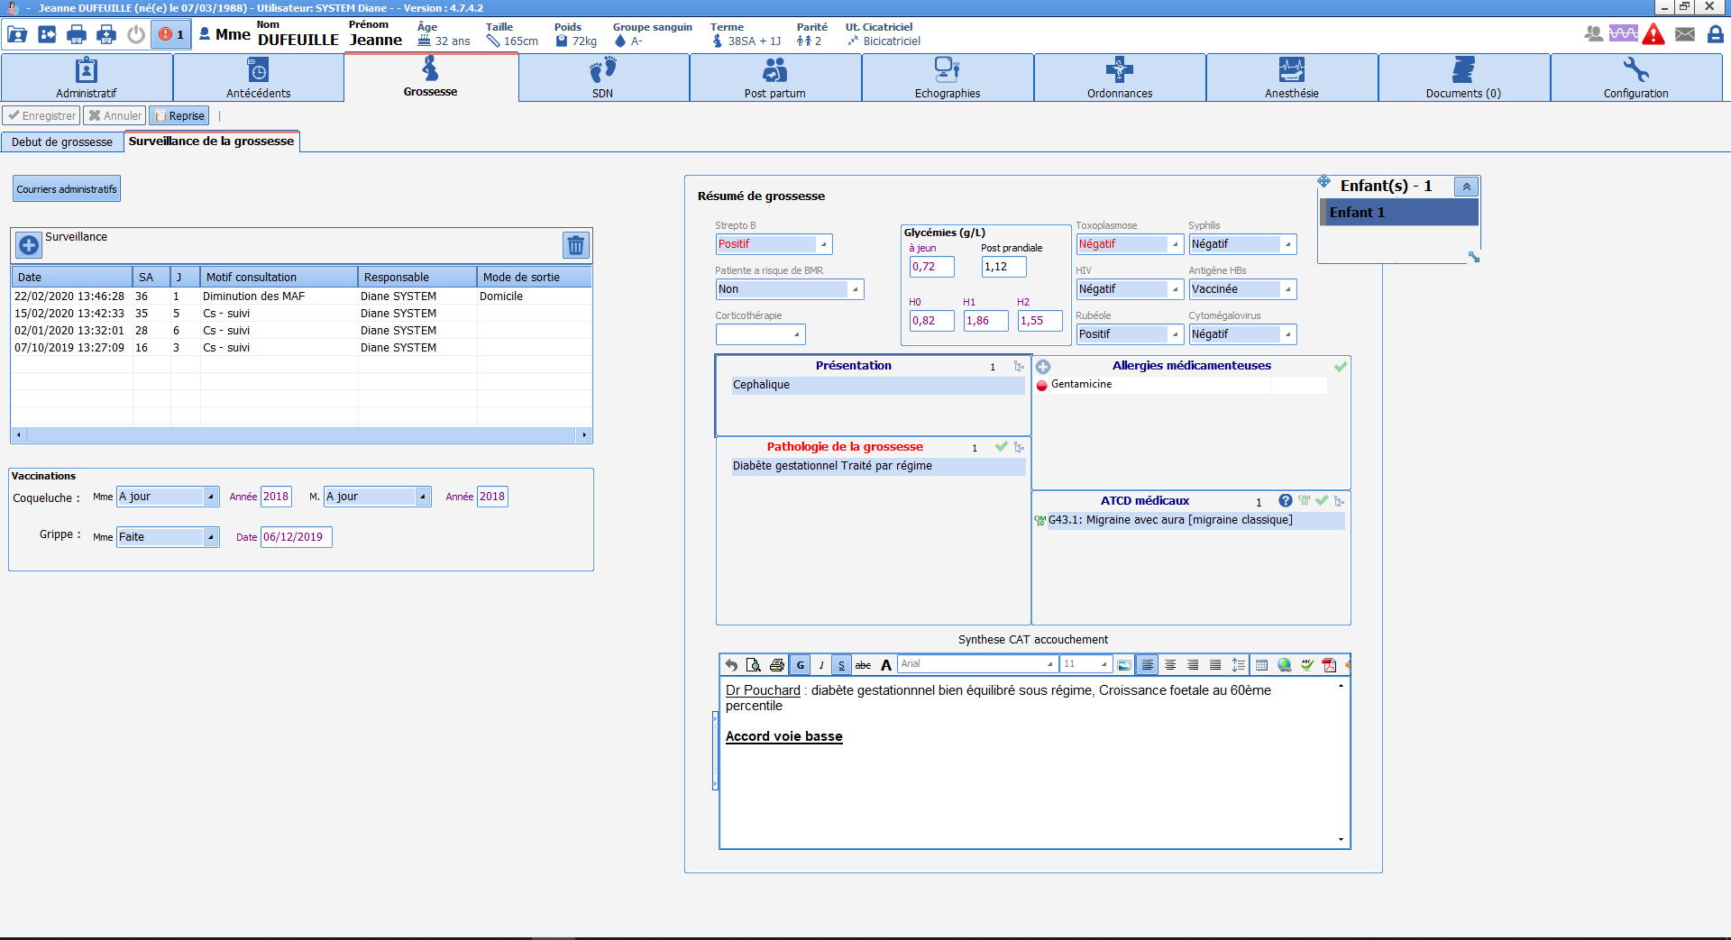
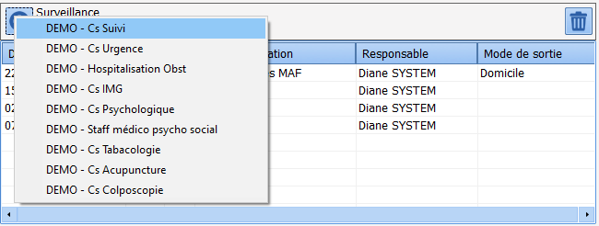
Pregnancy monitoring
SC
Buttons giving access to administrative documents
Pregnancy summary
Enter what to do
Consultation text input box
Notes:
The ‘Pregnancy monitoring’ sub-tab lets you enter all the consultations that will take place during pregnancy and gives access to the important monitoring information summarized in the right part of the screen, in the ‘Pregnancy summary’ box.
The ‘monitoring’ table gives access to all types of consultations throughout pregnancy, such as follow-up consultations or emergency consultations. The hospitalization sheet can also be accessed from this table. To display the list of consultations, simply click on the + sign at the top left of the table. Then simply click on the consultation you want to bring up. Once the consultation has been entered, a brief summary of all the consultations appears in the table and gives quick access to them.
The ‘Administrative letters’ button gives access to certain letters, such as the pregnancy calendar or the genetic test consent form.
The data in the pregnancy summary are read-only. The information comes from the different consultations and from the ‘history’ and ‘start of pregnancy’ tabs.
A free text input box is available at the bottom of this summary and lets you enter additional information and specific things to do if necessary.

Slide 16
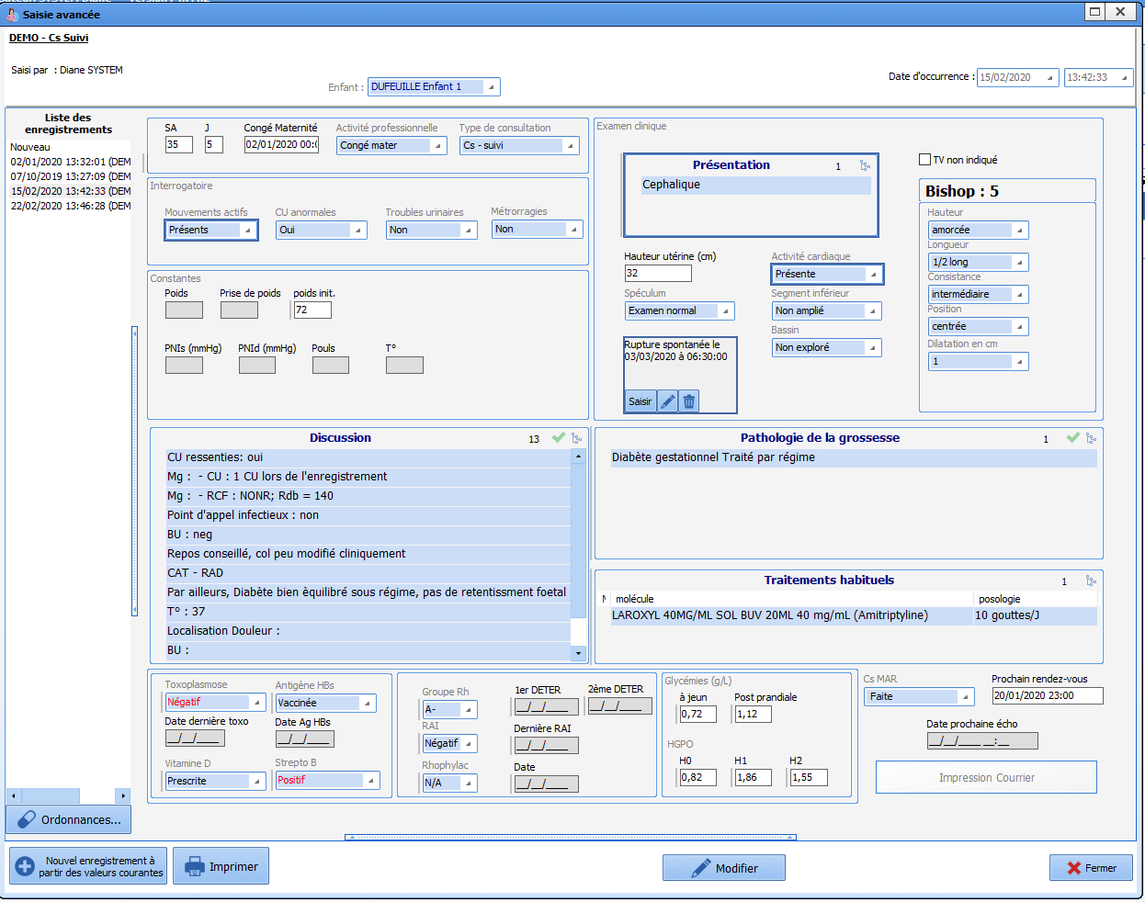
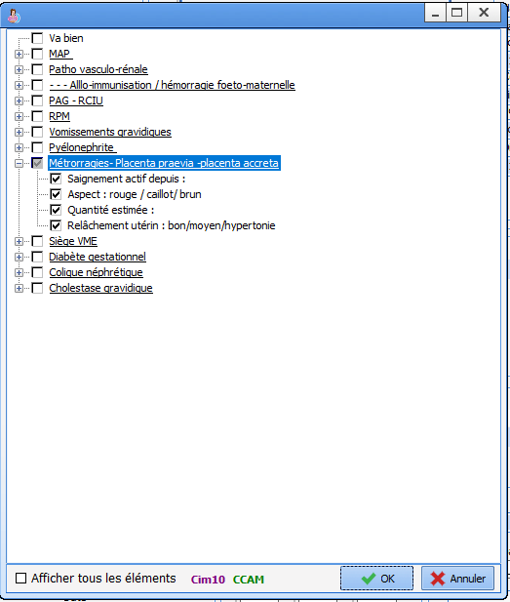
Pregnancy monitoring: example of follow-up consultation
SC
To change foetus in a multiple pregnancy
Questioning
Clinical examination
Vitals
Diagnosis
Discussion
Lab work
Prescription input
To print out follow-up letter
Notes:
The follow-up consultation lets you complete all the data from questioning the patient and the clinical examination.
The discussion component lets you record information with free text. By clicking on the list button at the top right of the component, you can bring up a predefined list to detail the questioning based on the type of condition. This checklist adapts the questions to each clinical situation. In the list, simply tick the desired information then click on OK. The data will automatically appear in the ‘discussion’ component and you can then complete the relevant information.
To switch from one foetus to another for a multiple pregnancy, simply change the child in the drop-down menu at the top of the consultation. The fields concerning the foetus will then change colour.

Slide 17
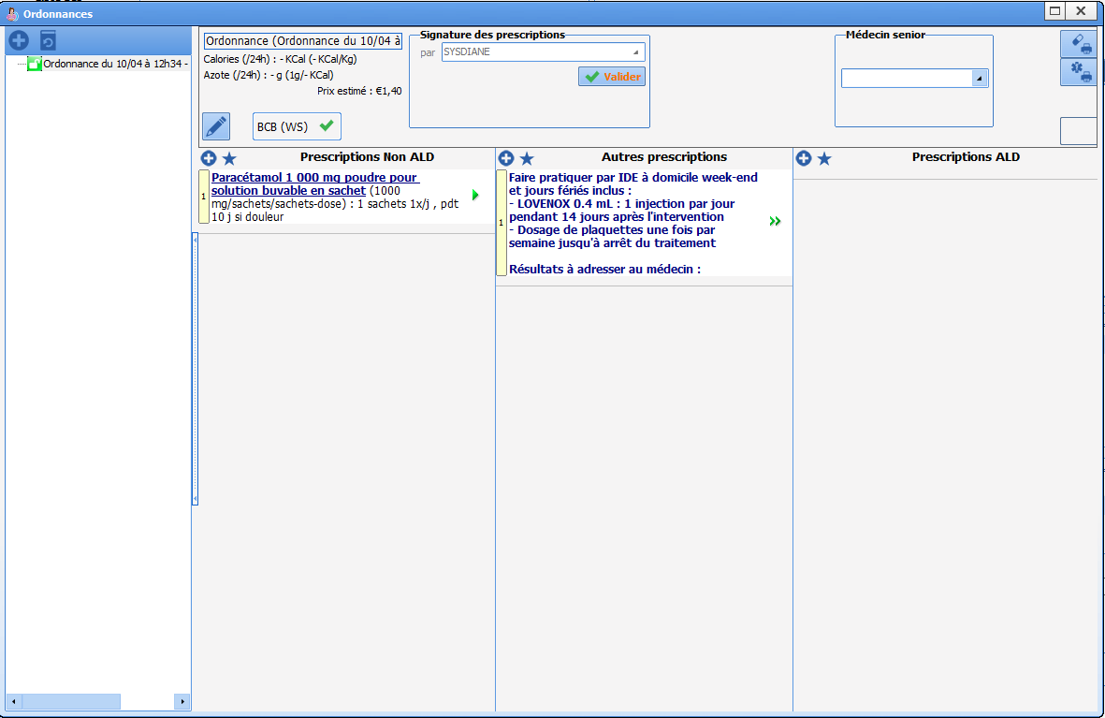
Pregnancy monitoring: example of follow-up consultation - Entering a prescription
SC
- To create a new prescription
To sign the prescription
To print the order for further tests
To print the drug prescription
Name of doctor in charge
(if prescribed by Foundation Doctor)
Non-LTC medication order column
Column to order further tests
Column to order LTC drugs
Notes:
To issue a prescription from a consultation sheet: click on the ‘Prescription’ button at the bottom left. A prescription sheet appears.
Prescriptions can also be issued from the ‘Prescription’ tab. The functioning is the same as described below. However, you must remember to click on the button to create a new prescription before you can prescribe a treatment.
3 columns are visible on the prescription sheet:
Non-LTC medication order: lets you prescribe drugs outside the context of a long-term condition
Other prescriptions: lets you prescribe lab work and care
LTC medication order: lets you prescribe drugs in the context of a long-term condition

Slide 18
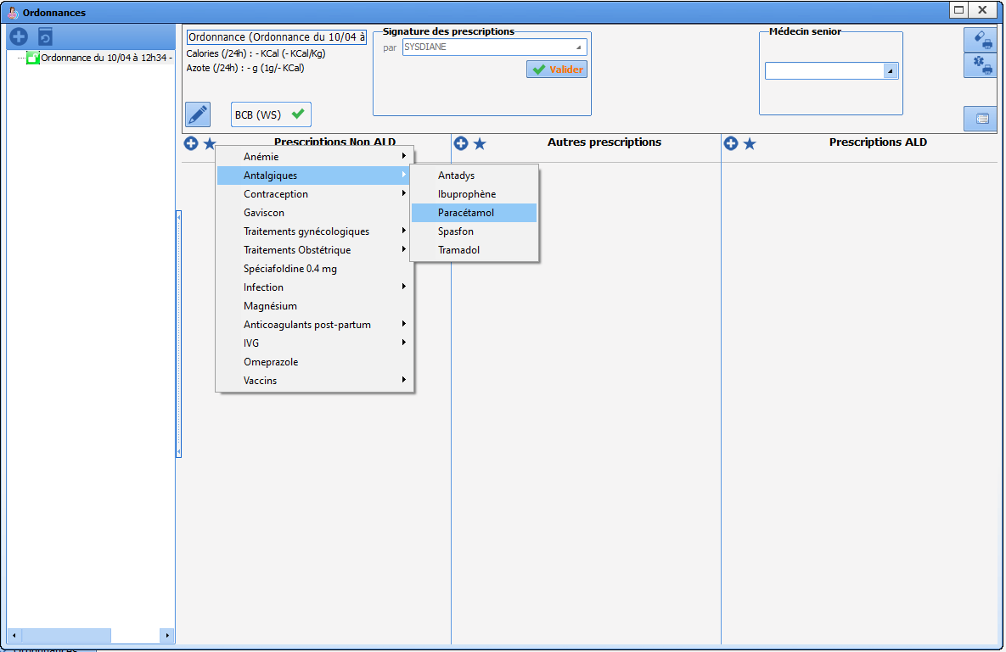
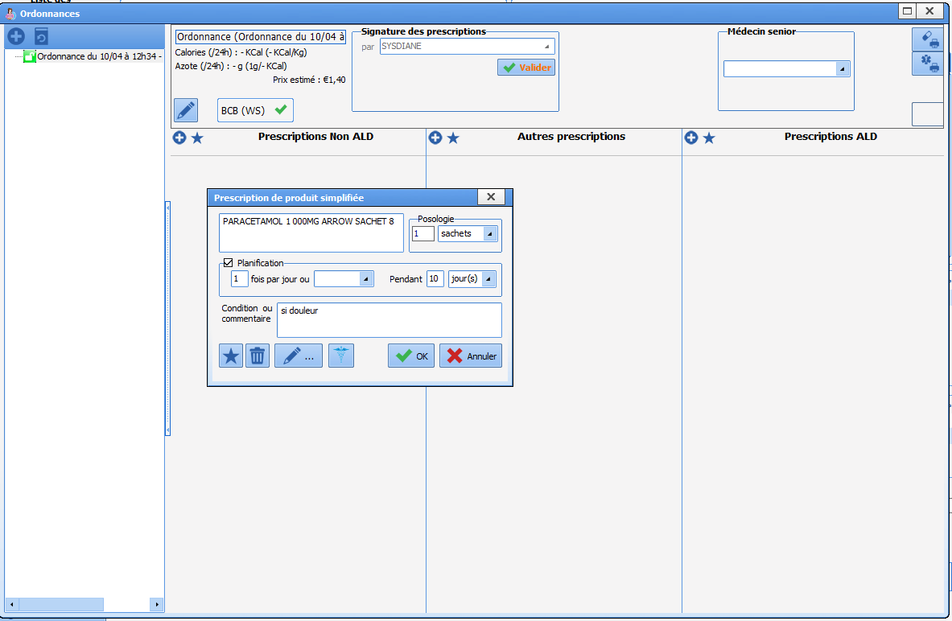
Pregnancy monitoring: example of follow-up consultation - Entering a prescription
SC
Medication order window
To enter a treatment using favourites
To enter a treatment
Notes:
To prescribe drugs: there are 2 possible methods:
Favourites: by clicking on the star, you have access to a list of favourite drugs. This list is pre-prepared but each user can create their own favourites. Choose the relevant treatment from the list to automatically prescribe it.
If you click on the cross at the top left of each column, a medication order window appears allowing you to enter the relevant product (a choice is offered from the drug bank), dosage, frequency of administration, length of treatment and circumstances for taking the treatment.
By clicking on OK, the medication order is displayed in the corresponding column. The prescription system is the same for each column.

Slide 19
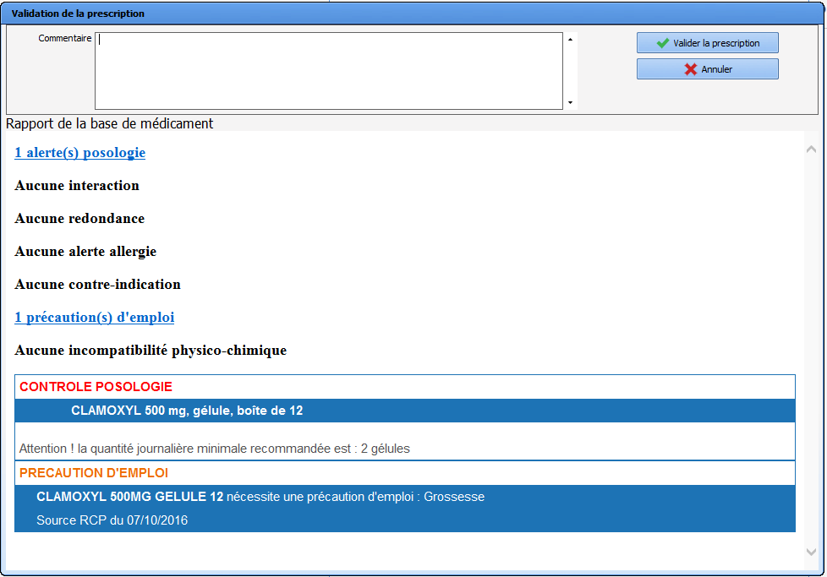
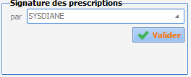
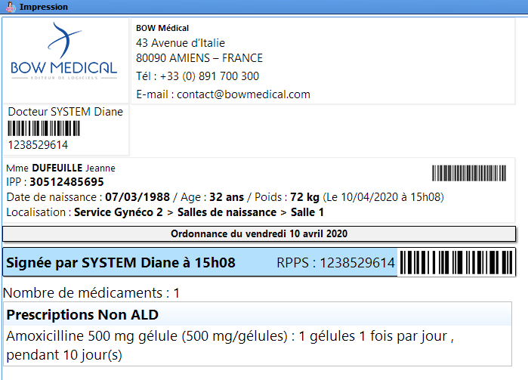
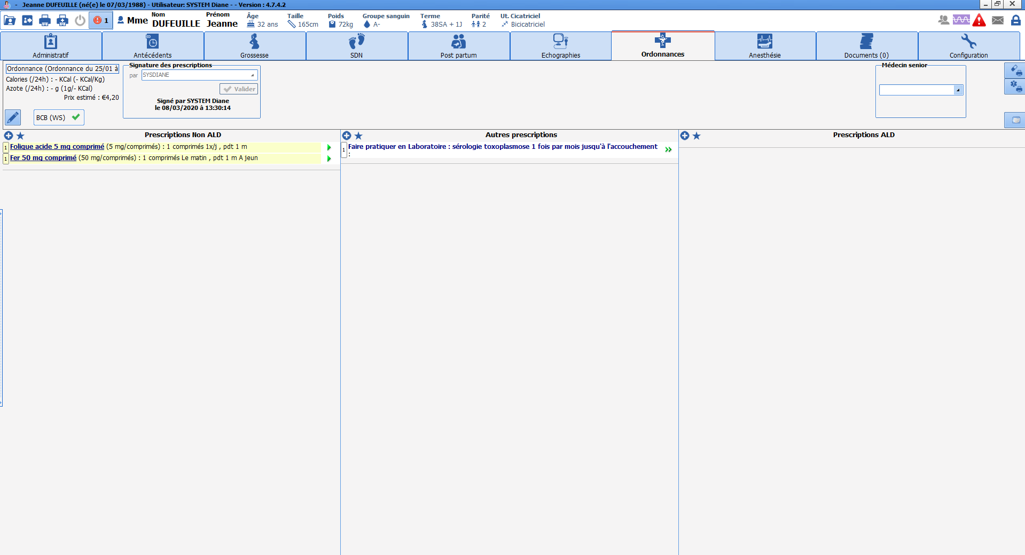

Pregnancy monitoring: example of follow-up consultation - Printing a prescription
SC
Prescription signature box
Prescription print buttons
Notes:
Once the prescription is finished, it must be signed (confirmed) using the prescription signature box which requires the prescriber's username and password to be entered.
A drug bank alert window then appears and issues warnings in the event of an overdosage, contraindication, allergy or drug interaction. Click on ‘confirm’. (These alerts do not block the prescription)
Printing: click on the print button at the top right of the window to print the drug prescription and click on the button underneath to print the prescription for further tests.

Slide 20
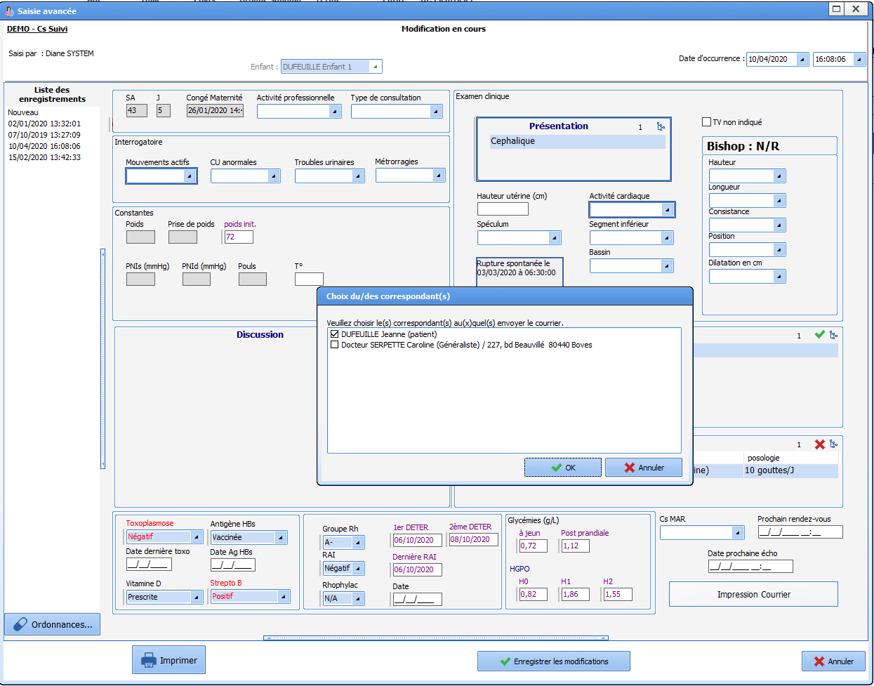
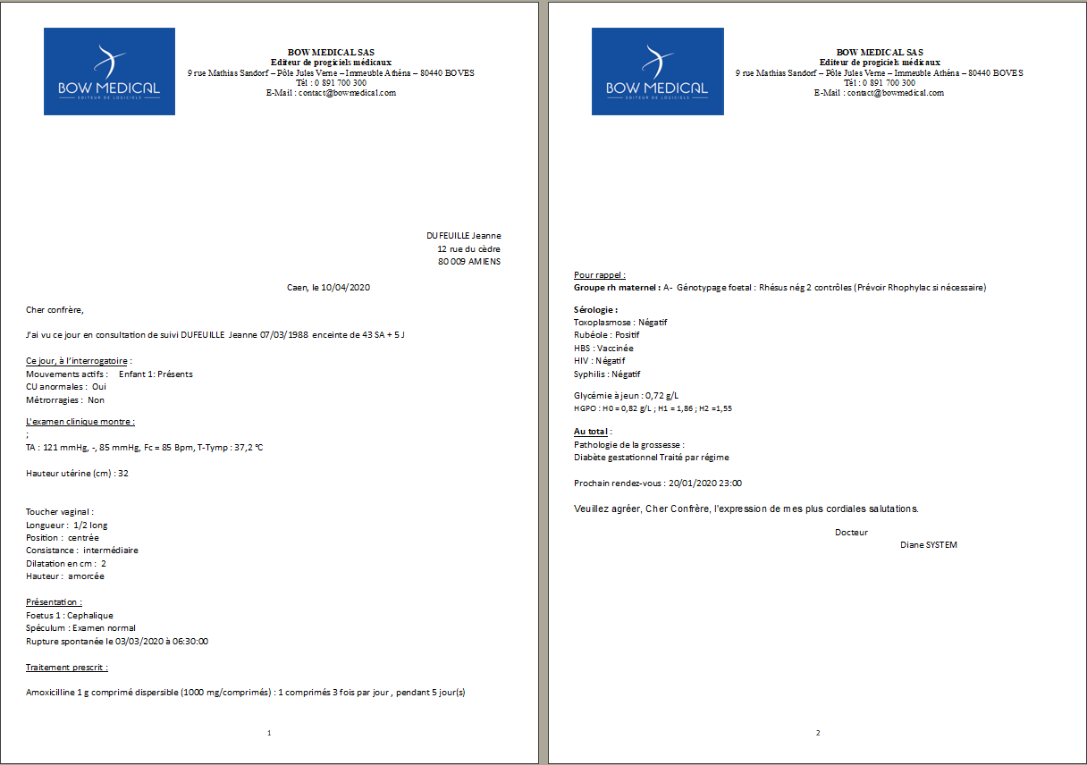
Pregnancy monitoring: Example of follow-up consultation - Creating the ‘follow-up letter’
SC
Follow-up letter
Window to select letter recipients
Print button
Notes:
When the consultation is finished, click on the ‘print letter’ button. A window opens to let you select the recipient(s). Simply click on the corresponding check box.
The letter is displayed. It is possible to add to or delete text boxes if necessary. Next click on the ‘save’ button at the bottom right.

Slide 21
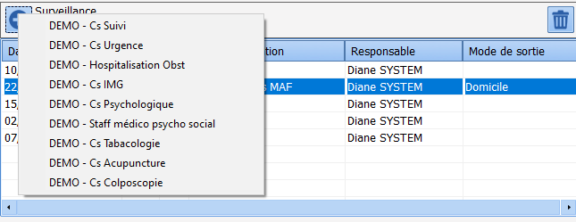
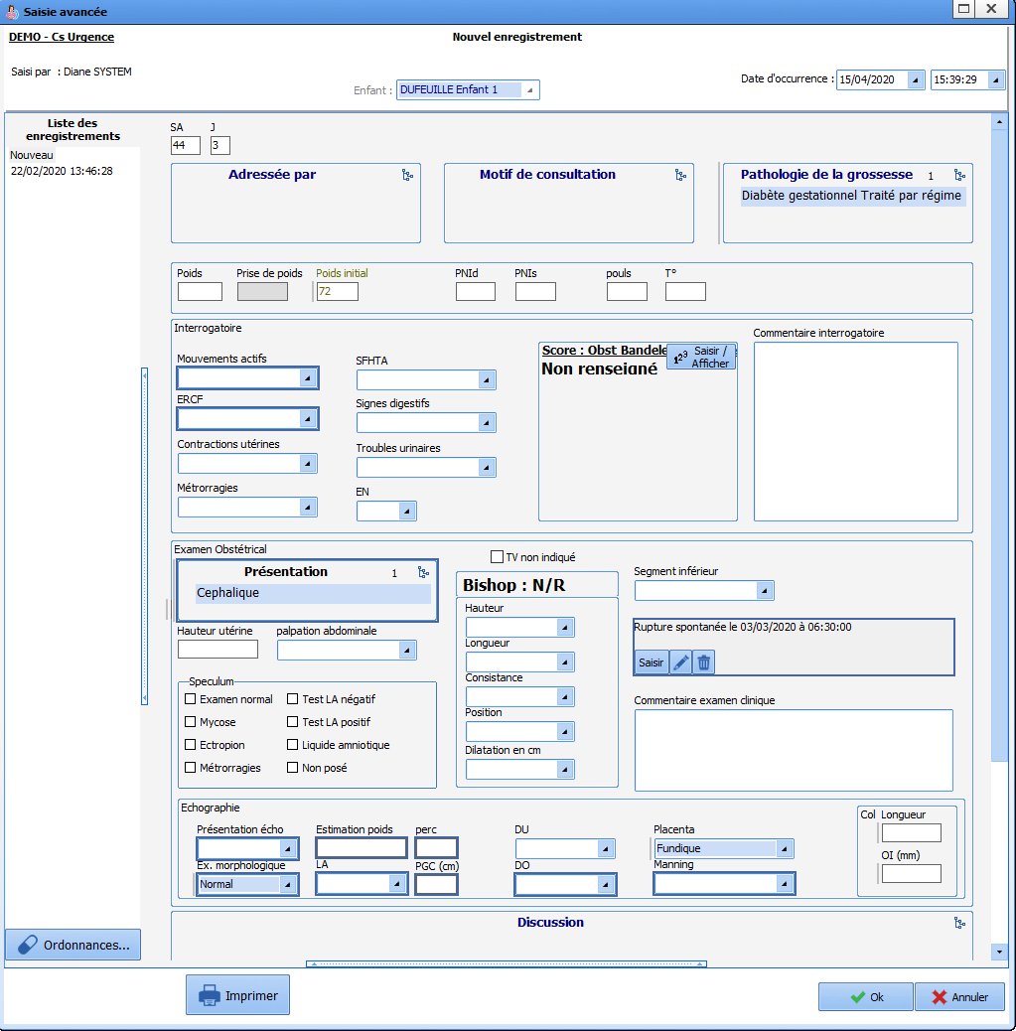
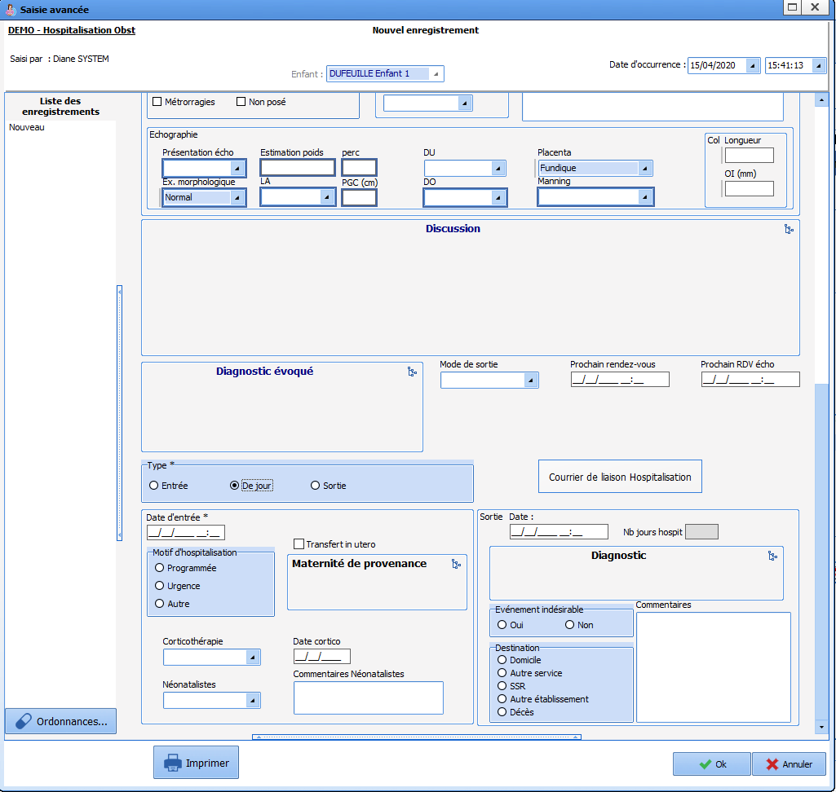
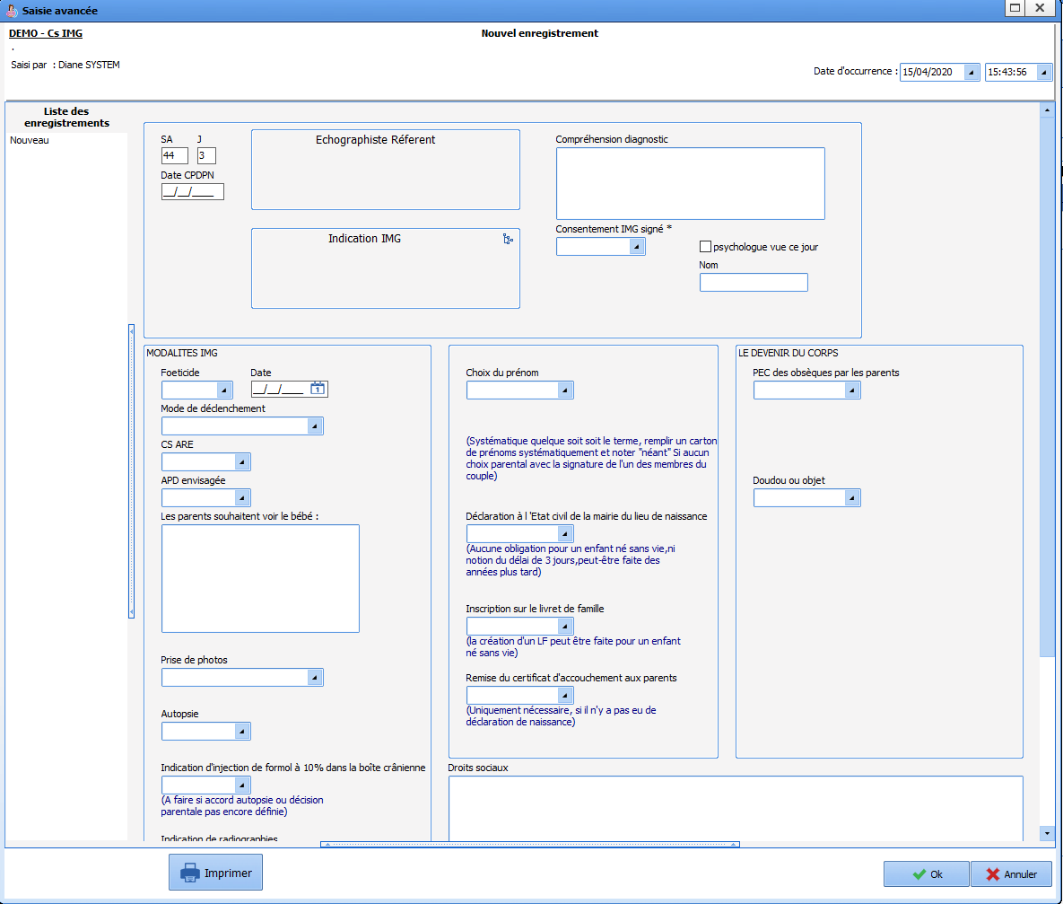
Pregnancy monitoring: Example of follow-up consultation - Creating the ‘follow-up letter’
SC
List of consultation templates
Emergency consultation
Hospitalization sheet
Therapeutic abortion consultation
Notes:
Many consultation templates are available and let all perinatal caregivers monitor pregnancies.

Slide 22
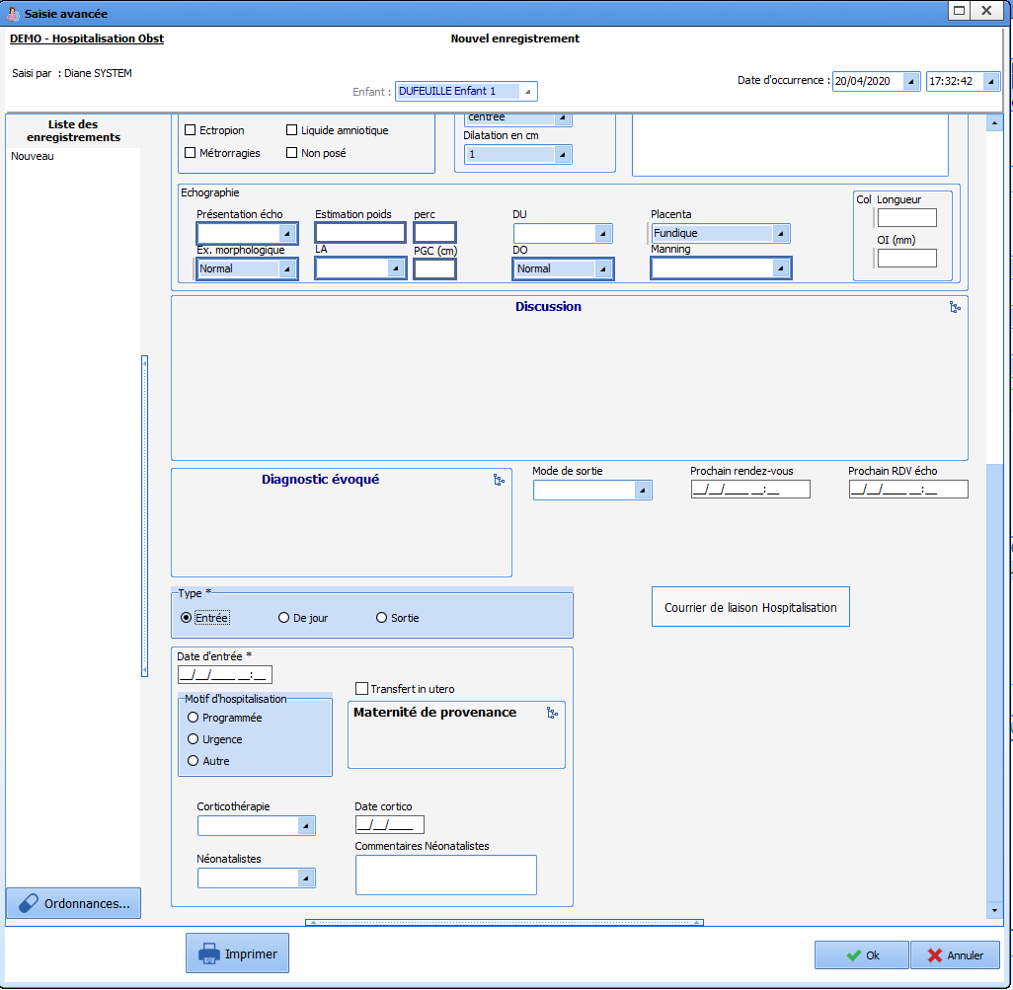
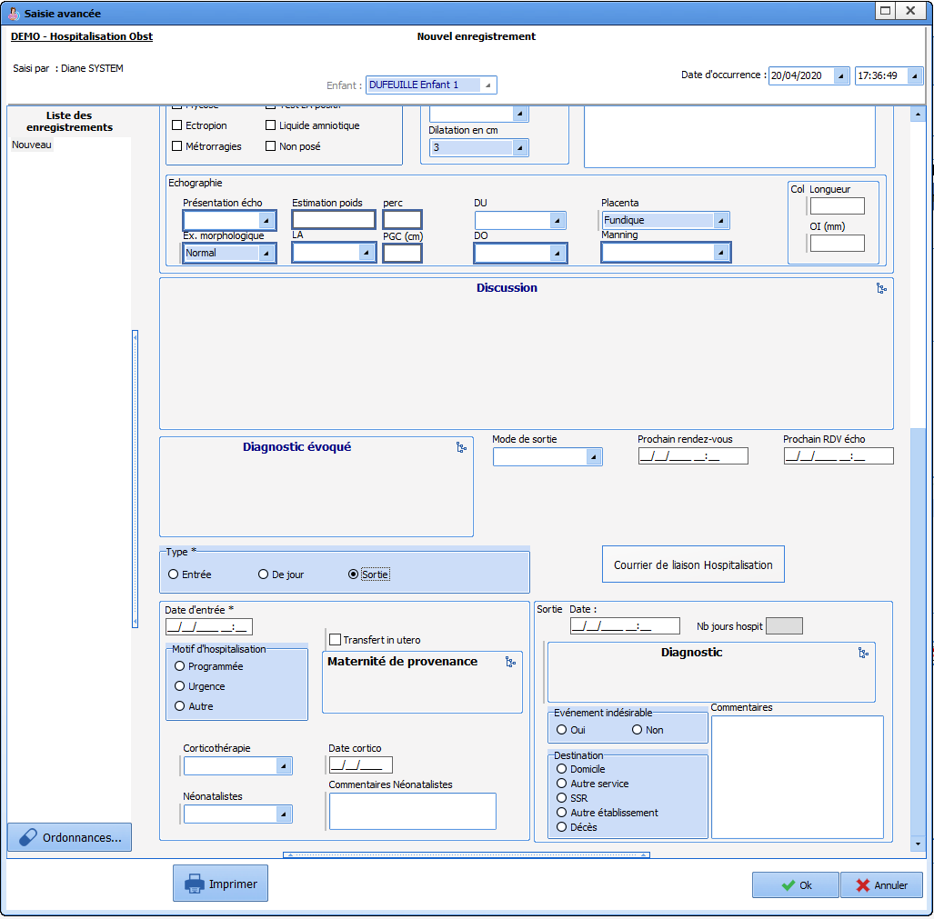

Hospitalization
H
Notes:
In the event of hospitalization, a specific ‘Hospitalization’ sheet lets you enter hospitalization data. When admitting the patient, simply tick the ‘admission’ box and enter the corresponding data. When the patient is discharged, you must open the same sheet and click on ‘Discharge’. Specific fields are displayed and let you record the discharge data and generate the liaison letter using the ‘liaison letter’ button.

Slide 23
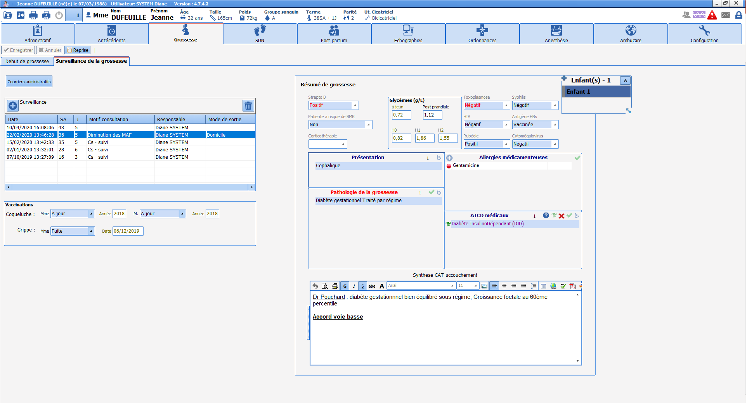
H
Monitoring patients at home
→ The patient can be monitored at home for a defined period with the Ambucare web application
Ambucare access tab
→ The forms exchanged can contain various types of questions and are fully configurable
Notes:
It is possible to monitor patients with a condition during pregnancy at home via the ‘Ambucare’ web application.
To access the application, click on the ‘Ambucare’ tab.
Ambucare sends patients questionnaires to monitor them closely.

Slide 24
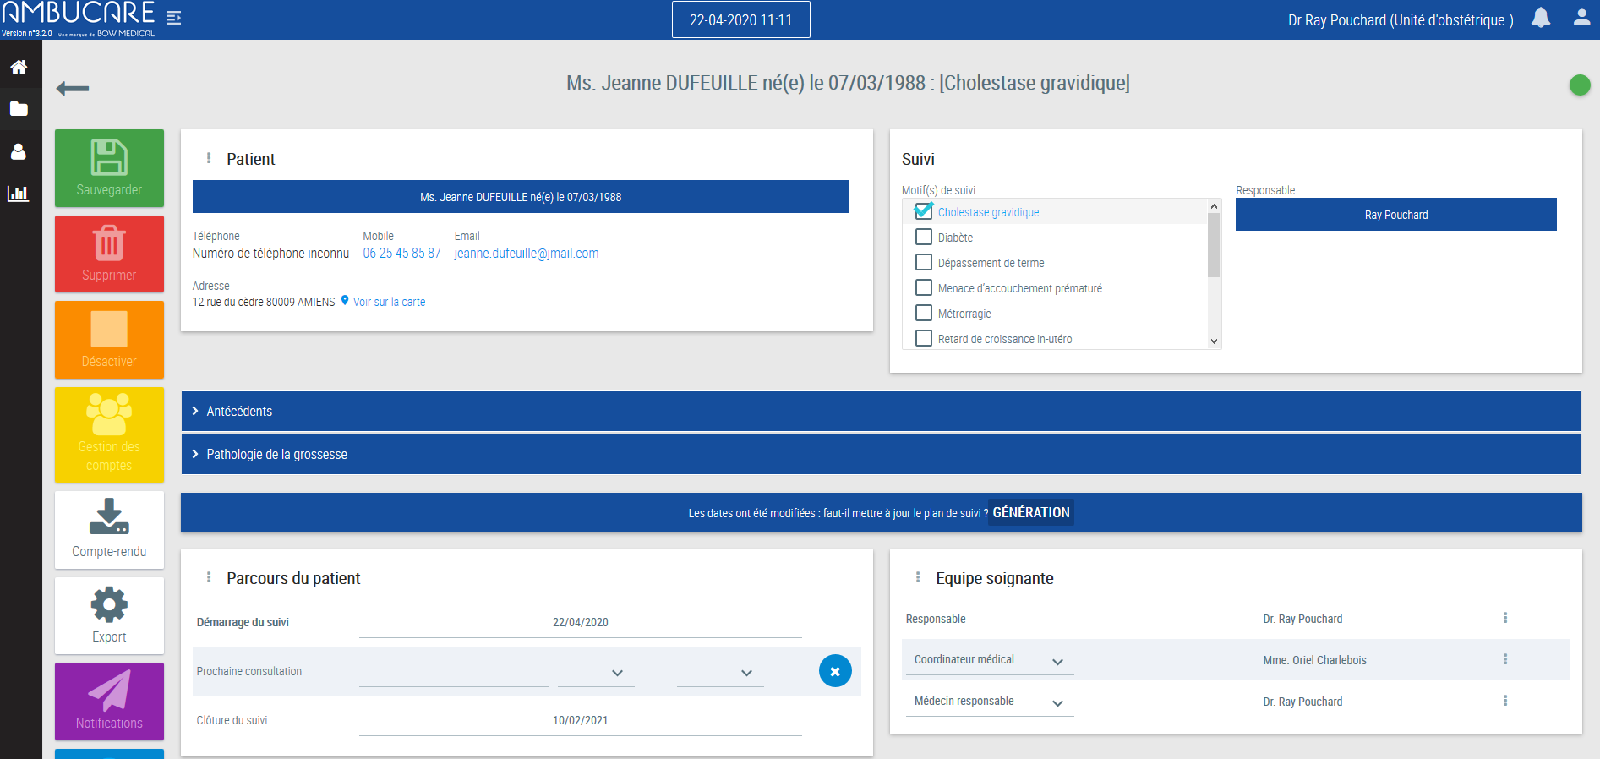
H
Ambucare: medical team area
→ Each reason for monitoring is associated with a predefined or free schedule for sending forms to the patient
To select reason(s) for monitoring
To generate the monitoring report in PDF format
To enter monitoring start and end dates
Link to generate monitoring taking into account the data entered
Notes:
On the Ambucare tab, you must start by choosing a reason for monitoring (the reasons can be configured) then you enter a monitoring start and end date. Next click on the ‘Generate’ button in the middle of the screen. This lets you pre-configure the questionnaires that will be sent to the patient and how often they are sent.

Slide 25
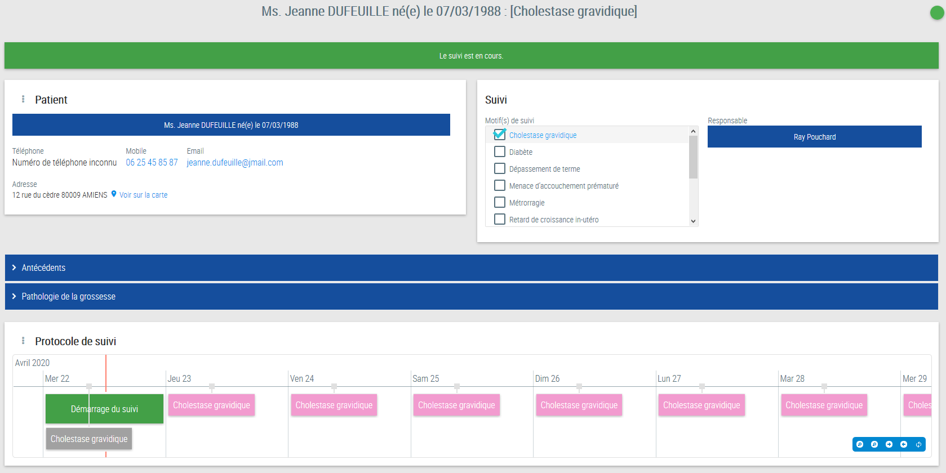
H
Ambucare: generating monitoring
→ Once the monitoring is generated, the timeline shows the form sending schedule
Form (awaiting an answer) sent to the patient's area and notification sent by email and/or text message
Scheduled forms
Notes:
The questionnaire tracking is then visible. The patient will receive questionnaires regularly in her patient area accessible on her smartphone, tablet or computer.
Colour code of timeline forms visible to caregivers:
Pink: forms not yet sent
Grey: forms awaiting an answer
Blue: forms returned by the patient without problems
Orange/Red: forms showing an alert (one of the patient’s answers indicates a sign of seriousness).

Slide 26
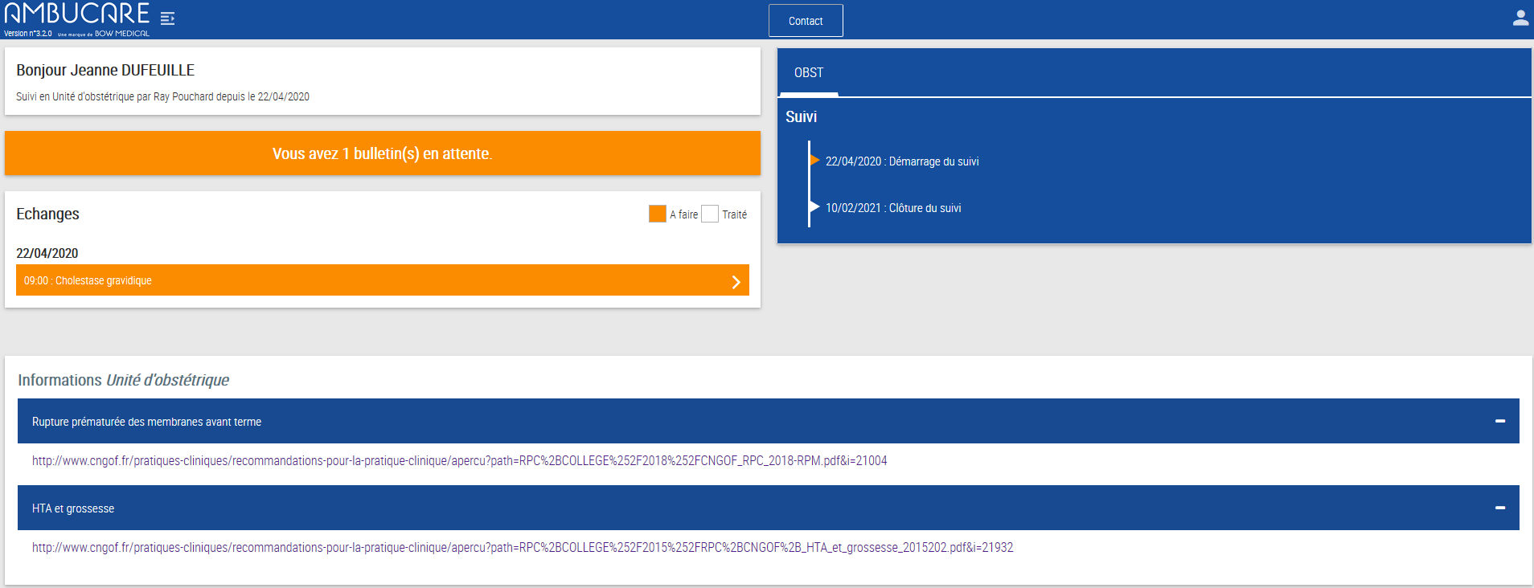
H
Ambucare: patient area
→ The patient has an account generated manually in the medical area (this can be automated)
The patient accesses the form by clicking on this ribbon
The patient can contact the medical team at any time using this button
The medical team can send information to the patient using this pane
Notes:
The patient has access to the different forms in her area with a username and password.
When a questionnaire must be completed, the ribbon is orange. By clicking on it, she can access and complete the questionnaire.

Slide 27
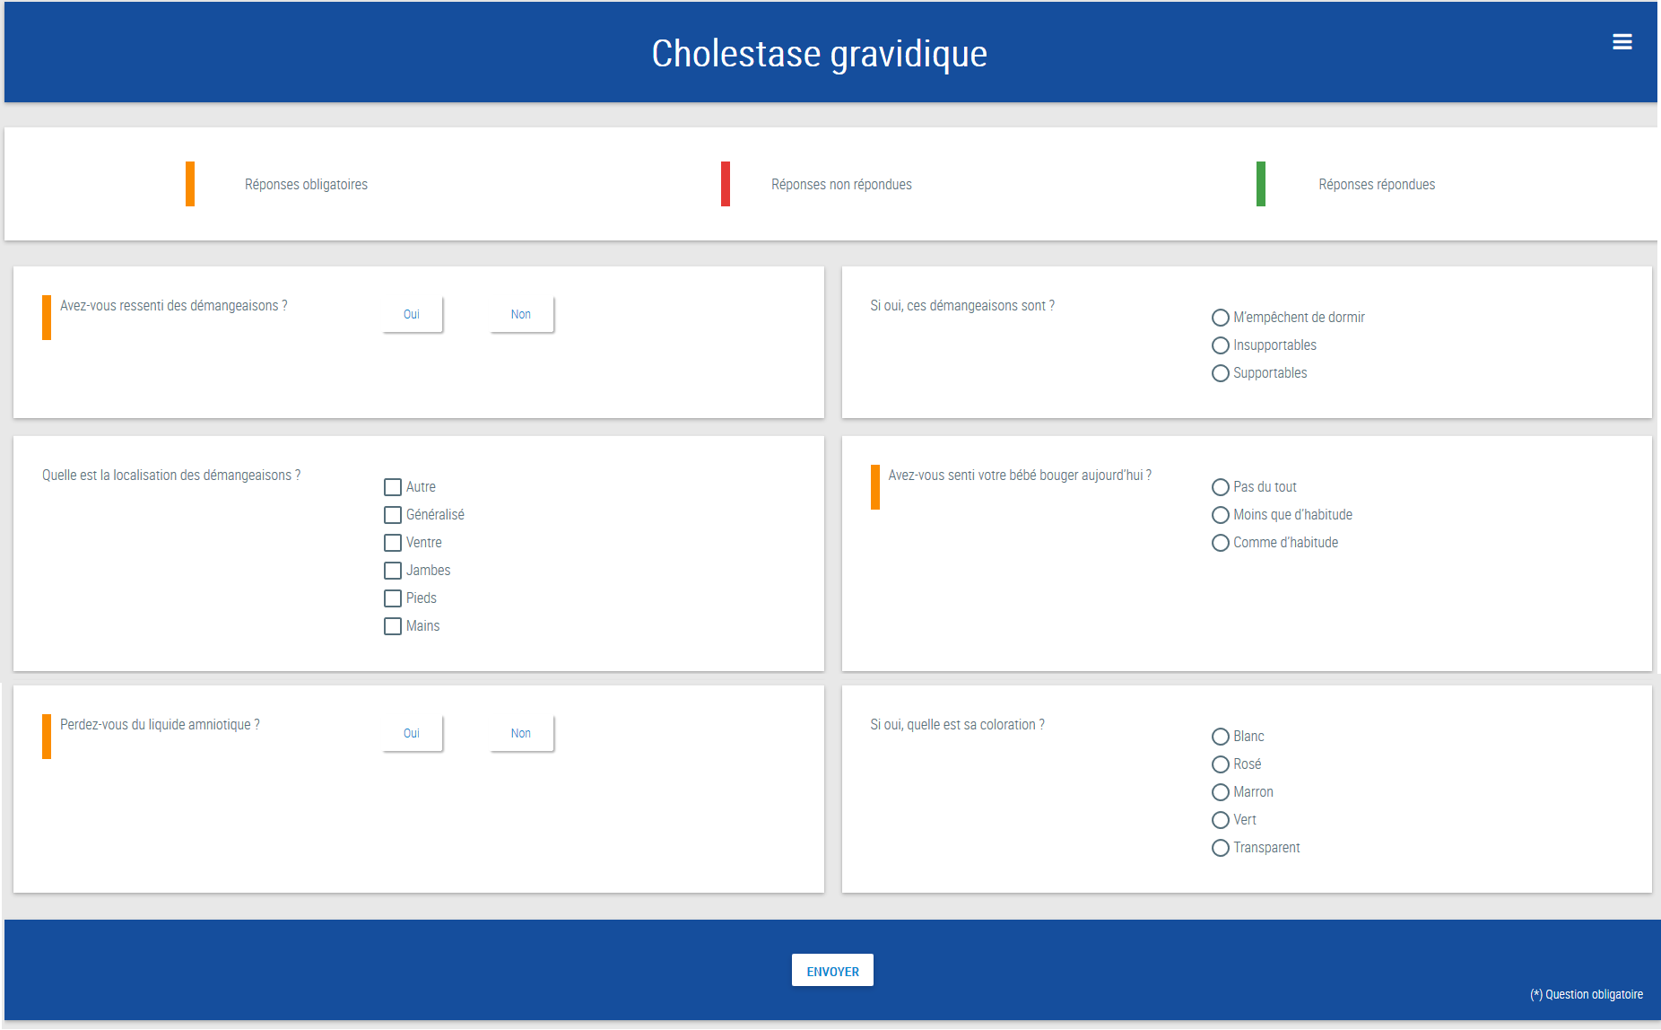
H
Ambucare: filling in a form
A patient who is doing well does not need to complete the form
Notes:
Example of a questionnaire to be completed by the patient about cholestasis of pregnancy: you can configure the questions and how often they are sent.

Slide 28


H
Ambucare: receiving answers
→ Alerts are received in the medical team area but also by text message and/or email.
→ The form answer status is indicated in the tracking timeline by the relevant colour
Notes:
The healthcare team receives alerts stating that a questionnaire has been completed and specifies whether an alert has been detected.

Slide 29

H
Ambucare: processing answers 1/2
→ Each answer is visible and alerts can be processed by the medical team
A phone call can be made to the patient. Calls are tracked.
Notes:
The summary screen shows the medical team all alerts for current questionnaires to take care of patients reporting problems.

Slide 30

H
Ambucare: processing answers 2/2
→ The different interactions between the patient and medical team are tracked.
Notes:
A diagram is used to easily track exchanges between the medical team and the patient.

Slide 31

Pregnancy monitoring: pregnancy summary
SC
Pregnancy summary
Summary /
What to do
Notes:
The pregnancy summary is permanently visible and recaps the major pregnancy monitoring information to help the teams make fast decisions in an emergency.
The ‘Summary / What to do’ section lets clinicians record additional information in the event of specific pregnancy care or specific neonatal care.

Slide 32

Ultrasounds
SC
Notes:
The ‘Ultrasounds’ tab lets you enter data from ultrasounds during the pregnancy.
To bring up a data entry sheet, simply click on the ‘+’ at the top left of the sub-tab, complete the ultrasound data and then click on ‘confirm’.

Slide 33
Delivery room
DR

Slide 34



ROOM SAFETY CHECKLIST
DR
‘Identity monitoring’ and ‘equipment’ checklist
Notes:
First of all, when opening a record in the delivery room, you are prompted to complete 2 checklists:
- 1 identity monitoring checklist
- 1 equipment checklist
It can be completed later in an emergency by ticking the ‘Postpone’ box.

Slide 35


Delivery
DR
Chart pane
Clinical examination data
Free text input box
Notes:
The delivery is monitored on the labour curve, which lets you provide all the labour monitoring information, including clinical examination data or drugs administered.

Slide 36

Delivery
DR
The labour monitoring information is entered via the buttons above the chart
Notes:
To enter the labour monitoring information, a series of buttons corresponding to the different stages of labour monitoring are found above the chart:
DR admission: lets you fill in the data from the initial labour exam
Labour curve: lets you record the data from the clinical examination
Analgesia: lets you enter the type and time of analgesia
Delivery: lets you enter the delivery and placental delivery procedures
Obs drugs: provides access to the list of treatments used in the delivery room
PPH: lets you enter specific data in the event of postpartum haemorrhage
Immediate postpartum: lets you enter data relating to the follow-up of the mother and neonate after birth

Slide 37

Labour monitoring data input
DR
Exam time
Vitals
Uterine contractions
Rupture of membranes: colour of amniotic fluid
Clinical examination
Foetal heart rate analysis
Emergency call
Urine output
Other treatments
Notes:
The labour curve sheet lets you record all the data from the patient’s clinical examination.
Once the exam is entered, simply close the sheet and the data will automatically appear on the labour curve.
Caution: remember to change the time of the exam if the data is entered afterwards.

Slide 38

Entering the delivery process data
DR
Vaginal delivery
Urine output
Emergency call
C-section
Birth
Placental delivery
Notes:
The Delivery sheet is used to enter the data for delivery whether this is a vaginal delivery, instrumental vaginal delivery or C-section.
The ‘Birth’ event lets you record the date and exact time of birth.
The placental delivery box lets you record the placental delivery method and the prophylactic administration of oxytocin (= active management).

Slide 39



Drug administration
DR
Administration of a fixed-duration treatment
Administration of a continuous treatment
Notes:
The list of treatments can be accessed via the ‘Obs drugs’ button. By clicking on the relevant treatment, a menu appears to choose the dosage. The information will be displayed automatically on the labour curve.
For continuous intravenous treatments, the data is entered in the same way. The labour curve will show a green progress bar representing the duration of administration.
If you want to change the flow rate, simply click directly on the bar where the flow will be changed. We then click on the appropriate flow rate. On the display, the bar representing the duration of administration of the old rate will be shaded. The green bar will continue to progress taking into account the new flow rate.
When you want to stop the administration, simply click on the bar and then on ‘stop’.

Slide 40

Pregnancy summary
DR
The duration of the different stages of labour is calculated automatically
Start of
labour
Labour
process
Delivery methods
Placental delivery
methods
Notes:
The pregnancy summary must be completed and lets you summarize all the events during labour.

Slide 41




Pregnancy summary
DR
The delivery method AND the outcome must be entered
Notes:
Special features:
Some fields are hidden and are displayed when certain data is entered (e.g. if a C-section was done, entering ‘yes’ in the ‘C-section’ drop-down menu displays the ‘additional procedures’ and ‘C-section complications’ fields).
Entering the pregnancy outcome: the pregnancy outcome list contains 2 sub-menus: (The 2 menus in the list must be filled)
- Delivery method - Outcome

Slide 42

DR neonate
DR
Apgar score
Measurements
Acid-base status
Samples
Prophylactic measures
EONI score
Notes:
The ‘DR neonate’ sub-tab lets you enter data relating to the neonatal examination.
The Apgar score is entered via drop-down menus. There is a shortcut under each column to directly enter an Apgar score of 10.
The neonatal measurements are recorded in the corresponding boxes. The percentile is calculated automatically and varies depending on the gender of the child and the number of weeks of pregnancy.
In the samples box, you can enter all the samples collected from the neonate in the delivery room. The Early Onset Neonatal Infection score classifies the child according to the risk of infection based on neonatal society guidelines.

Slide 43

Clinical examination/resuscitation
DR
Clinical examination
Discharge methods
Treatments administered to neonate
Resuscitation
To enter staff meeting instructions
Notes:
The ‘clinical examination / resuscitation’ sub-tab is used to record data from the clinical exam of the neonate.
If you select ‘yes’ in the ‘resuscitation’ drop-down menu, fields appear that let you record the procedures performed in the event of resuscitation and the Silverman score.

Slide 44


Generating reports
DR
Generating letters
Buttons to generate reports
Display of report
Notes:
The delivery report can be compiled in the ‘Delivery report’ sub-tab.
Simply click inside the component then click on the buttons on the right. Templates are prepared and can be modified directly.
Example: to create a delivery report with a placental delivery haemorrhage: simply click on the ‘Delivery report’ button. To then retrieve the haemorrhage information, simply click in the text box where you want the information to appear then click on the ‘postpartum haemorrhage’ button. The haemorrhage information will be automatically inserted where you want on the report.
Then, simply click on the ‘letter’ button and generate the relevant letters: delivery reports and birth declaration. In the event of a multiple pregnancy, the information concerning each child is retrieved automatically.

Slide 45

ANAESTHESIA RECORD
DR
Notes:
The ‘anaesthesia’ tab gives the anaesthesiologist access to labour information related to anaesthesia.
Information is shared directly between the labour curve and the anaesthesia record to share information more easily.
The anaesthesia record functions in the same way as the anaesthesia module (see anaesthesia demo).
Here, the anaesthesiologist can provide data concerning the analgesia method used in the delivery room but also in the operating theatre in the event of a C-section.

Slide 46


Departure from delivery room
DR
Patient departure
Patient transfer to another unit
Notes:
Once the delivery room monitoring is complete, click on the patient departure button then select ‘Transfer’ in the window that opens and click on ‘Yes’.

Slide 47
Postpartum
PP

Slide 48

Postpartum: Maternal monitoring
PP
Button to bring up the different monitoring sheets
Postnatal care at home
Early discharge
Staff meeting instructions
To generate the 8th day certificate
Notes:
The maternal postpartum monitoring is done via the ‘+’ button at the top left of the table. This button lets you bring up different monitoring sheets using the same principle as consultation monitoring.
At the top left of the sub-tab there is a component giving feedback on the patient's eligibility for ‘Postnatal care at home’ or ‘Early discharge’. (This information is recorded in the ‘Postnatal care at home / Early discharge’ sub-tab.
The ‘cerfa’ button is used to automatically generate the 8th day certificate.
The staff meeting instructions component lets you record specific maternal monitoring instructions decided during the staff meeting.

Slide 49



Postpartum: maternal monitoring
PP
Notes:
Different monitoring sheets are available from the postpartum monitoring table:
Postpartum admission
Postpartum vaginal delivery monitoring: for vaginal deliveries
Postpartum C-section monitoring: to monitor C-section patients
Discharge
Postnatal consultation, etc.

Slide 50

Postpartum: 8th day certificate
PP
Input box
Text box
Notes:
To generate the 8th day certificate
Click on the ‘cerfa’ button under the maternal postpartum monitoring table in the ‘maternal postpartum’ sub-tab.
The vast majority of data is already filled automatically.
To tick a checkbox: simply click in the check box
To complete a text box: click on the desired text box then enter the text in the ‘text’ input box at the top of the component
Once the first page has been completed: click on ‘next page’, complete the second page then click on ‘print’

Slide 51

Postpartum: Neonatal monitoring
PP
Pregnancy summary
Paediatric exam
Notes:
The ‘Neonate postpartum’ sub-tab includes an upper part summarizing the pregnancy and the patient's history.
The lower part includes a table to bring up sheets to let the paediatrician fill in the data from the clinical examination of the neonate.

Slide 52


Postpartum: Neonatal monitoring
PP
Bilirubinaemia
Light therapy
Weight
Values input box
Notes:
The ‘Curves’ sub-tab lets you enter the curves for bilirubinaemia, light therapy and weight.
To create the monitoring curves, simply enter the data in the ‘VALUE’ box then click on ‘send’. The value will then be displayed in the curve. (Remember to change the date and time of data entry if incorrect)

Slide 53

Postpartum: Postnatal care at home and early discharge
PP
Notes:
The ‘Postnatal care at home / early discharge’ sub-tab has two boxes:
Postnatal care at home: lets you fill in all the relevant eligibility criteria
Early discharge: lets you fill in all the relevant eligibility criteria
When all the criteria are met and therefore all the boxes are ticked, the ‘Eligibility for postnatal care at home’ drop-down menu will automatically switch to ‘yes’. The ‘early discharge’ box functions in the same way.

Slide 54
Family planning
FP
Notes:
Family planning (= follow-up after abortion)

Slide 55



Family planning
FP
To select the type of record
Family planning configuration
Notes:
To open a family planning record, when creating a record, choose family planning in the record type selection window, then enter the date of conception and click on ‘confirm’.
In the family planning configuration, the tabs for pregnancy monitoring, delivery room and postpartum are not available and are replaced by the family planning tab.
The other tabs function in the same way.
The family planning tab includes an information pane in the upper part and a table to bring up family planning care monitoring sheets.
The ‘Pregnancy outcome’ component must be completed and lets you enter the pregnancy termination method.

Slide 56



Family planning monitoring
FP
Notes:
The different monitoring sheets:
Pre-abortion consultation: lets you enter the data and ensure that the conditions are met and consent is given to perform an abortion
Medication abortion and surgical abortion protocol: lets you record the abortion method data
Post-abortion consultation

Slide 57
Gynaecology
Gyn

Slide 58


Gynaecology
Gyn
To select the type of record
Gynaecology configuration
Notes:
To open a gynaecology record, when creating a record, choose gynaecology in the record type selection window then click on ‘confirm’.
In the gynaecology configuration, the tabs for pregnancy monitoring, delivery room and postpartum are not available and are replaced by the gynaecology tab.
The other tabs function in the same way.
The gynaecology tab includes an information pane in the upper part and a table to bring up gynaecology care monitoring sheets.

Slide 59


Gynaecology monitoring
Gyn
Gynaecology monitoring sheet
Colposcopy monitoring sheet
Notes:
Several consultation sheets are available from the table to monitor standard consultations, colposcopies, etc.

Slide 60



Gynaecology admissions
Gyn
Notes:
In the event of hospitalization, a specific ‘Gynaecology hospitalization’ sheet lets you enter hospitalization data. When the patient is admitted, simply tick the ‘admission’ box and enter the corresponding data. When the patient is discharged, you must open the same sheet and click on ‘Discharge’. Specific fields are displayed and let you record the discharge data and generate the liaison letter using the ‘liaison letter’ button.

Slide 61
Thank you for your attention

