Slide 1

Preoperative assessment
(Pre-Op)

Slide 2
CONTENTS
    Startup
    Patient selection
  Preoperative assessment (Pre-Op)
      Record opening form
      Administrative
      History
      Clinical examination
      Treatments / Premedications
      Paraclinical
      Conclusion
      Summary
      Documents
          Generating a CONSULTATION REPORT
Notes:
Presentation of DIANE Anaesthesia software: consultation module

Slide 3
    Startup
    Patient selection
Notes:
We will begin by starting up the consultation module and selecting a patient’s record.

Slide 4
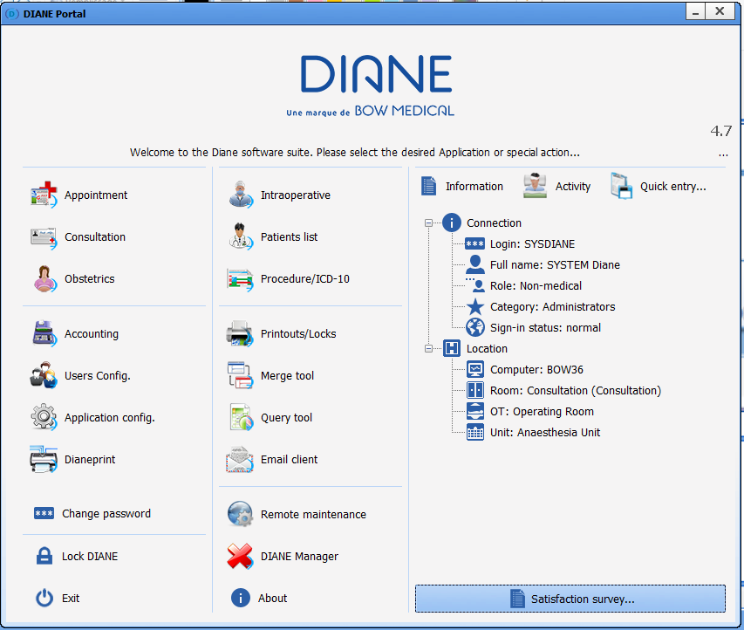
STARTUP
‘Consultation’
Notes:
When starting up the software, you arrive on the home page.
We can see WHO is logged on and WHERE the computer is on the tree structure.

Slide 5
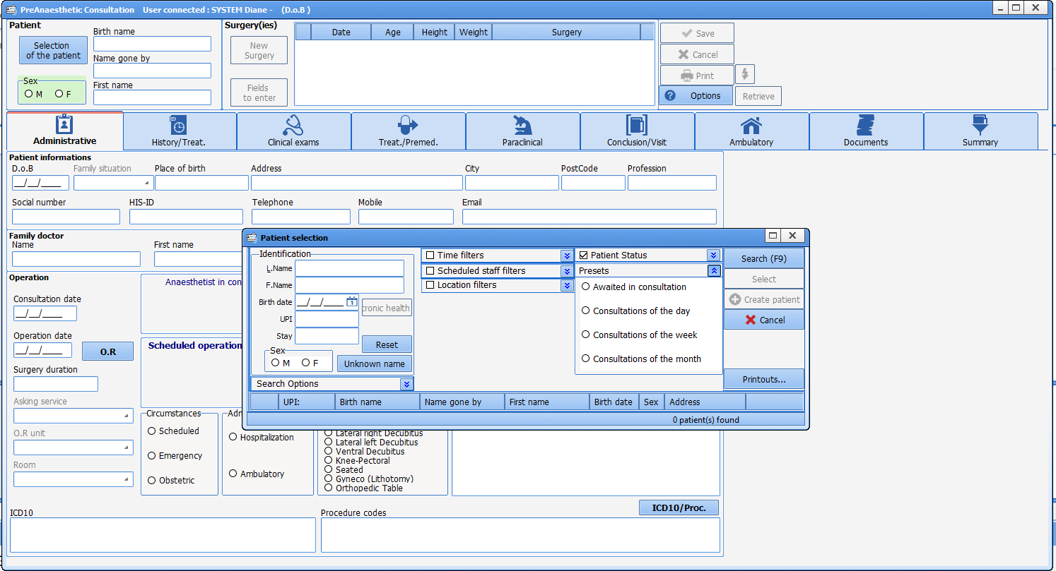
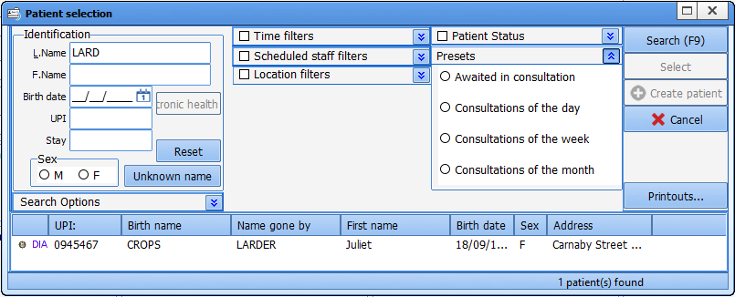
PATIENT SELECTION
SEARCH using:
- Date of birth
or
- The UPI
or
- The first letters of the last name
Notes:
You are prompted to select the patient. To do this, you can search for the patient either by date of birth, UPI or by the first letters of their last name.
This generates the corresponding list.
Click on the record to open.

Slide 6
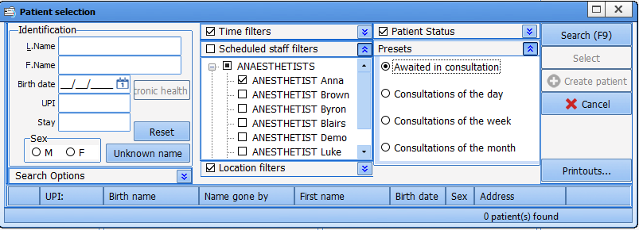
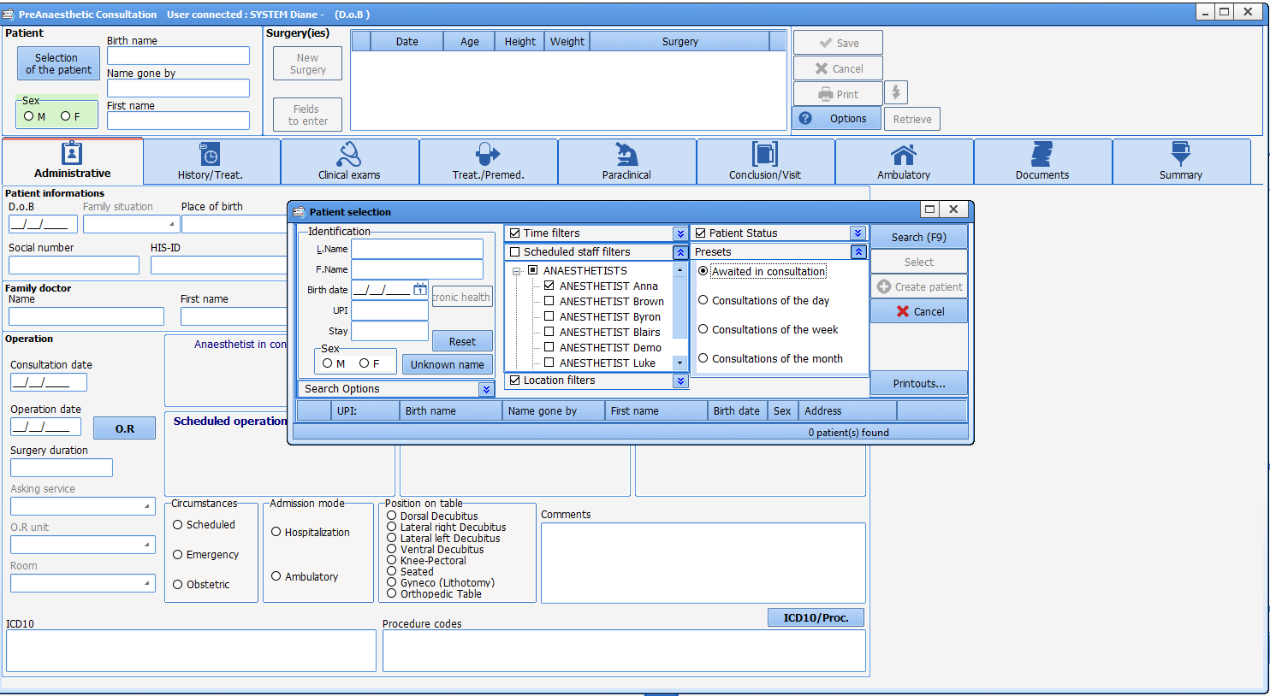
PATIENT SELECTION
Sorting possible based on
different items…
Notes:
You can use a filter to focus on patients expected for consultation.

Slide 7

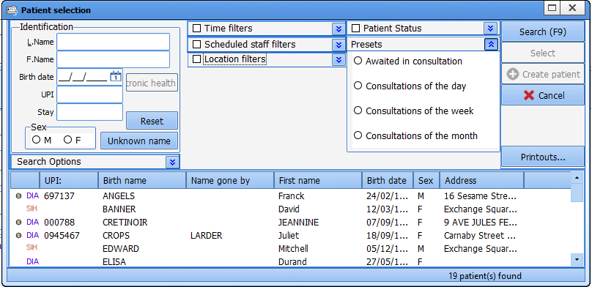
PATIENT SELECTION
HIS: patient registered at the hospital
DIA: patient already registered in DIANE
Notes:
Before selecting the patient's record, you can see the records registered in the anaesthesia software.
HIS means that the patient is registered in the facility’s administration database.
DIA means the patient is already registered in the DIANE software.

Slide 8
PATIENT SELECTION
Notes:
Once the record has been selected, click to open.

Slide 9
  Preoperative assessment (Pre-Op)
      Record opening form
      Administrative
      History
      Clinical examination
      Treatments / Premedications
      Paraclinical
      Conclusion
      Summary
      Documents
Notes:
We will now look at the actual consultation.

Slide 10
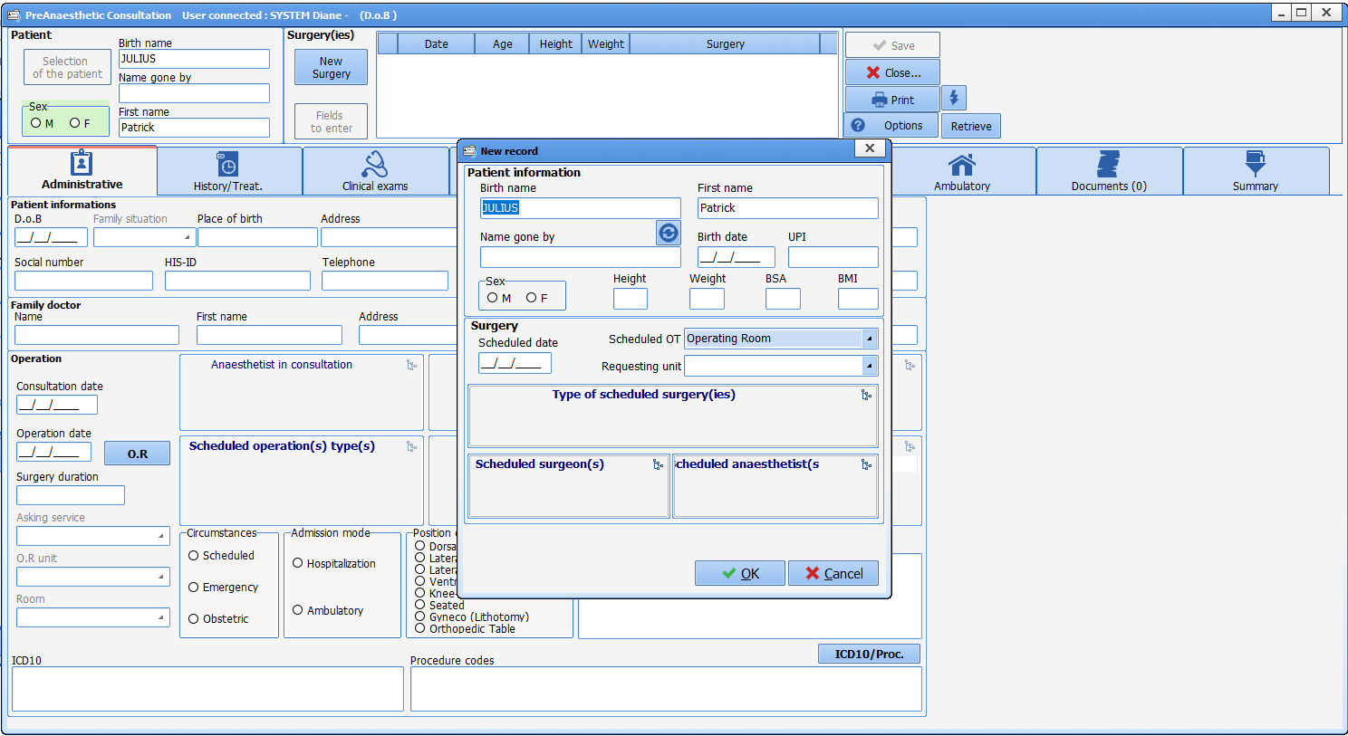
Opening the Pre-Op
Notes:
From the start, a first form is shown containing information. If there is a connection with the HIS, some information is automatically provided... otherwise now is the time to enter it.

Slide 11
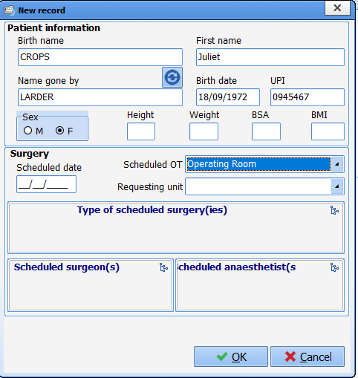
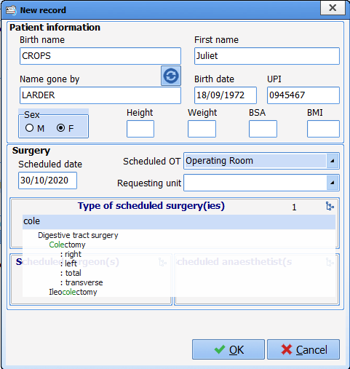
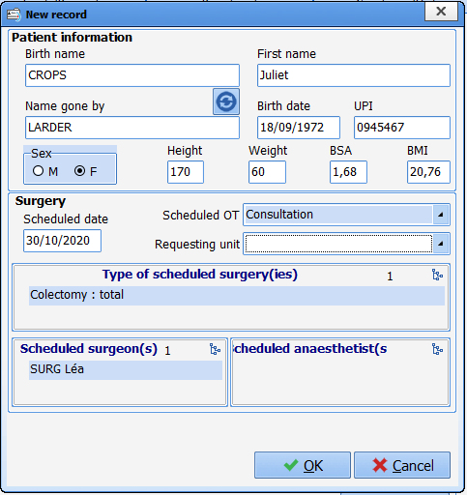
Record opening form
Notes:
We will also fill in the type of surgery, the scheduled date, etc. Completion is structured. By typing the first 4 letters of the surgery or surgeon, you have access to pre-existing lists.

Slide 12
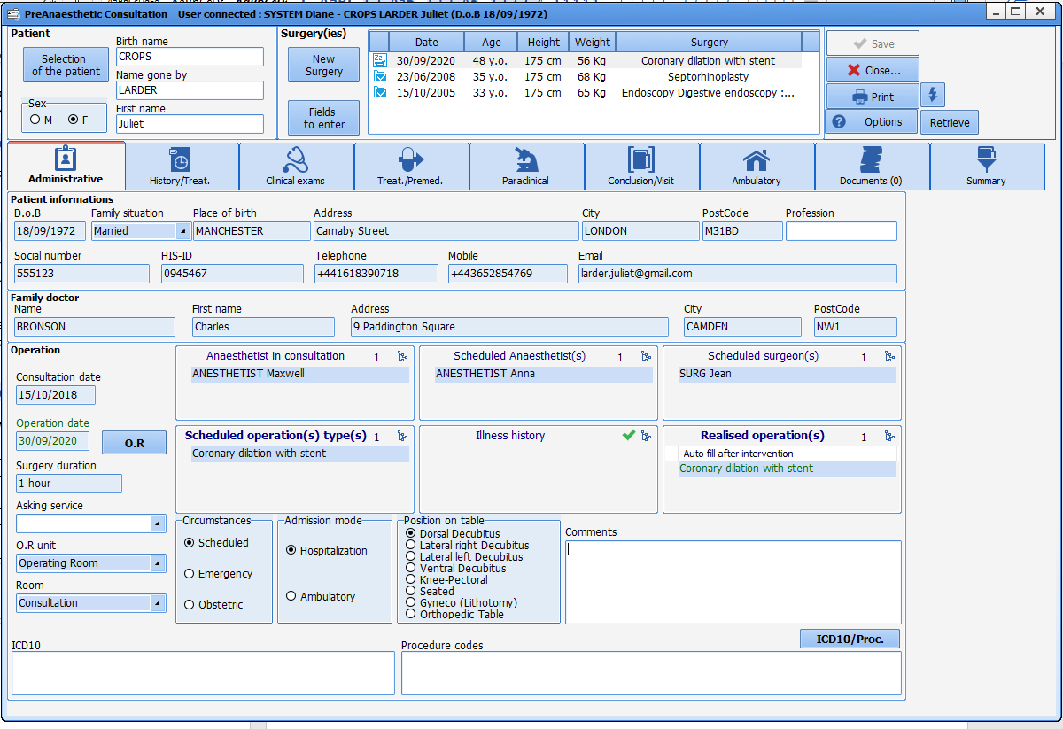
‘Administrative’ tab
Old records available for consultation
Patient’s identity
Information
about
the operation
Notes:
The administrative tab has two parts:
Administrative part: provided by the HIS
Operation part: must be completed

Slide 13
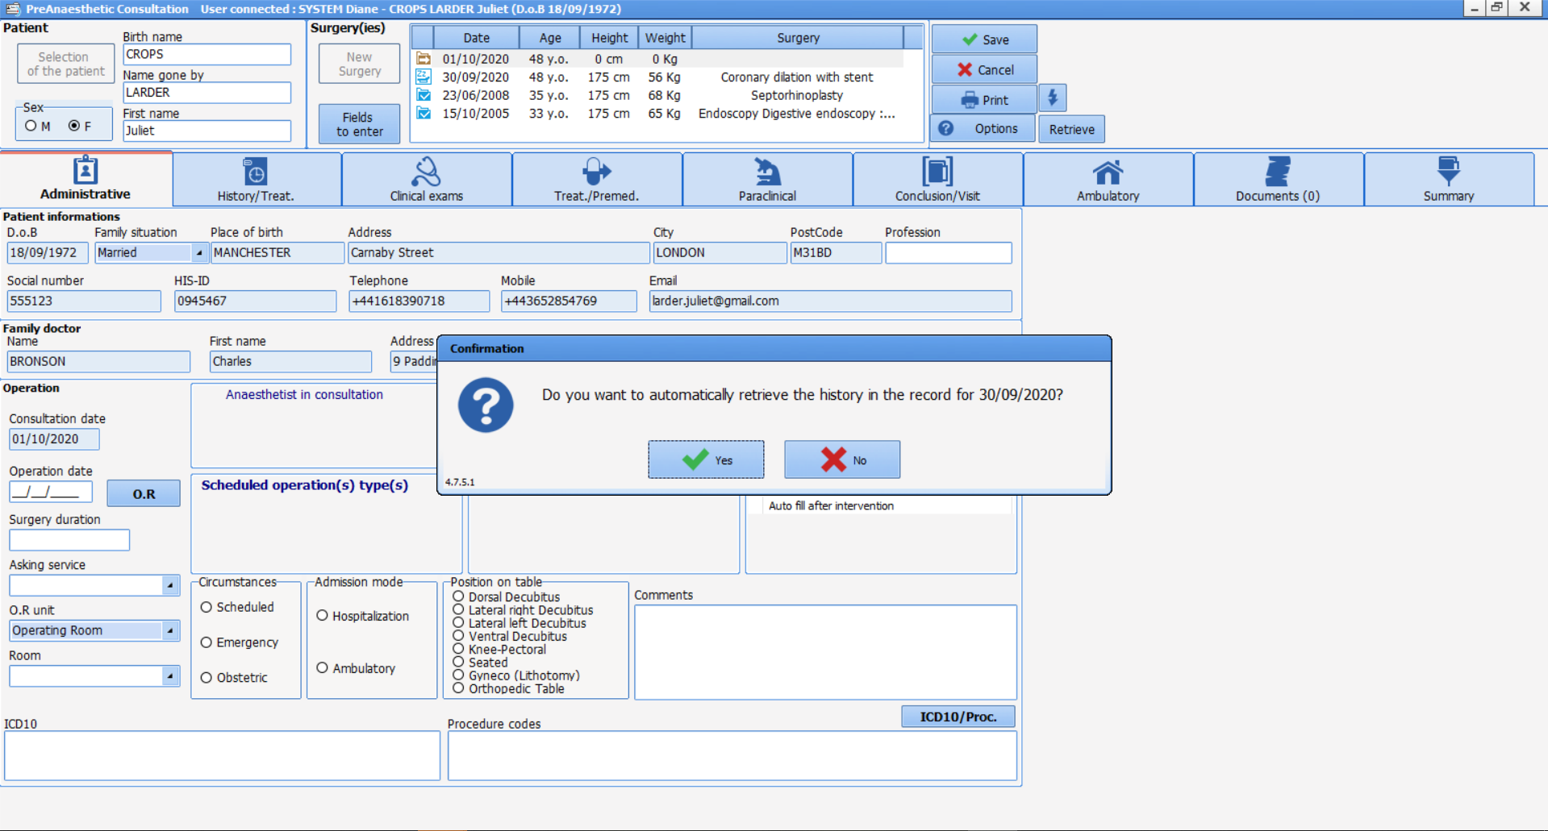
Copying previous information
Notes:
If the patient is registered in DIANE, you will be asked if you wish to copy some of the information from the previous consultation. The range of information copied is set during configuration. In general, all history is copied and surgeries are automatically incremented by the software with the complications reported during the consultation.

Slide 14
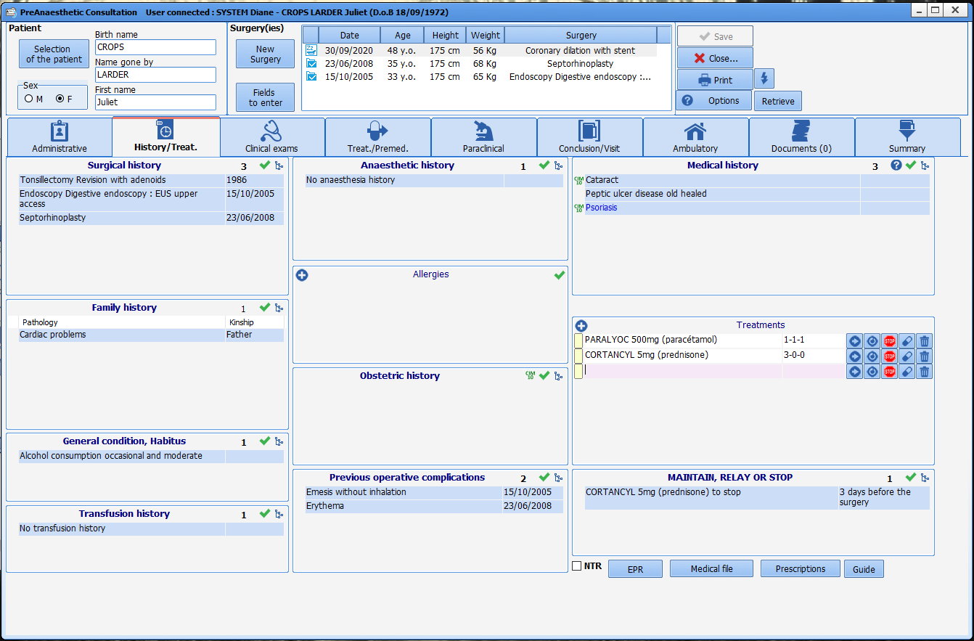
‘History’ tab
Notes:
Each component uses an exhaustive list corresponding to each type.

Slide 15

‘History’ tab
Notes:
Ticking the NTR box will let you quickly confirm the history for a patient who has no history.
The other buttons provide quick access to the EHR and/or the medical record (depending on the interfaces set up).

Slide 16
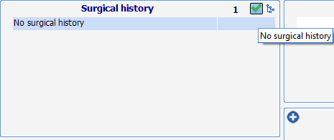
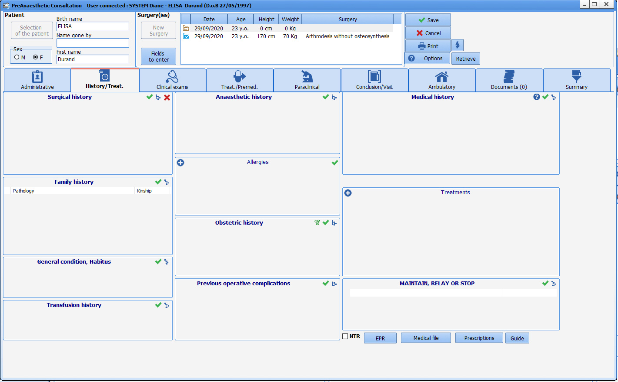
‘History’ tab
Quick entry using the green tick
Notes:
Each component uses an exhaustive list corresponding to each type.
The green tick will allow quick completion using a default item (chosen during the configuration).

Slide 17
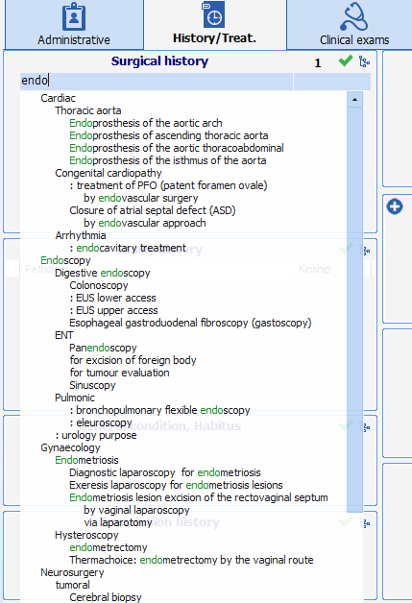
‘History’ tab
Notes:
When you enter the first letters of the word, the search engine highlights the corresponding items in the list.

Slide 18
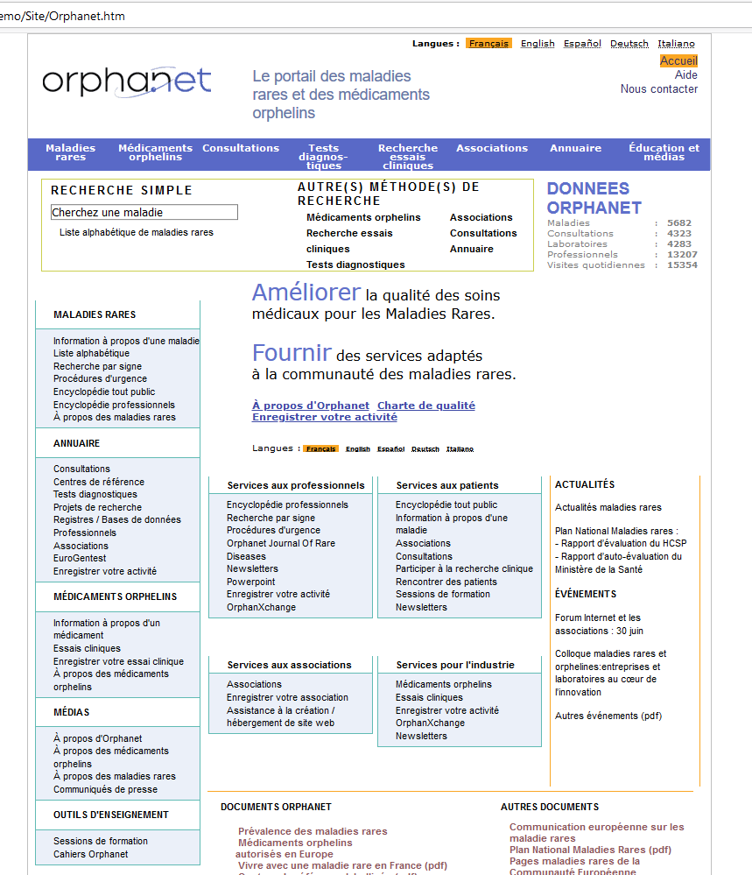
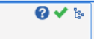
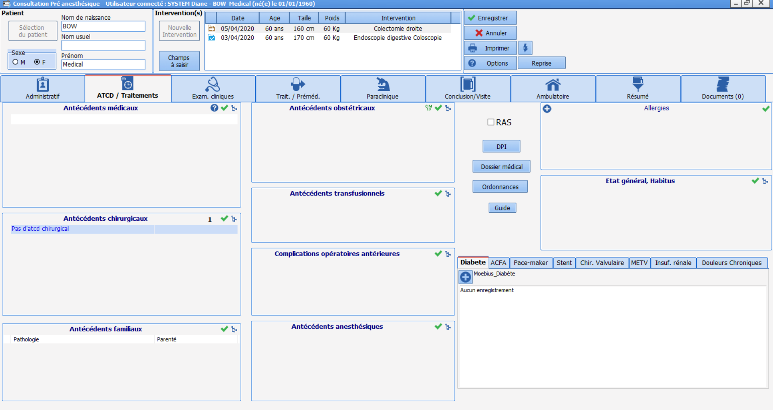
‘History’ tab
Notes:
It is possible to set up quick access to external websites to obtain further information. Here, for example, it was decided to create a link to ‘Orphanet’ (website for rare and orphan diseases and corresponding drugs).

Slide 19
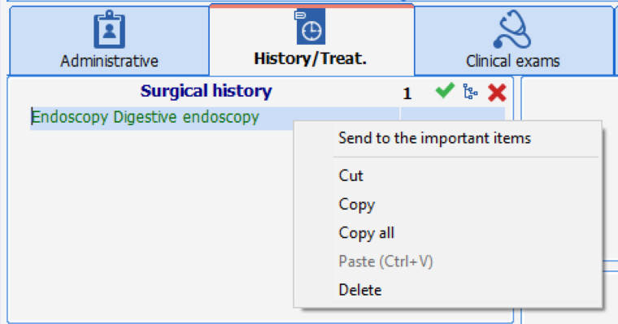
‘History’ tab
Notes:
By right-clicking, items can be sent to the ‘important information’ in the ‘conclusion’ tab.
The information entered in this part is automatically transferred to the ‘treatment’ tab so that you do not have to browse for drug searches.

Slide 20
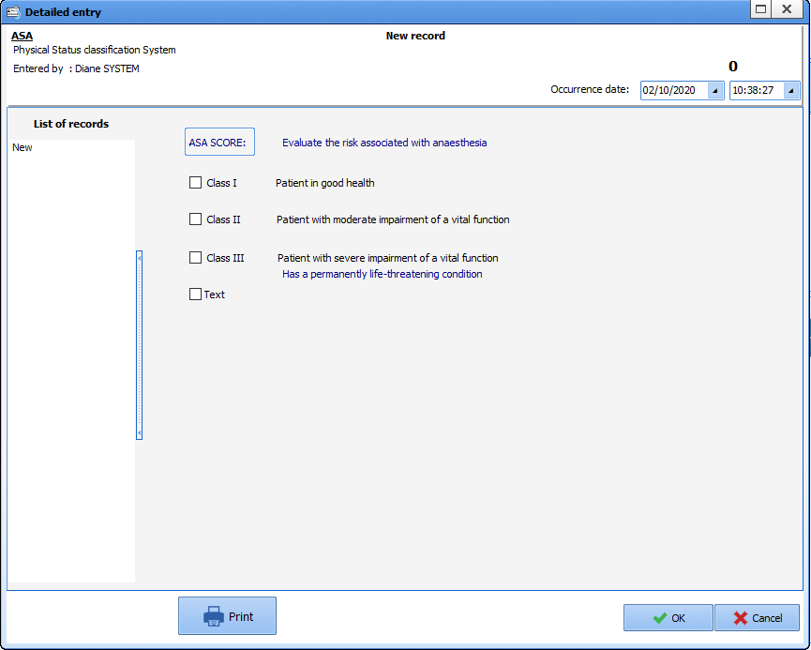
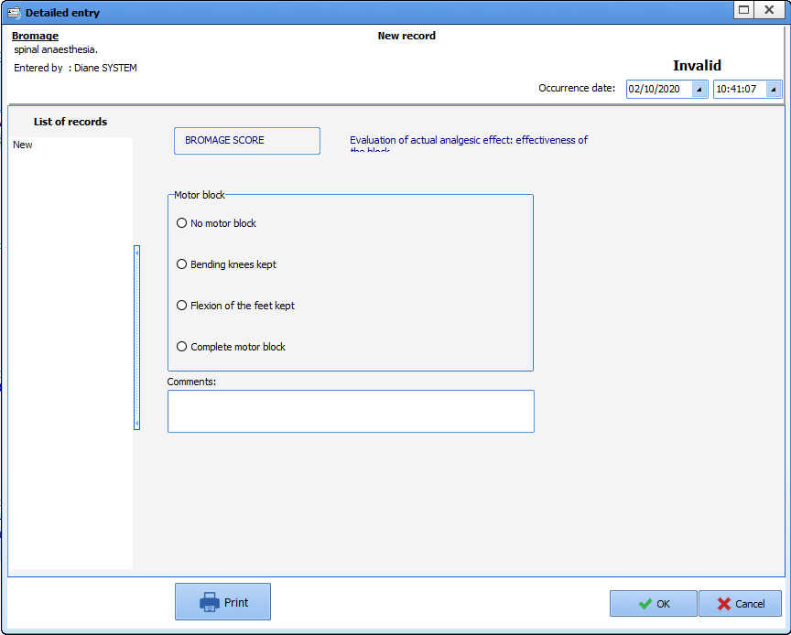
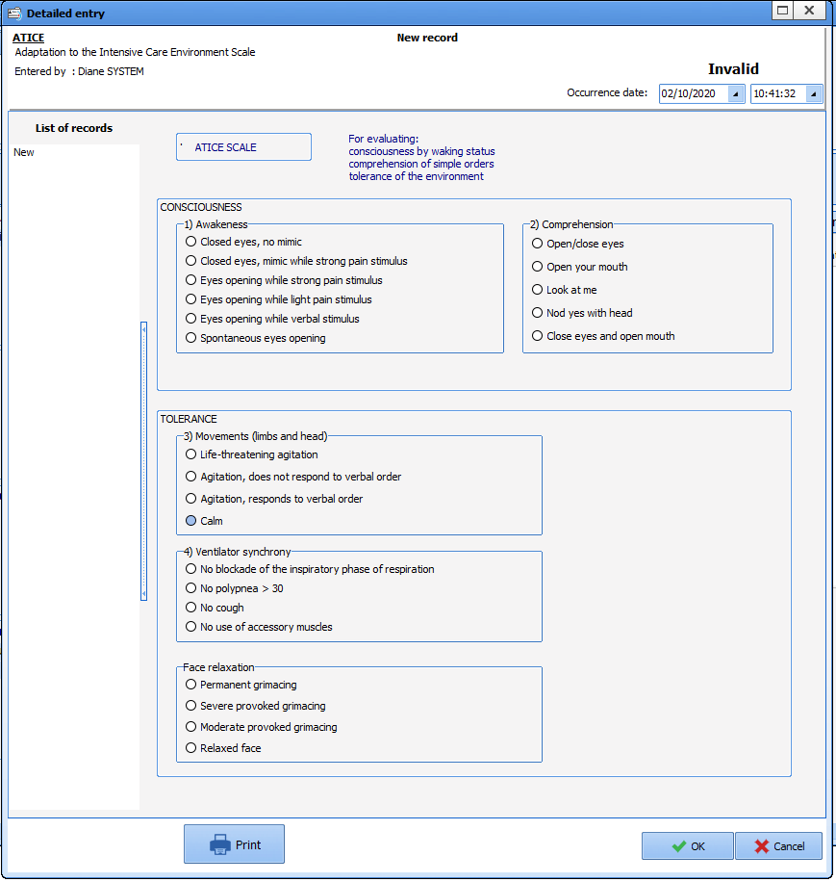
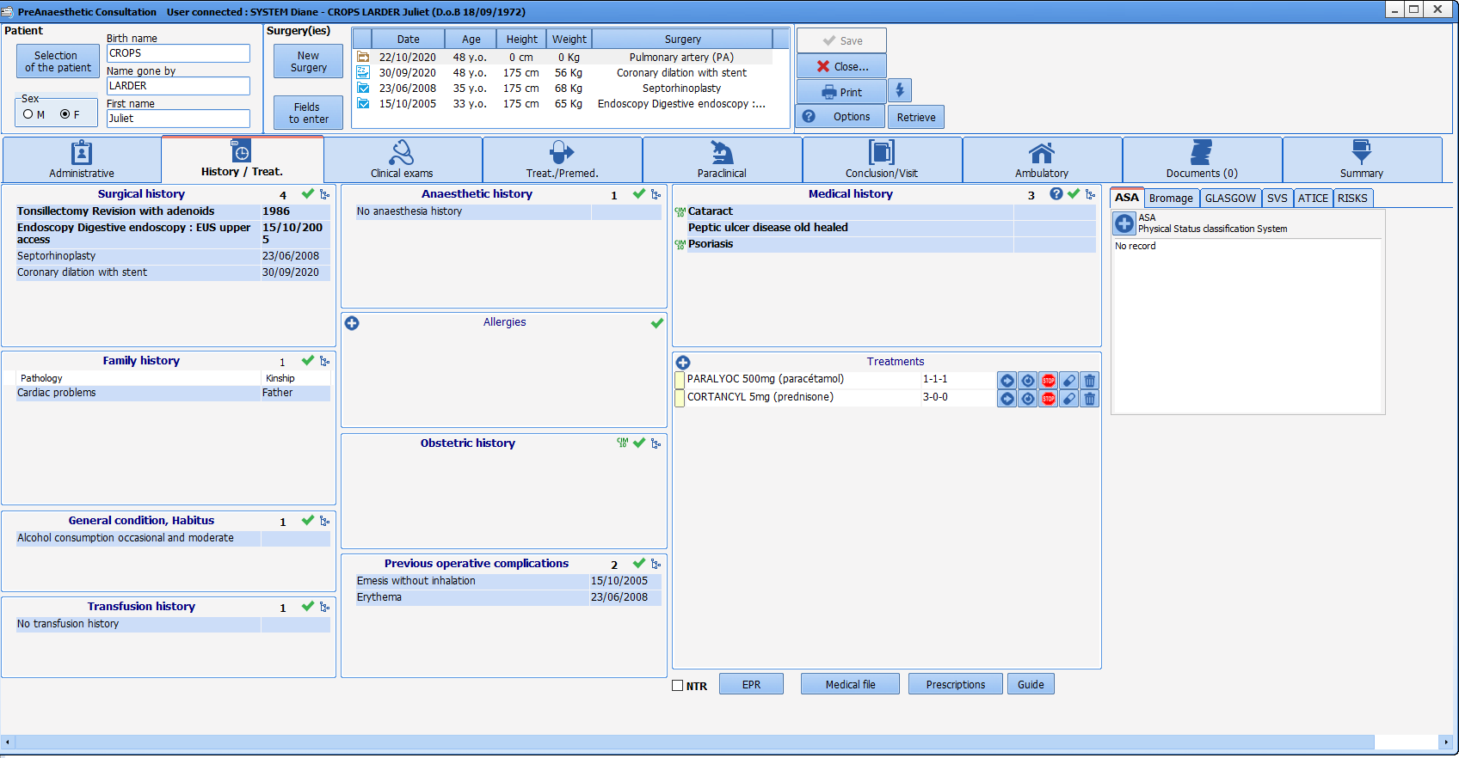
‘History’ tab
History scoring
and details
using Advanced Entries
Notes:
Scoring possible using advanced entries (FAGERSTROM, LEE, MET, diabetes, etc.) provided with the official scores. This enables more accurate assessments. Customizable.

Slide 21
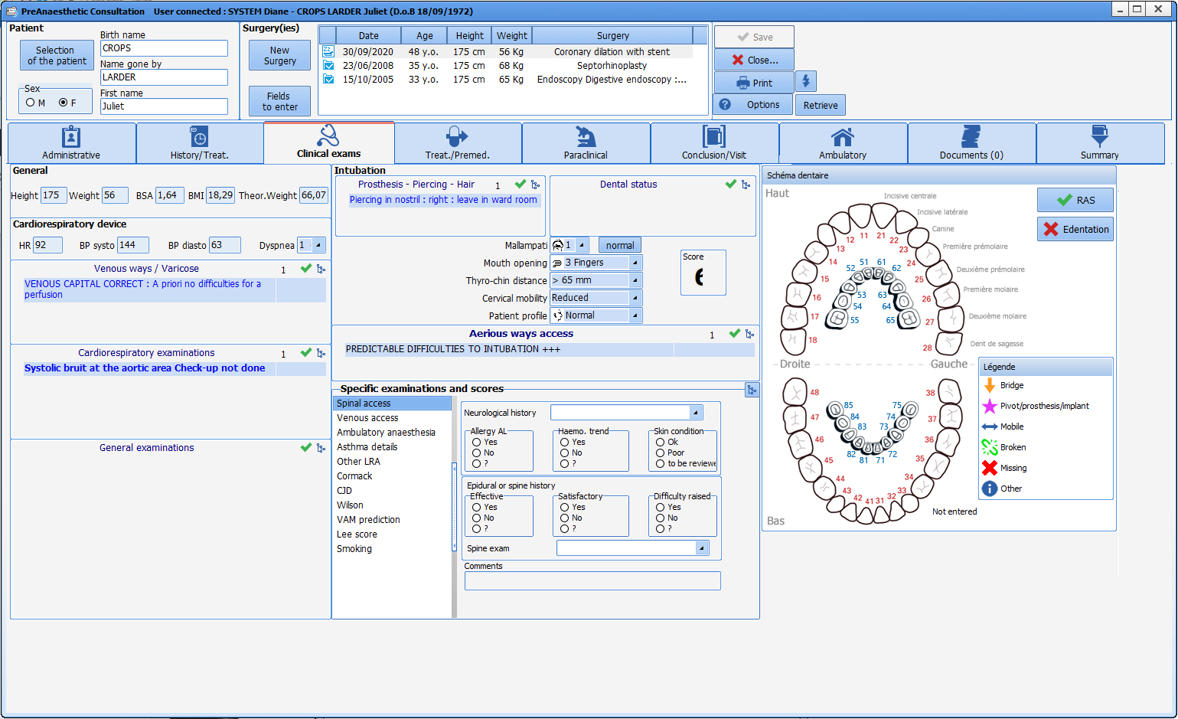
‘Clinical Examination’ tab
Notes:
We will now move on to the clinical examination tab.

Slide 22
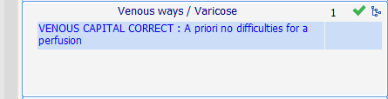
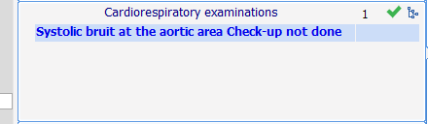
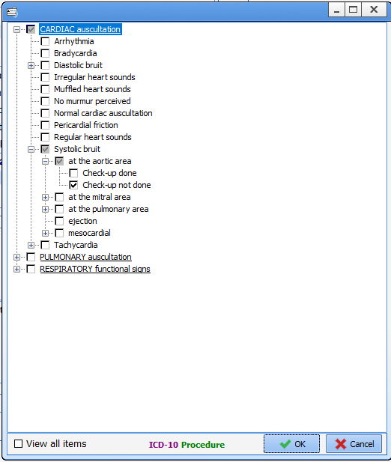
‘Clinical Examination’ tab
Notes:
To track the patient's assessment on the day of the consultation. We see the examinations carried out today: cardiopulmonary exam, general exam, etc. Again, each component uses an exhaustive list corresponding to each type.
Writing the first letters of the word you are looking for will quickly call up the item in the list.
The green tick will allow quick completion using a default item (chosen during the configuration).

Slide 23
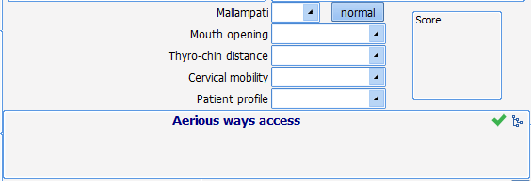
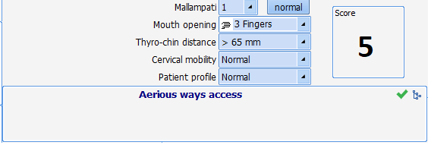
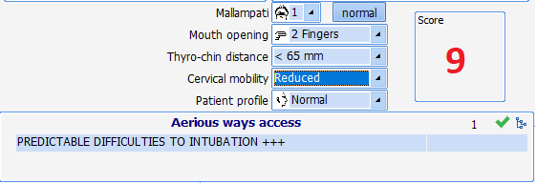
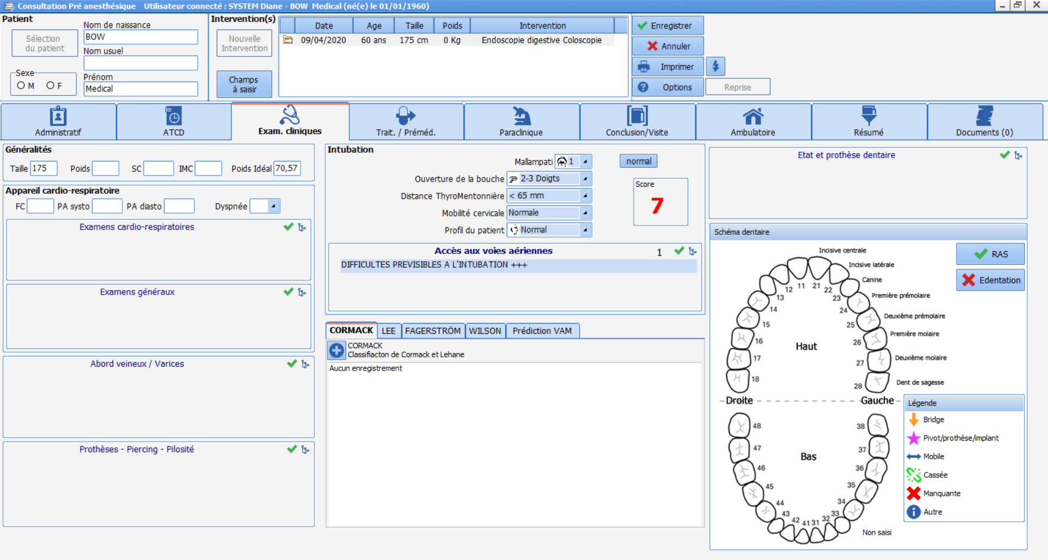
‘Clinical Examination’ tab
Notes:
To evaluate the intubation score: the ‘normal’ button lets you fill in the items directly.
If the score is 7, it is red and generates the information ‘intubation problems foreseeable’.

Slide 24
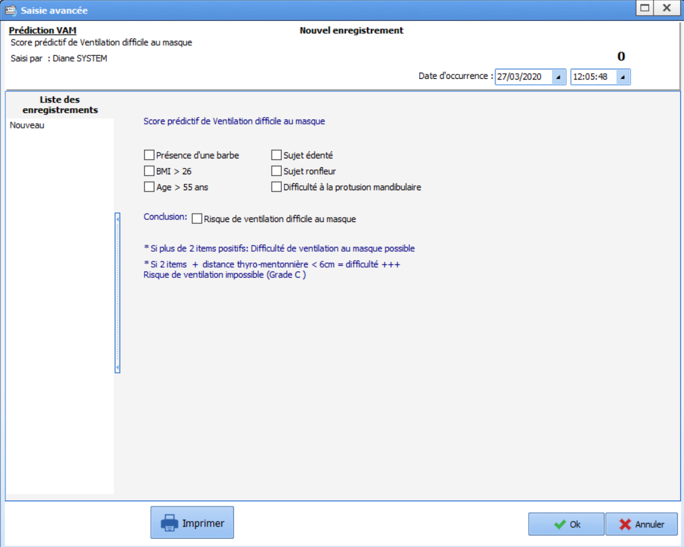
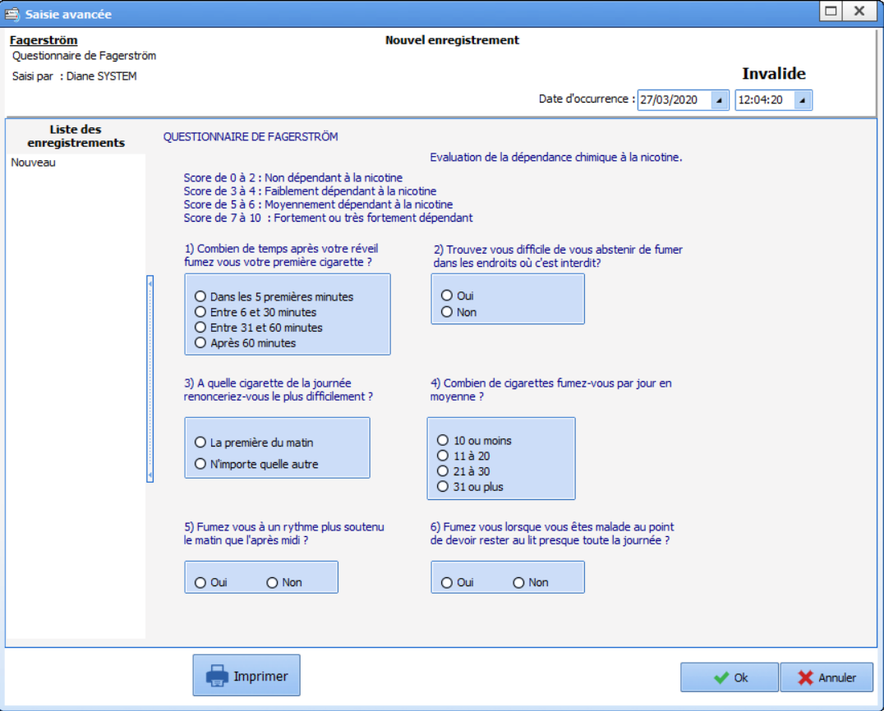
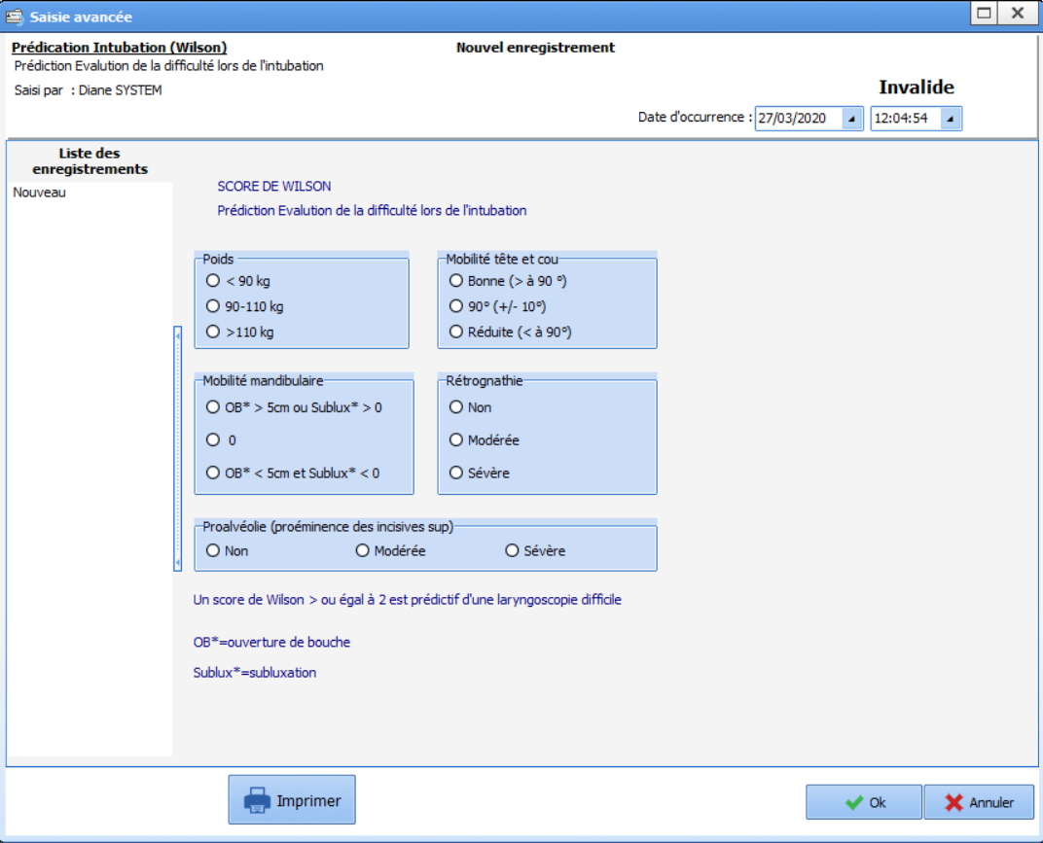
‘Clinical Examination’ tab
Scoring
and evaluation
using Advanced Entries
Notes:
There are also AEs here to carry out scoring with the official scores (evaluation of ventilation problems, intubation prediction, Apfel score, etc.). Customizable.

Slide 25
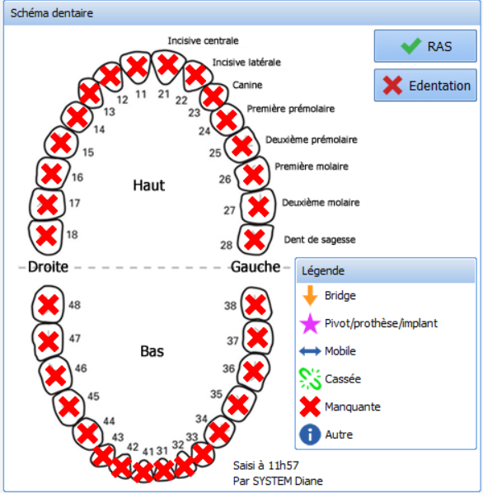
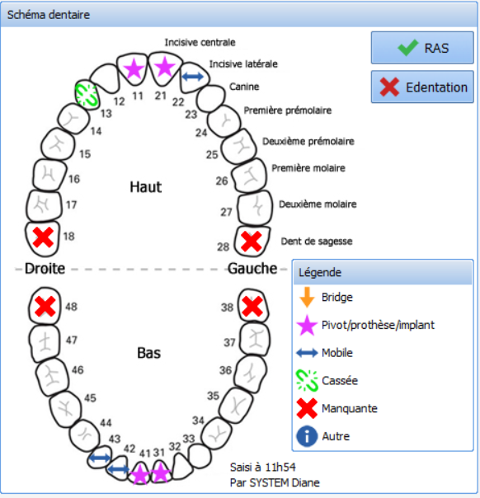
‘Clinical Examination’ tab
Notes:
The dental diagram gives a visual overview.
By pressing the ‘edentulous’ key all teeth will appear as ‘missing’. We can send clear and unequivocal important information such as pivot crowns, bridges, etc.
The tool is easy to use and lets you provide clear information.

Slide 26
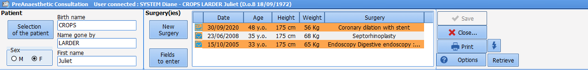
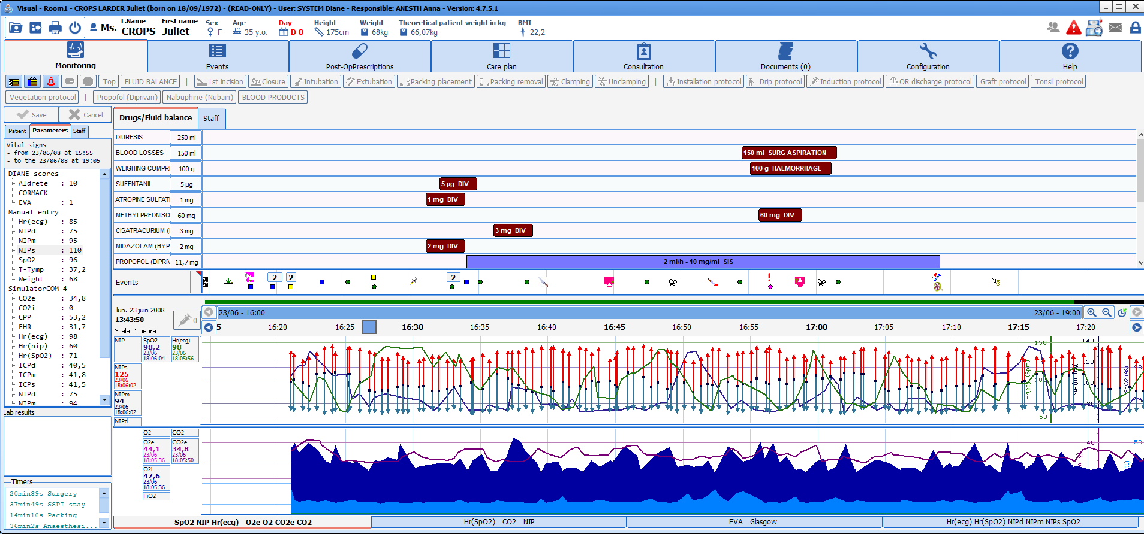
Viewing a previous record
Feasible at any
time during the
consultation
Notes:
Note that a previous record can be viewed at any time during the consultation. This lets you search for specific information.

Slide 27
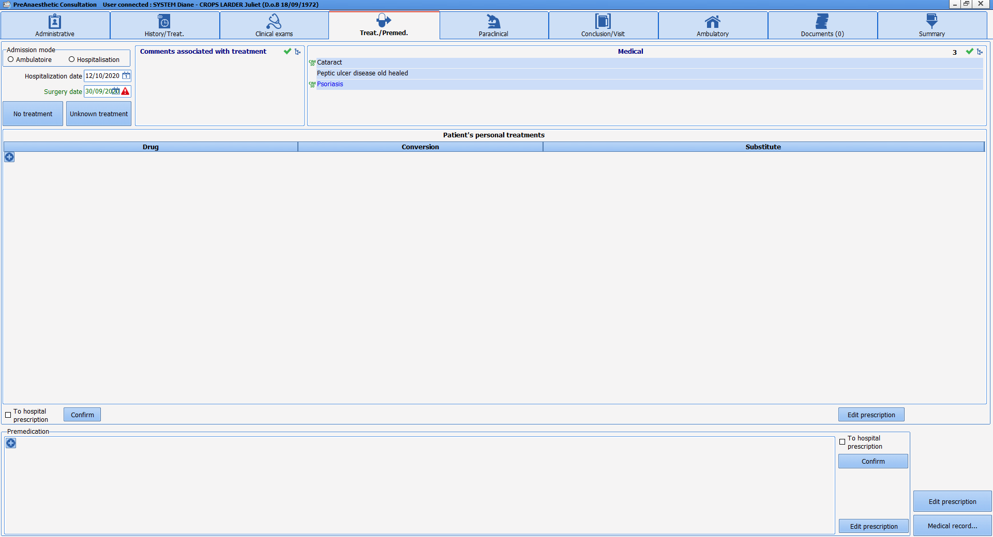
‘Treatments / Premedications’ tab
Notes:
Now let's go to the ‘Treatments / Premedications’ tab

Slide 28
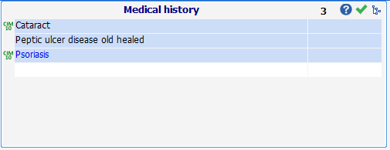
‘Treatments / Premedications’ tab
Notes:
We can see that the medical history has been automatically inserted at the top of the page. You can add more at this time if you wish. The content of the previous tab will be supplemented simultaneously.

Slide 29
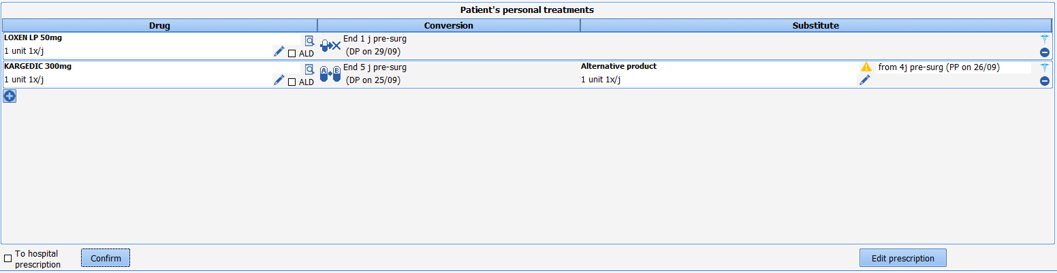

‘Treatments / Premedications’ tab
Patient treatment management
Notes:
Entering the patient's treatment lets you make the related choices such as discontinuation, switches or maintenance.
Note the simple completion, help with choices, choices that can be changed using the pencil on the right: these proposals are configured in the software and can be adapted to your preferences during configuration while it is possible to make changes during the consultation for special cases.
Example of Loxen which proposes discontinuing 2 days before, Kardegic 300 results in the proposal to decrease to 75 mg, or for Previscan, a switch to Lovenox.

Slide 30
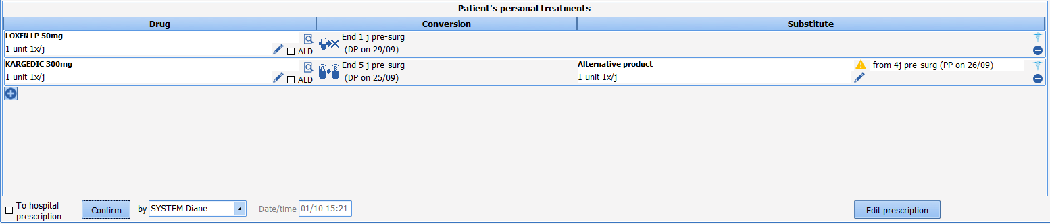
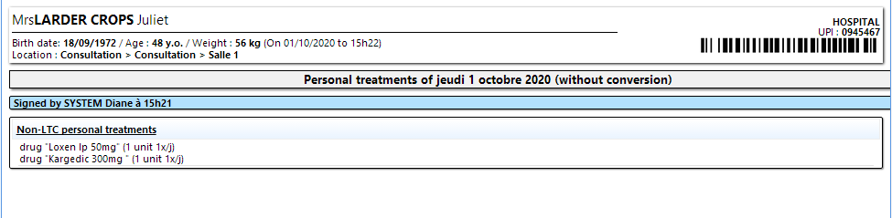
‘Treatments / Premedications’ tab
Generating the prescription
Notes:
The ‘generate prescription’ button generates the prescription which will allow the patient to pick up their drugs from the pharmacy and manage their treatment in anticipation of surgery.

Slide 31
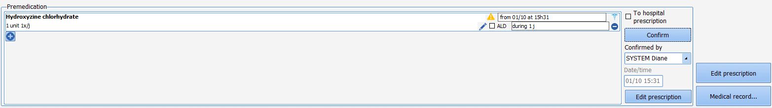
‘Treatments / Premedications’ tab
Managing premedication
Notes:
Premedication is also generated from this tab and can be incremented via an interface in the EHR.

Slide 32
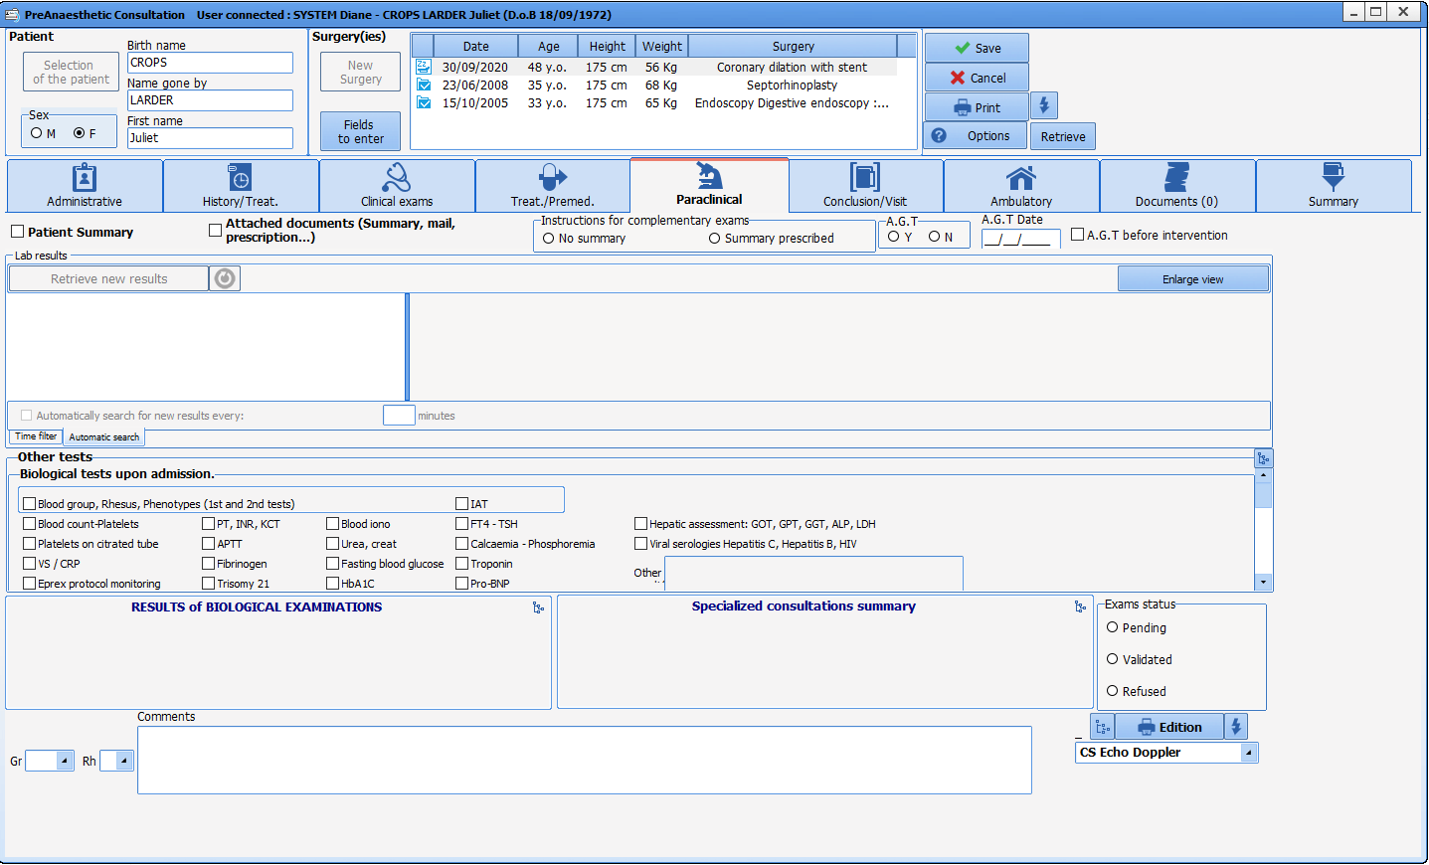
‘Paraclinical’ tab
Notes:
The paraclinical tab lists the assessments in the patient's possession. We can also order assessments and request further tests, etc.

Slide 33
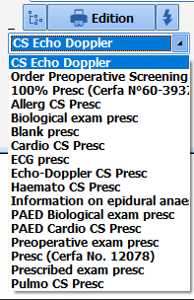
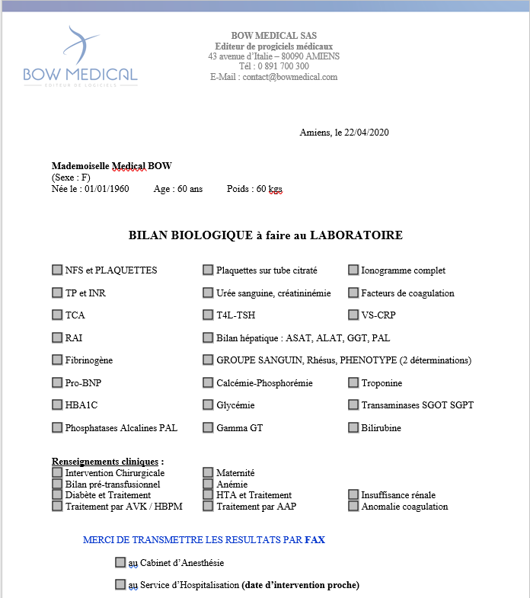
‘Paraclinical’ tab
Notes:
Prescriptions and letters requesting specific tests are generated by clicking on the print button after selecting the desired items.

Slide 34
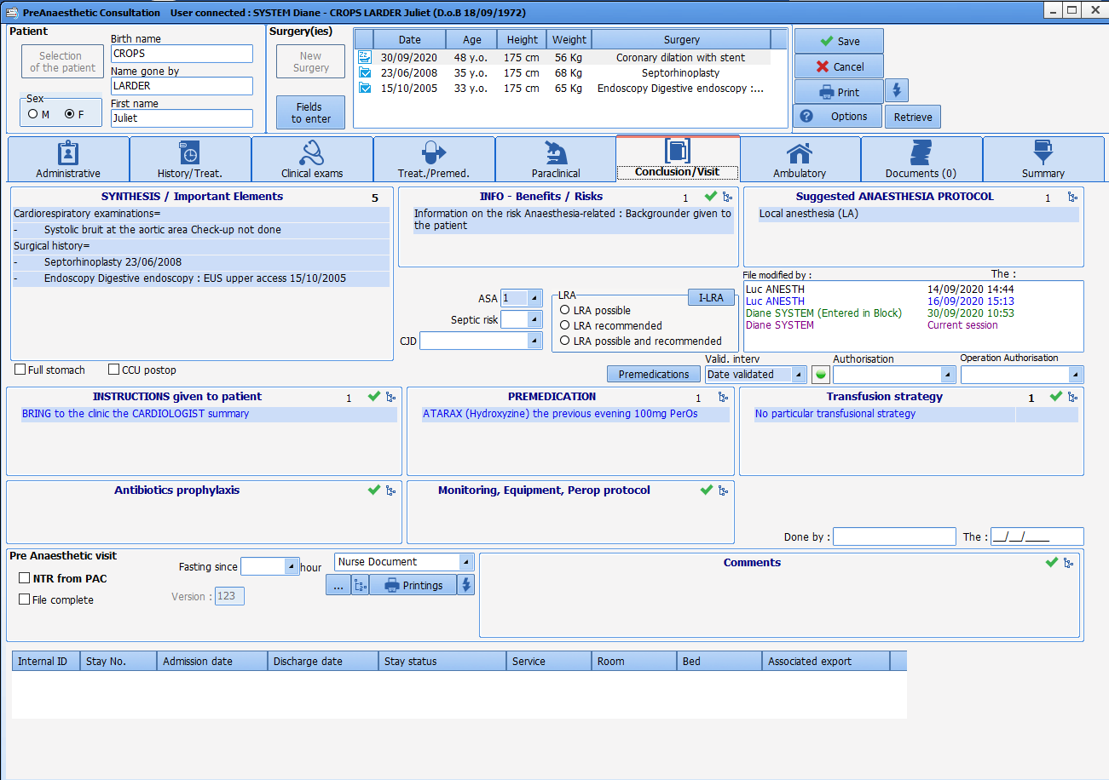
‘Conclusion’ tab
Notes:
Now let's go to the ‘Conclusion’ tab. As its name suggests, this tab shows a recap of the consultation that has just taken place.
The information is completed like the previous tabs… using the green ticks or the first letters of the words entered.

Slide 35
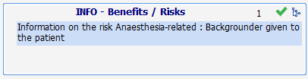


‘Conclusion’ tab
Notes:
On the left, you will find information relating to specific instructions and information given to the patient.

Slide 36




‘Conclusion’ tab
Notes:
Associated with this pane is a pane with printable documents such as the surgery authorization, information documents, compression stocking prescriptions, etc. You can also generate documents to help patients (recap of instructions, explanation to help put on stockings, etc.) or any document you usually give patients. These documents are created through the configuration.

Slide 37

‘Conclusion’ tab
Notes:
In the central pane, we can see that the important parts of the medical history are displayed to enhance the recap and help choose the anaesthesia strategy by having the necessary information in front of you.

Slide 38


‘Conclusion’ tab
Notes:
On the right, we find everything related to the anaesthesia strategy: chosen anaesthesia technique, instructions for ATB prophylaxis, monitoring and transfusion strategy.
These items are completed in the same way (green tick, list).

Slide 39

‘Conclusion’ tab
Notes:
Here is an example of what we can see.

Slide 40

‘Summary’ tab
Notes:
Next is a summary tab, with all of the consultation information on one page.

Slide 41

‘Documents’ tab
Notes:
Lastly, there is a ‘Documents’ tab that lets you file in the record all the documents that could be collected during the consultation by scanning or importing them. Here we can see the consultation that was printed and saved... these can be specialists’ letters, an ECG, etc.

Slide 42



Closing the consultation
Items can be made
mandatory
for closing
to avoid any oversights -
completely mandatory
or just reminders
Notes:
By closing and saving the consultation you can generate a document containing everything that was noted during this consultation. If the facility chooses, this document can be sent as a pdf to the EHR. From this point, the consultation can be accessed from any computer that has the DIANE software and the report accessed via the EHR.

Slide 43
          Generating a CONSULTATION REPORT
Notes:
The preoperative assessment report

Slide 44

Pre-Op assessment report
Notes:
Here is an example of a preoperative assessment report. All the information collected during the consultation is automatically inserted in the appropriate areas.
This document is customizable and you can choose the order in which the information is displayed.
The visual display is customizable.
The lettering and order of the components can be adapted to suit each practitioner.

Slide 45
Thank you for your attention

