Slide 1

Intensive care

Slide 2
CONTENTS
    General information
      Arrival in the unit
      Different connections to medical devices
      Mirror computers
      Offline mode
      Project initialization / preconfigured database / key users
  Intensive care
      List of hospitalized patients
      Record / Administrative / Patient ribbon
      Doctor tab
      Paramedical tab
      Medication order
      Care plan
      Body diagram / Invasive materials
      Laboratory
      Views
      Germs
      SAPS II / Marker procedures / Procedure codes
      Report
      Blank record / Continuity between anaesthesia and ICU

Slide 3
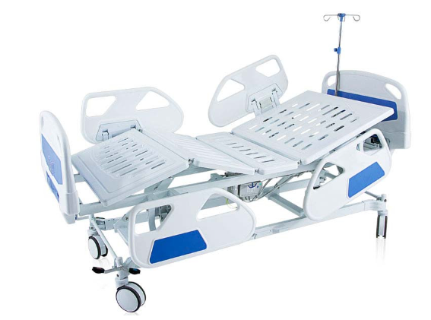


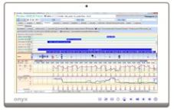
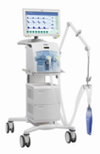
Arrival in the units
RS232
RS232
RS232 server
ICU: a ‘main’ desktop computer for each bed
CCU: a ‘main’ desktop computer for 1 or several beds
RS232
TCP-IP
1GB Hospital Lan

Slide 4




Connecting MD
Multiple connection possibilities:
Via direct RS-232
Via RS hub
Via direct HL7
Via interface server
Medical
equipment
Direct
RS-232
Biomedical network
RS-232
RS-232
hub
Hospital
networks
Interface
server
HL7
Central Gateway
Medical
equipment
HL7
Equipment
connected

Slide 5
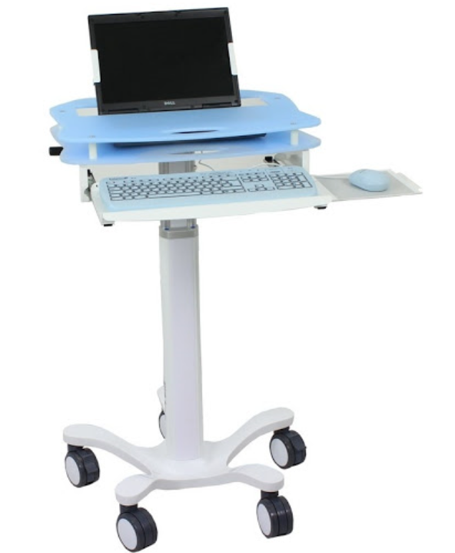
Mirror computers
Mirror computers:
Mobile
Full list of hospitalized patients
Read / write access to all records for multiple users simultaneously
gives access to all records for all units from the portal
Mirror computers:
Mobile
Full list of hospitalized patients
Read / write access to all records for multiple users simultaneously
gives access to all records for all units from the portal
Operating theatre
Recovery
ICU
CCU
‘Main’ desktop computers
1 PC that can manage 1 to 8 beds
grouping the connection
to the medical devices

Slide 6




Offline mode
Patient records and settings are loaded locally:
Responsive (no request to server)
No interruptions if connection with server is lost
.dat
Consultation
Consultation
Diane server
Diane server
Database
Main computer
Mirror computer
Intraoperative
Intraoperative

Slide 7
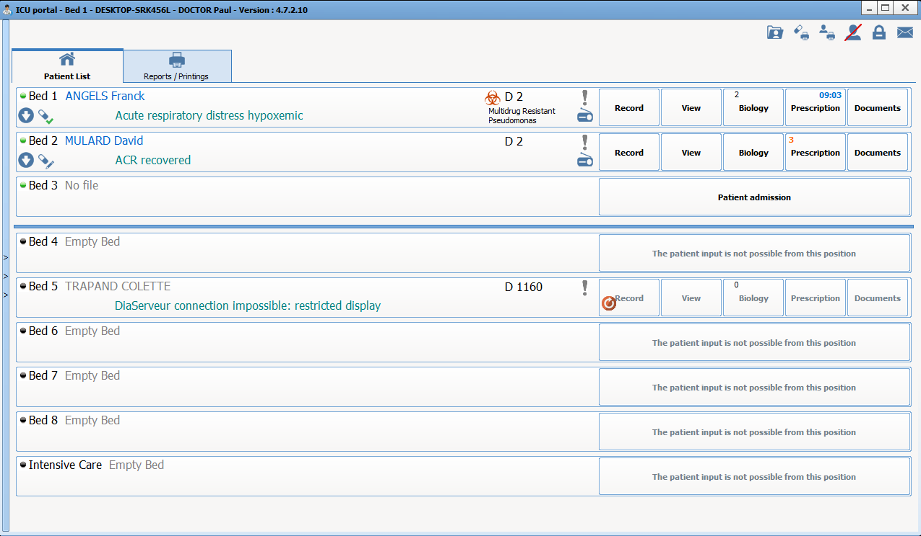
List of hospitalized patients
Overview of the unit
Patient information
View of nursing notes
Record access buttons
Notes:
This list of hospitalized patients lets you quickly see the unit’s situation - Who is there - and why
Stress the fact that we have clinical information on the patient including the reason for hospitalization, MDRB colonization, etc.
If you hover over the radio you will see details of the specific notes provided by the paramedical team to help understand the interventions and the patient's condition.
This display is important for all the people arriving in the unit when they come on duty, or when interventions need to be carried out, etc.

Slide 8
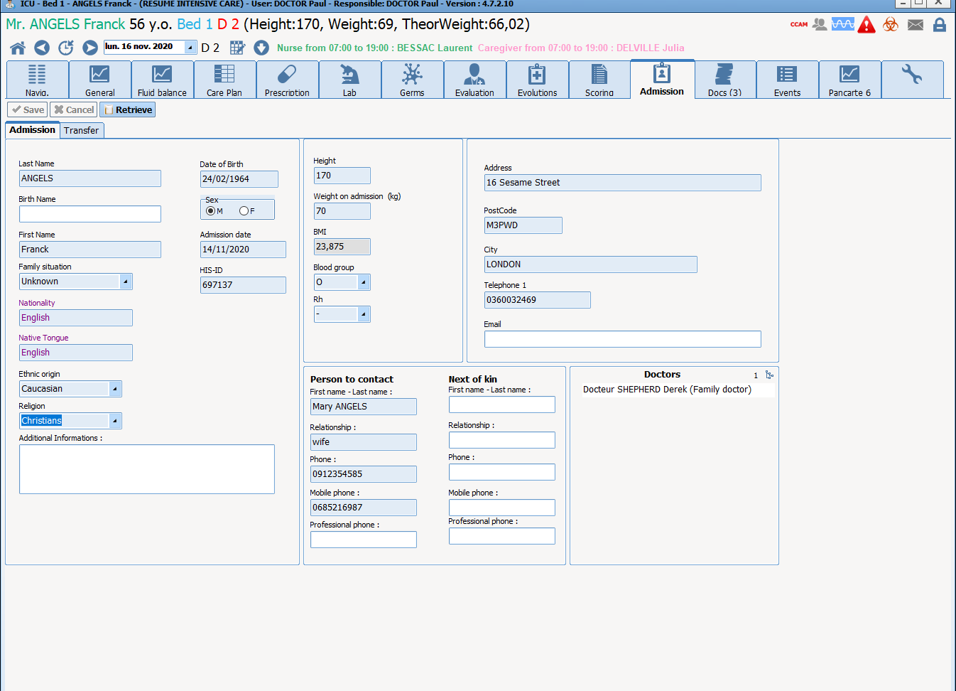
Administrative / Ribbon
Patient ribbon always displayed to rapidly identify them
Administrative data imported and integrated into the view
Notes:
The ribbon is displayed regardless of where we are in the record, to comply with identity monitoring criteria.
The configurable grids let you display administrative data, trusted persons and persons to notify and any other information that the unit would like to track.
Some of this information is imported from the identity/movement server.

Slide 9
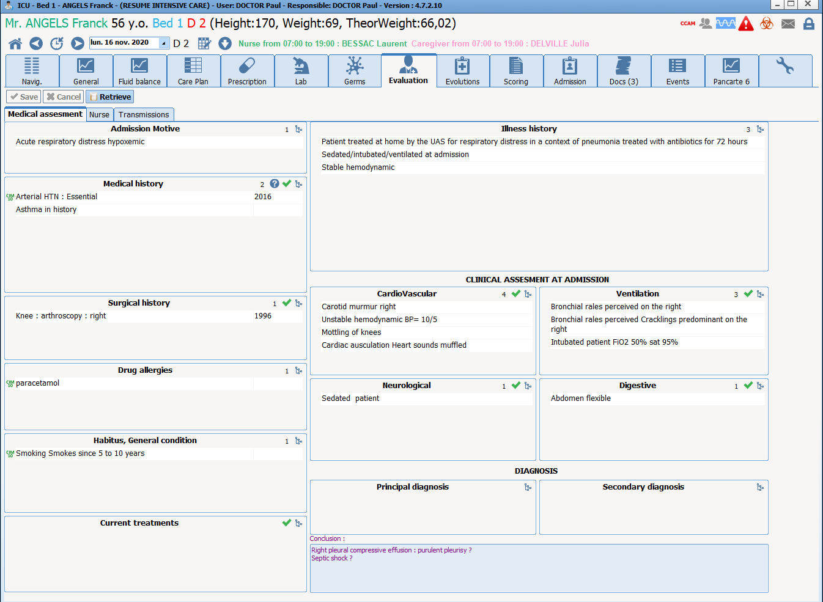
Doctor tab
- Patient overview
- See at a glance who this patient is (history) and why they are in the ICU (clinical examination / conclusion)
Notes:
It is important here to stress that this display gives an overview of the patient's history and the reasons for admission to the ICU.
Also show how to enter history simply via the menus or free text using the keyboard.

Slide 10
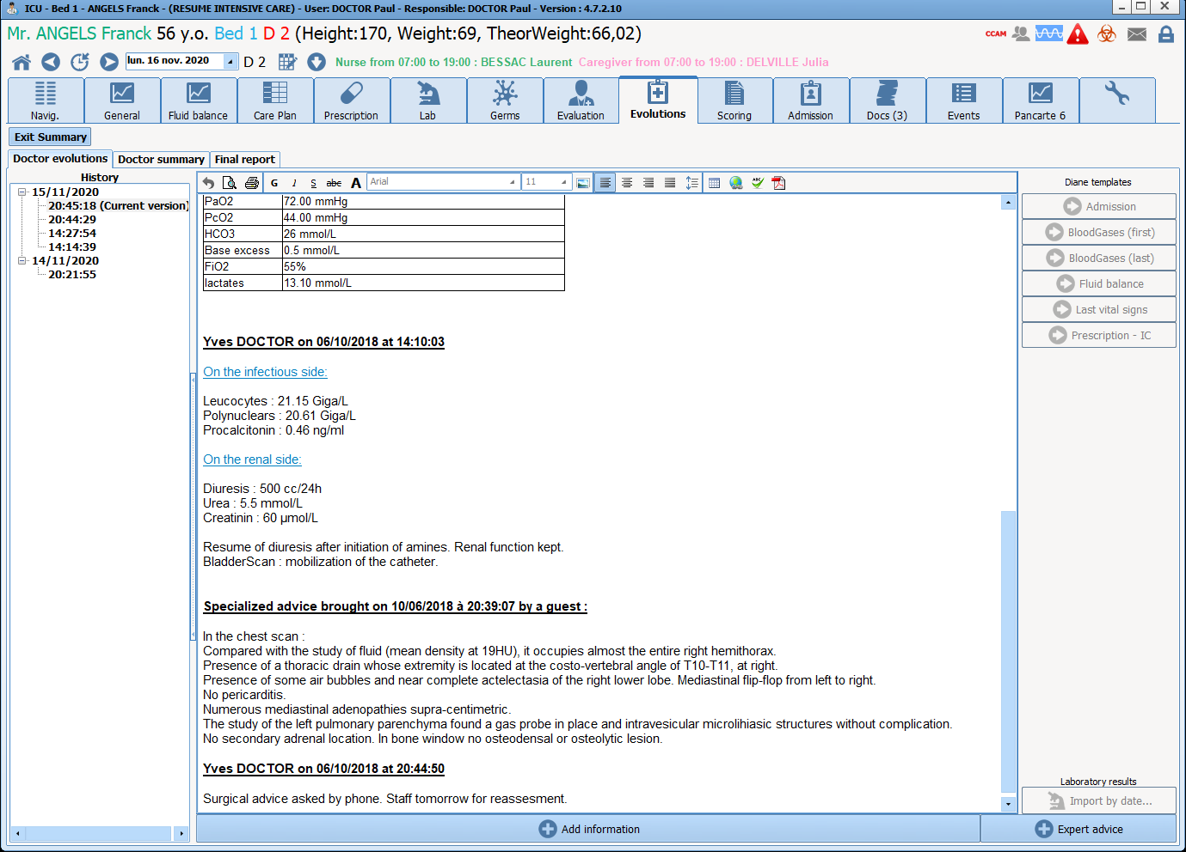
Changes
A simple word processing tool to enter and look at patient changes
Show how to add information using the buttons (including ‘latest blood gas’)
Notes:
This is a very simple tool to use. It is a comprehensive word processing tool (allowing you to copy/paste text and images).
It is important to show the buttons to clarify that the doctor does not need to browse through the different tabs to get the information needed.

Slide 11
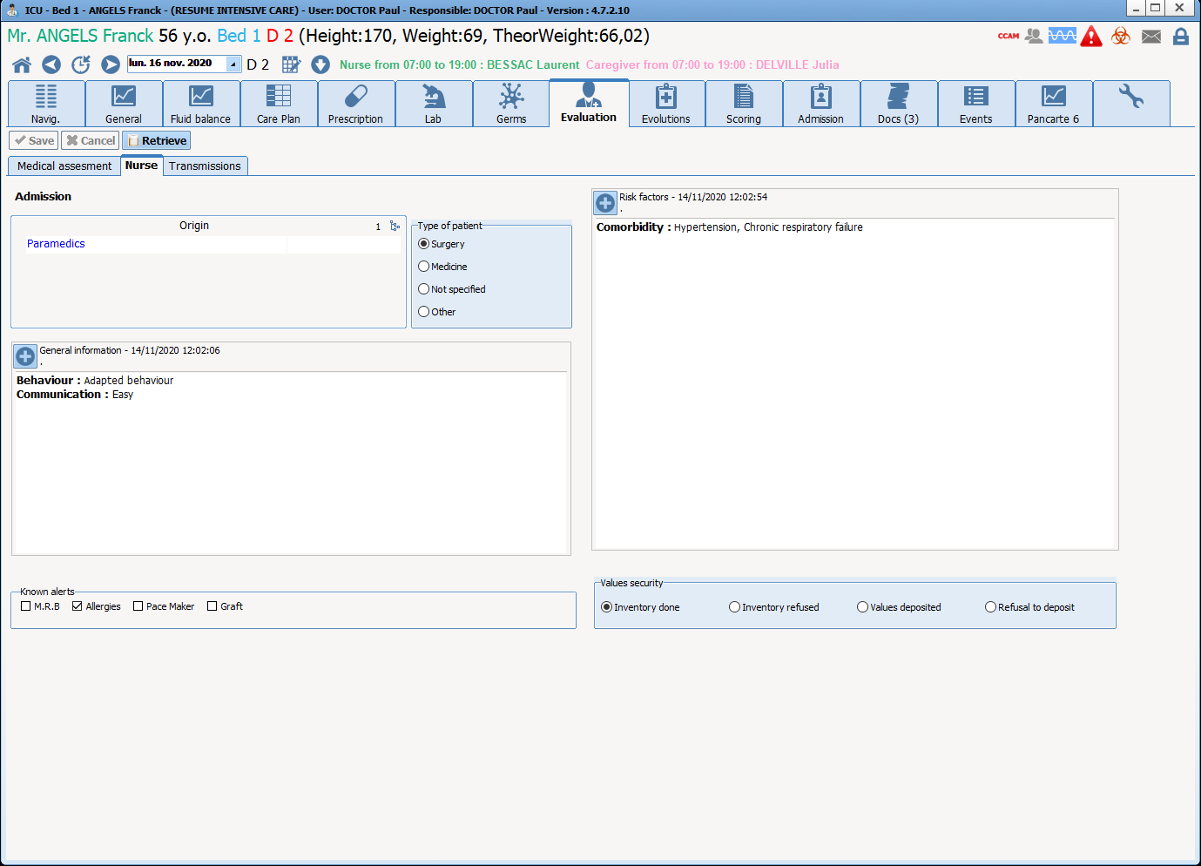
Paramedical tab
Arrival and transfer summary record:
- Patient overview
- Same information as in the medical tab for the history
+ data adapted to the paramedical team
Notes:
Show here how information is shared between doctors and the paramedical team.
Everyone has access to their own tab with customized views, but with the same information.

Slide 12
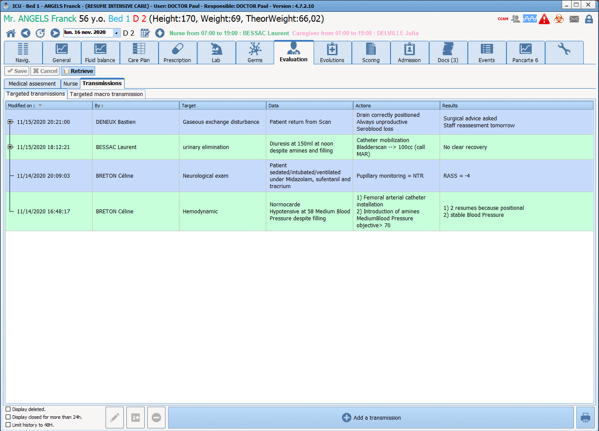
Nursing notes
Ranked in chronological order and by specificity
Add information to a specificity to show that it is easy to use and how the ranking changes
Also see the other tabs
Notes:
The nursing notes tab displays a summary of lots of information entered by the paramedical team.
Add information to show quick data entry then updated display.
The other tabs are also important for other staff (physiotherapist, dietitian, etc.).

Slide 13
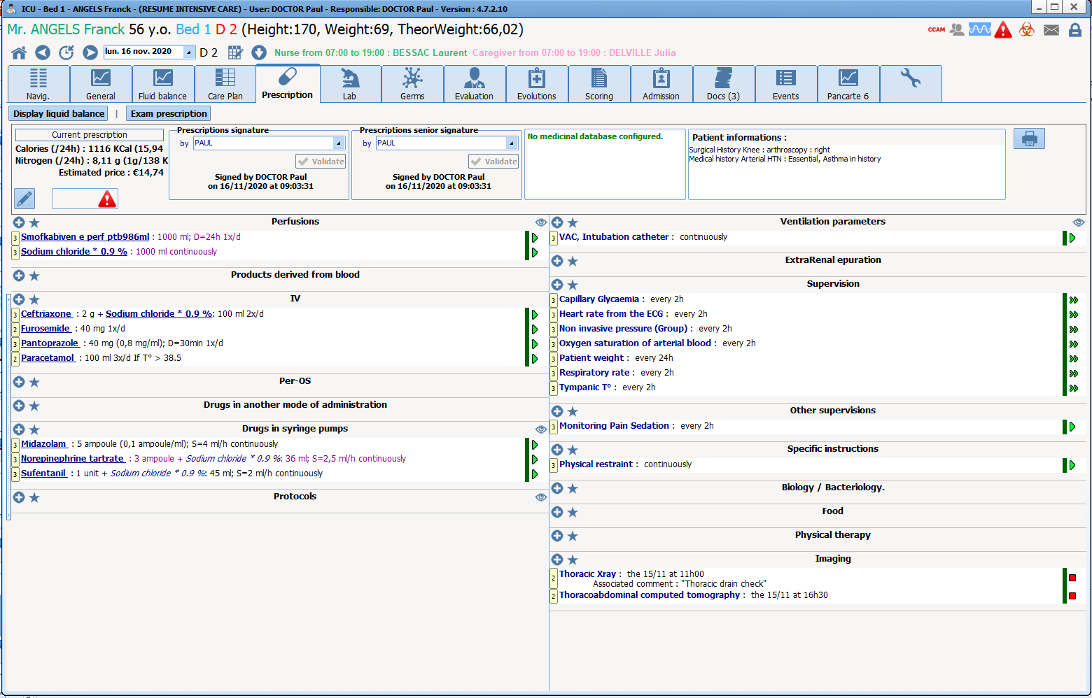
Medication order
- Summary view of the current medication order
- Gives a quick view of the patient's condition and care
View of history / allergies / treatments
Access to the monograph for each drug
Notes:
The medication order tab view lets you display the entire order on one screen.
Without doing anything, the way the different fields are organized and the summary of each medication order line lets the doctor quickly see everything active.
Displays allergies, medical history and personal treatment to give the doctor a reminder right here.
Direct access to the monograph for each drug.

Slide 14
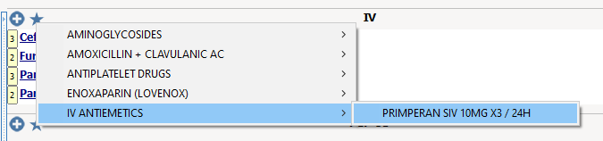
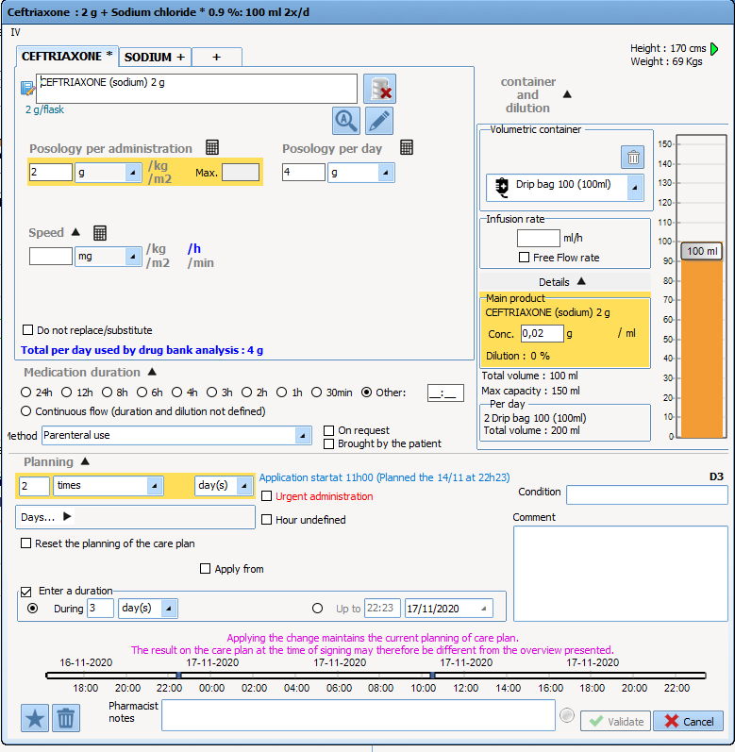
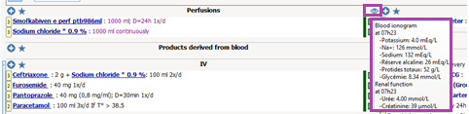
Medication order
Show how to quickly add a medication order using favourites (analgesic / Tramadol)
Then how to change a medication order and all the automatic calculations
Also see how the charts change based on the chosen dosage
Show the data displayed by the eyes
Notes:
Medication order favourites let you quickly enter new medication orders and respond to almost any situation. Once selected, show that we can still change this favourite.
In the medication order window, specify that the yellow items are items defined in the favourites or by the prescriber. All other items are calculated automatically.
We can very easily select another medication order unit (e.g. with µg/kg/min).
The real-time changes to the charts at the bottom right of the window are also important to show because they help doctors understand what they are prescribing.
The eyes are one of DIANE's major advantages, as they give very easy access to the patient's clinical data. Show that the data displayed is adapted to the field.

Slide 15
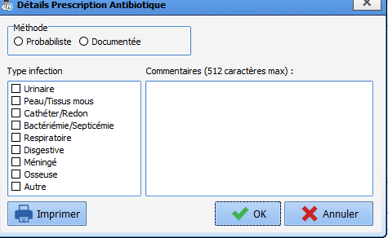
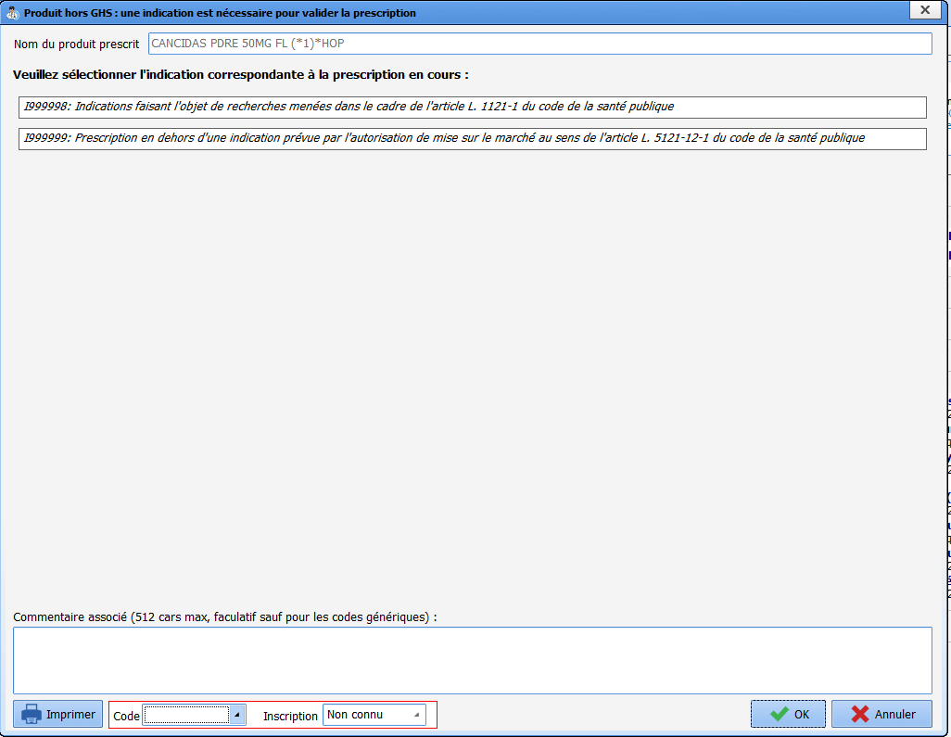
Medication order
Antibiotic tracking window
Provide procedure codes when prescribing drugs not included in the all-inclusive rate
Notes:
This part is particularly important for pharmacists.
For drugs not included in the all-inclusive rate, this data entry allows the reimbursement of expensive drugs. Example: prescribing Cancidas under antibiotics.

Slide 16
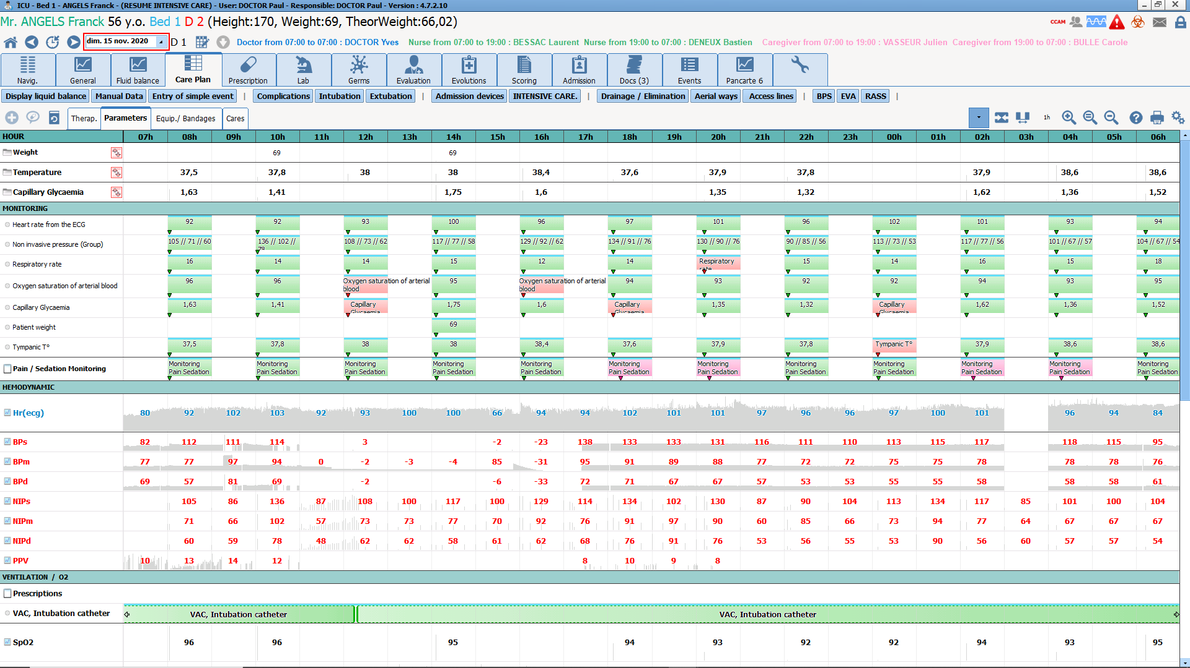
Care plan
Parameters tab
Display of vital signs retrieved automatically.
Monitoring of vitals with validation of data collected.
Notes:
Show how vitals are confirmed. DIANE proposes the data from equipment connected to DIANE.
The different data are cross-referenced.

Slide 17
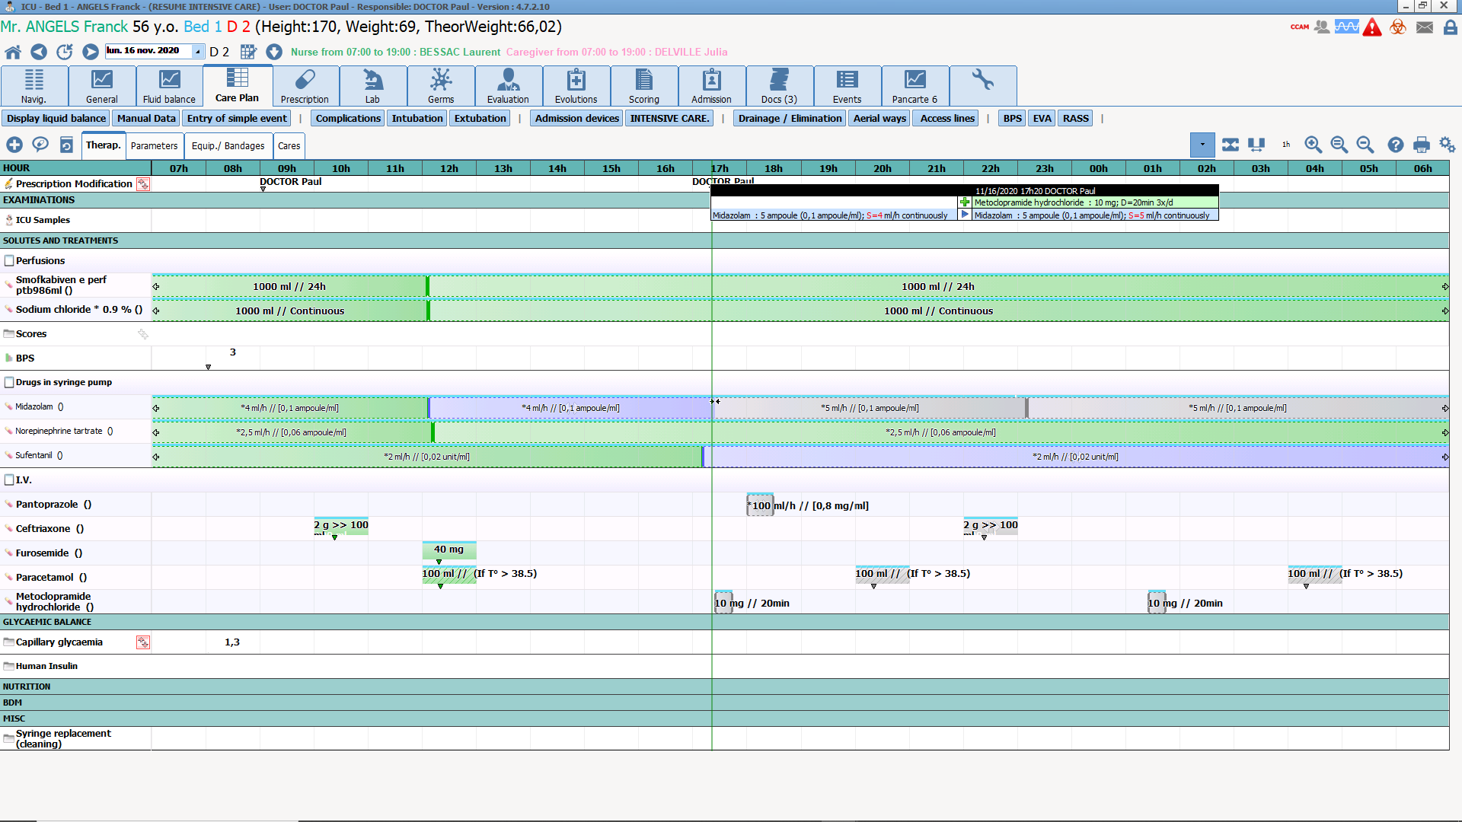
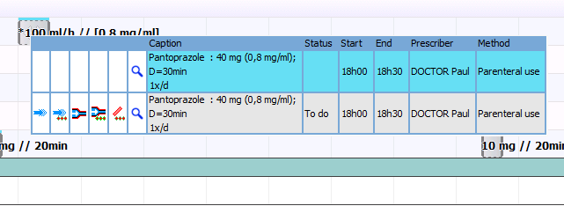
Care plan
Treatment tab
Show the icon indicating a medication order confirmed by a doctor and the highlighted items
-> Shows you quickly any new items or changes
The summaries of each occurrence quickly show what needs to be done
- Simple to confirm medication order
- Adjust times
- Easy to document real situation
Notes:
Talk about the clear and comprehensive care plan display.
The main message to get across here is that we have a simple view of the care plan to quickly understand what needs to be done.
It is designed to be easily used, to document the real situation, and therefore have a reliable record that can be studied in detail.

Slide 18
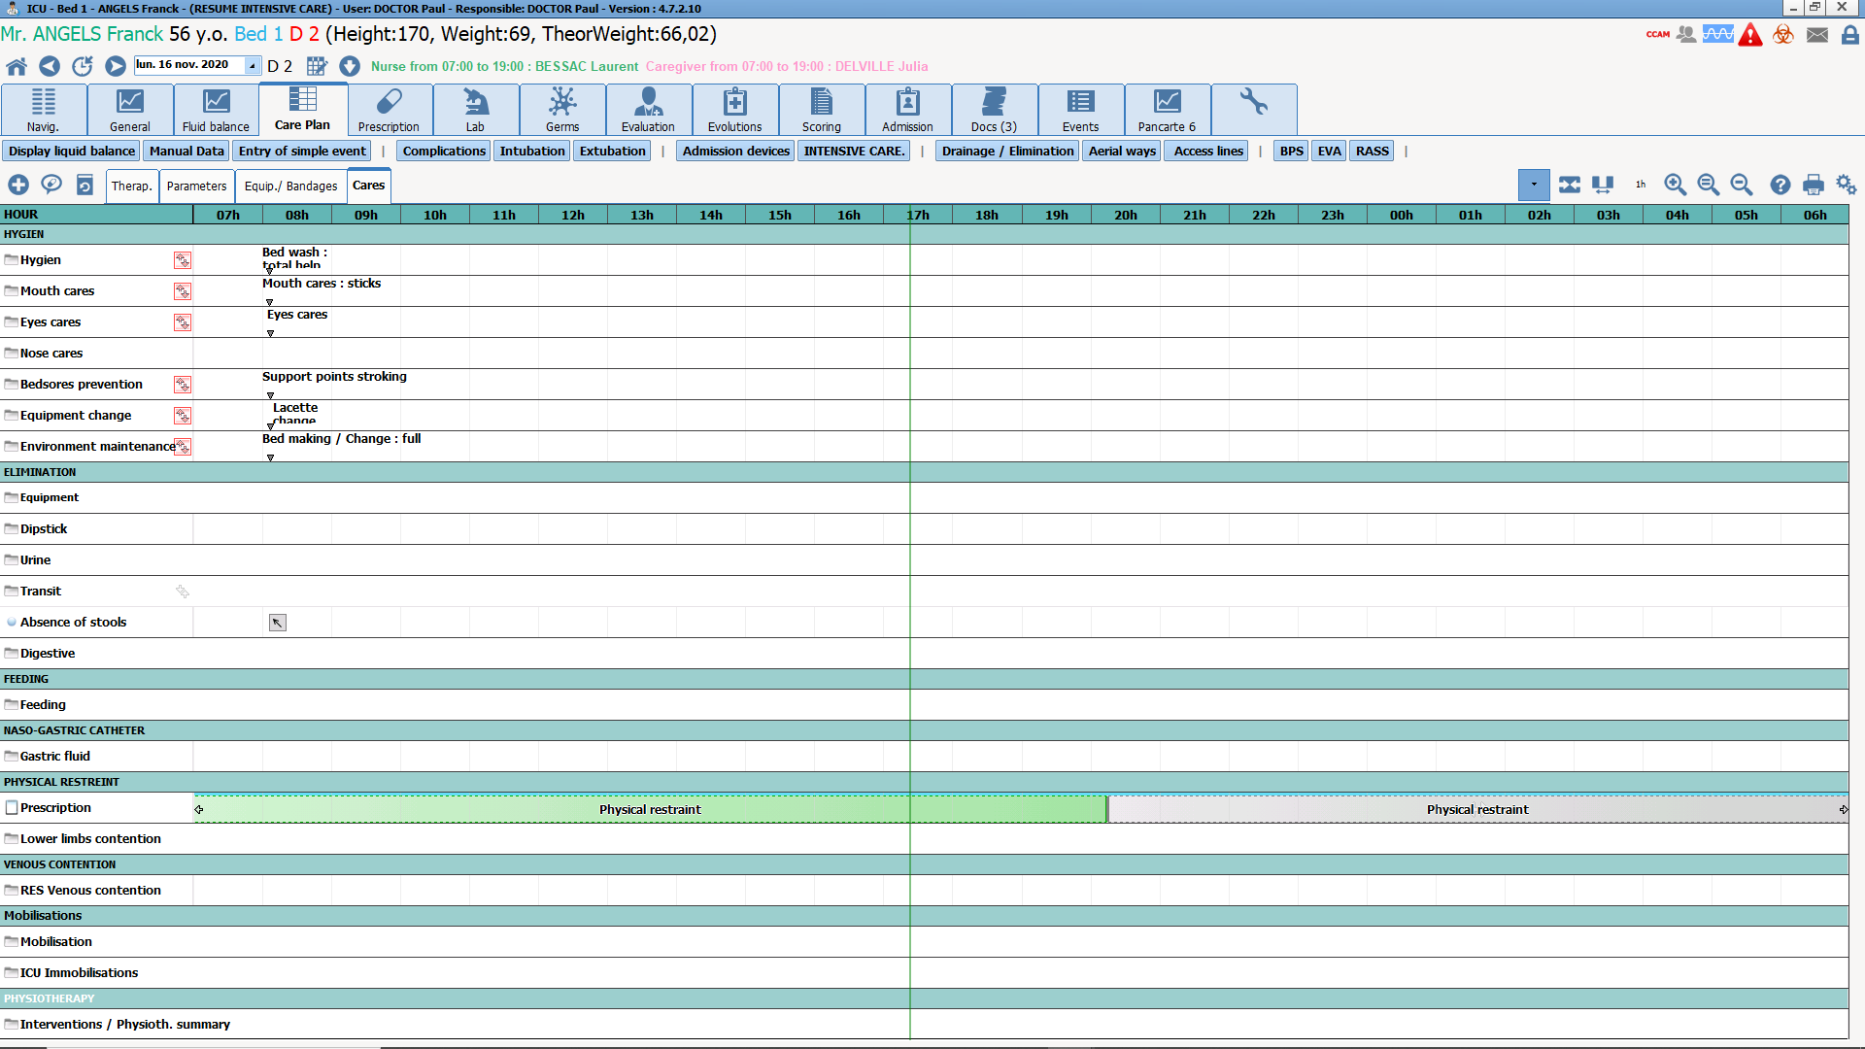
Care plan
‘Care’ tab
Show how to enter data simply by double-clicking on the care given

Slide 19
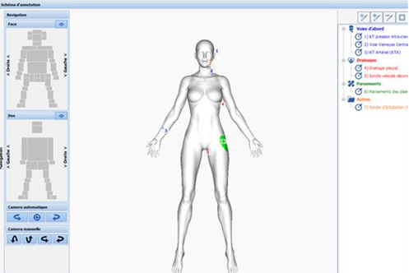
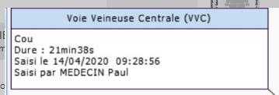
Diagram - Materials
3D representation of the patient to get an overview of the invasive materials and dressings used for the patient.
This function lets you automatically generate a care plan based on the equipment in place and the related protocol.
Notes:
The important features to highlight here are:
An overview of the devices and dressings allocated to patients
Changes over time, with the cursor to move from one day to another
Quick access to the details of each item (duration, photos, comments, etc.)
Related care protocols to automate the nursing schedule
Quick and detailed view of interventions needed
Pace of care flexible according to needs and changes
Information sharing to view and enter care both from the diagram and the care plan.

Slide 20
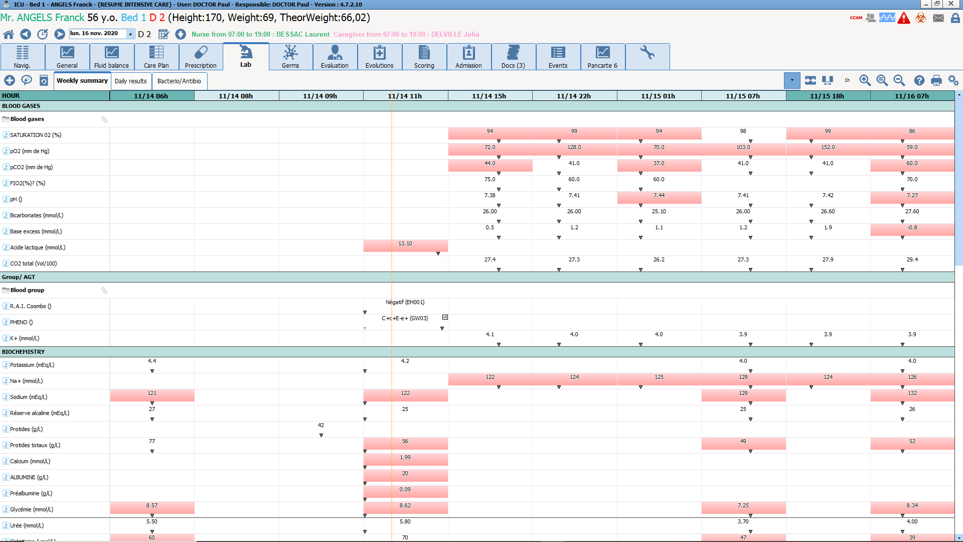
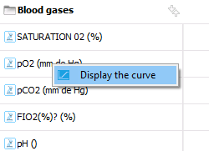
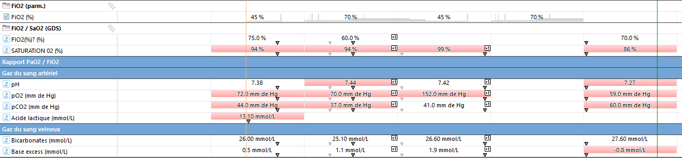
Laboratory
Incorporates structured lab results
Automatic view creation
If you right-click on any line you can see the curve
Data cross-referenced with other information in the record (example with the blood gas tab)
Notes:
The structured display makes it possible to categorize the information and therefore easily see the patient's changes.
The blood gas tab shows that we can also cross-reference the biological results with the equipment data and the data entered.
The right click to display the data curve is an important feature. Once the curve is displayed, we can change the timescale and add the other data from the record (lab and medical devices) to the chart.

Slide 21
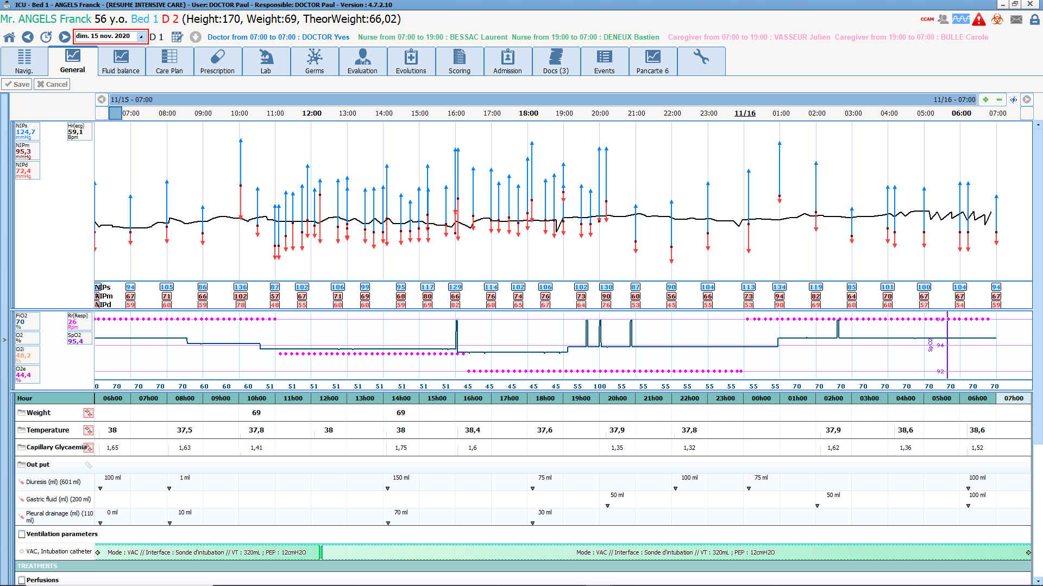
Views
General: for the overview of the record and the changes over time
Focus on the timescale
Haemodynamics:
Information cross-referenced to look at hemodynamic changes in the patient according to amine and volume expander treatments
Pulmonary
Infection
Kidneys
Notes:
Show how effective the views are for cross-referencing and studying patient changes.
All these views are provided by default and they can adapt them as they wish to their specialties, protocols, etc.

Slide 22
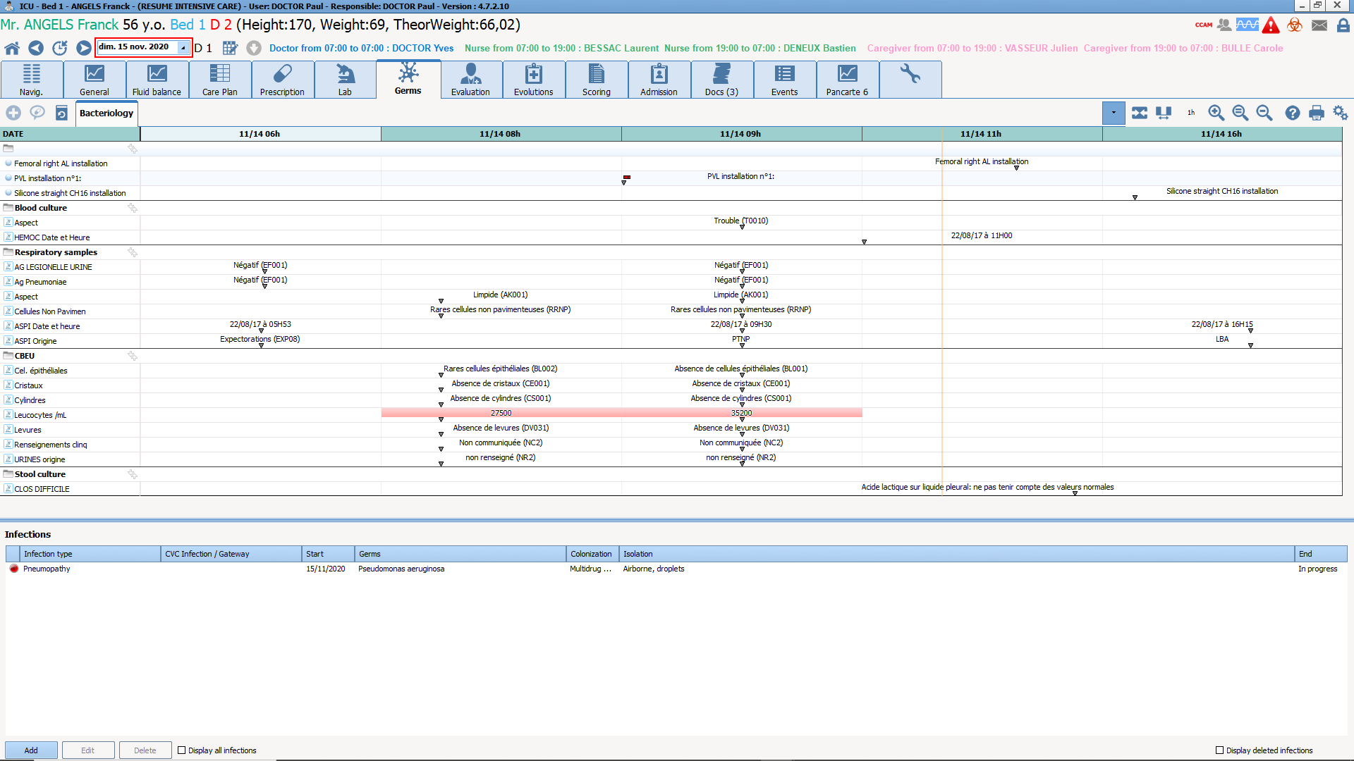
Germs
Infections are traceable
This information is cross-referenced with laboratory results and invasive materials

Slide 23
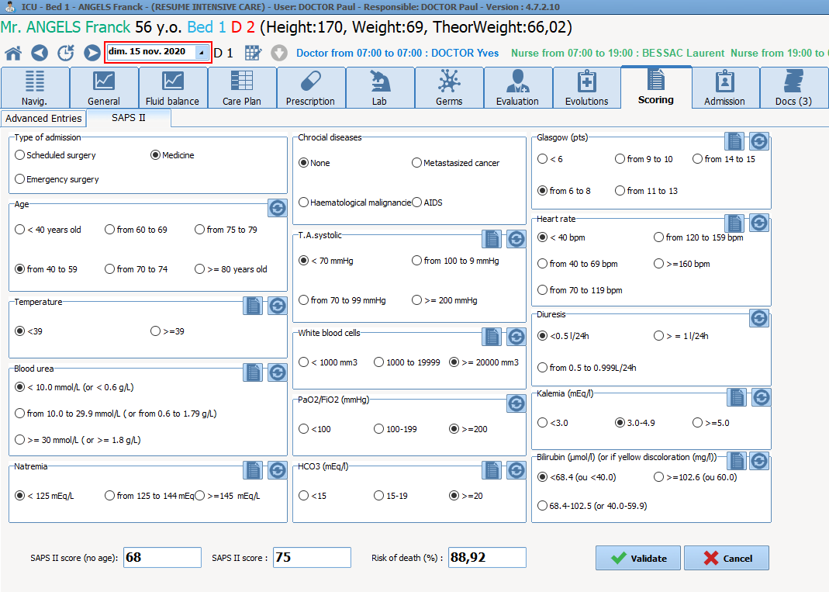
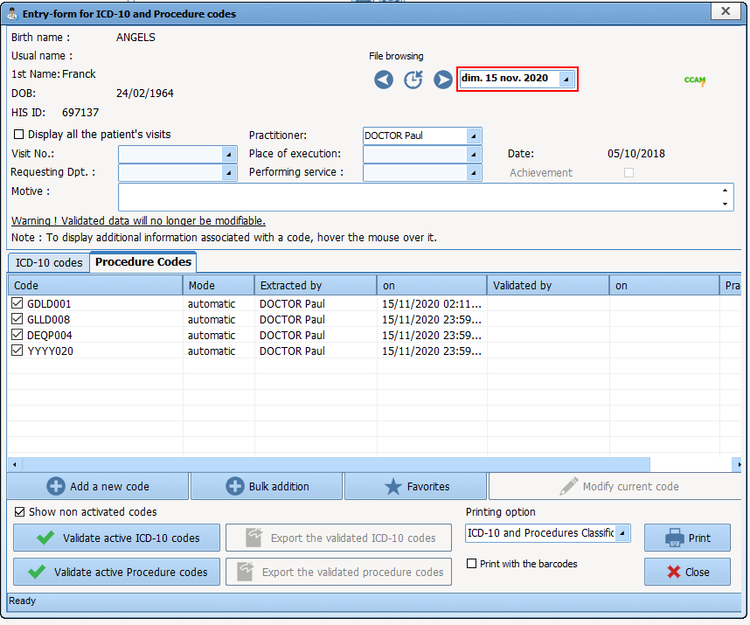
SAPS II / Marker procedures / Procedure codes
Automatic SAPS II calculation
Open the procedure code tool and show how procedures with procedure codes are detected automatically from the items in the record
Notes:
Automatic SAPS II calculation and automatic detection of marker procedures.
This part saves a lot of administrative time for the doctor in charge and/or the administrator.
Also lets you automate this transcribing to greatly limit the procedure part.

Slide 24
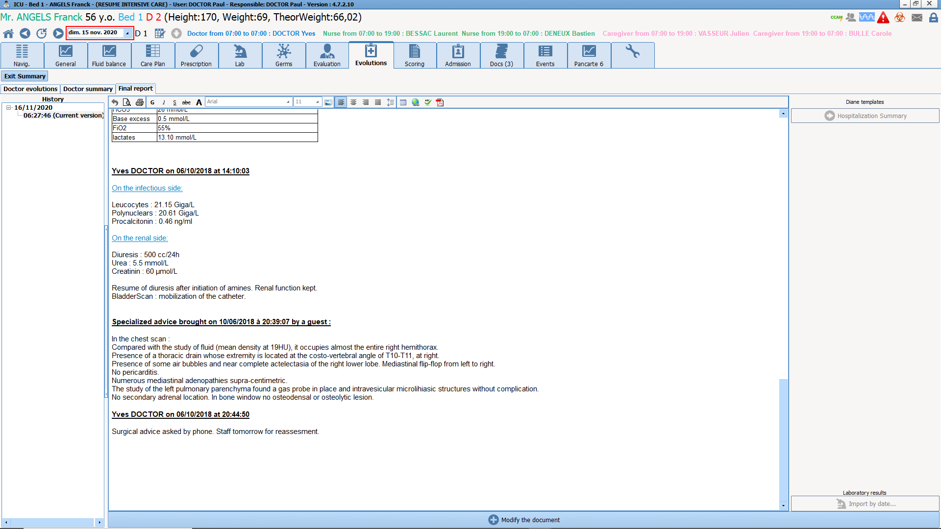
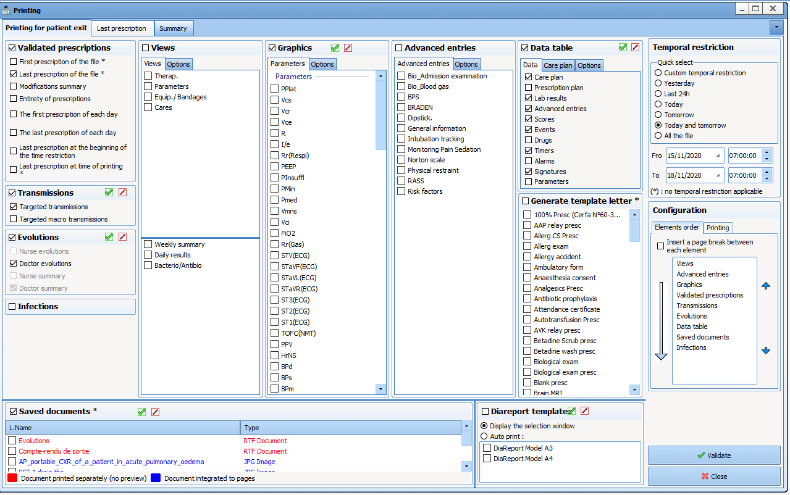
Report
In the ‘doctor’ tab, then the ‘discharge report’ tab
Explain the report example
showing a large amount of information
Then explain the centralized printing tool
- With all the items we can add to the report
Notes:
DIANE lets you generate almost all the data in the record, then export it to the EHR or print the documents.

Slide 25
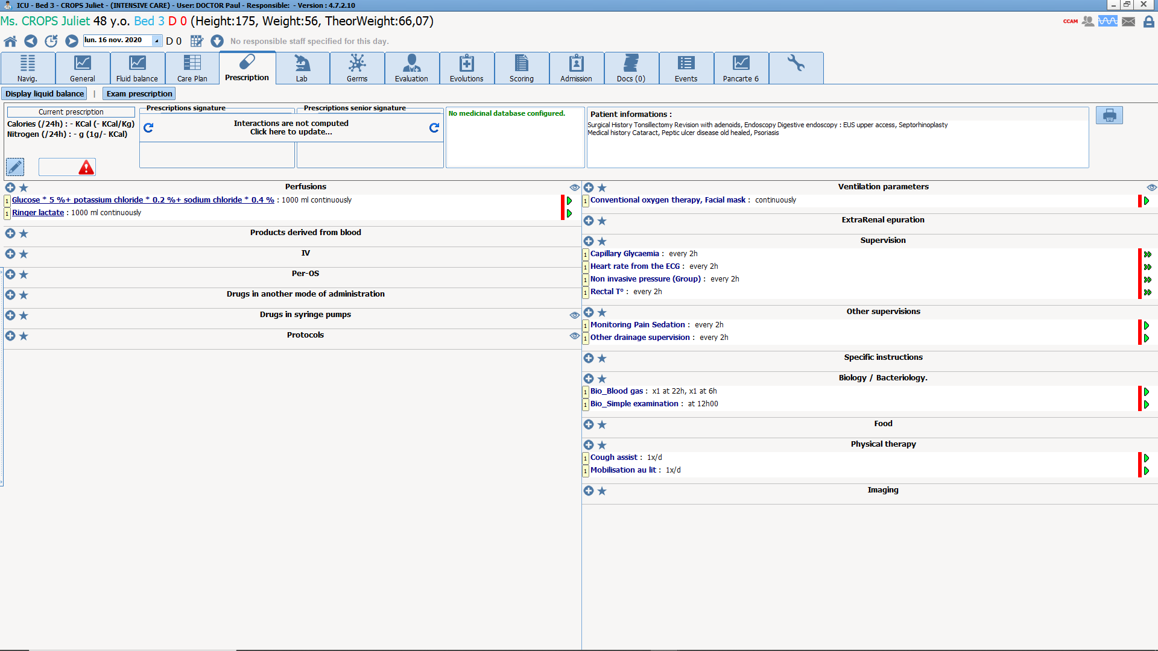
Blank record - Protocol
Open a blank record and show that the care is quick and easy to start
Show the data entry for a complete medication order protocol (example: ‘Sedated arrival’ or ‘Intubated arrival’)
This can also be the time to show the continuity between the OT and ICU by opening a record in which there is a Pre-Op and operation data.
Notes:
To show the continuity between the OT and the ICU, you need to prepare a record before the ICU demo:
To do this, before the demo, open a record in the OT, enter information then close the record indicating a transfer to the ICU -> It will then be proposed when we open a record for an empty ICU bed.

