Slide 1

Anaesthesia

Slide 2
CONTENTS
    OPERATING THEATRE – (OT)
      Startup
      Room Safety Checklist
      Patient selection
      Record selection
      Anaesthesia record: presentation
      Anaesthesia record: entering procedures / events
      Departure from room
  POST-ANAESTHESIA CARE UNIT (Recovery room) - (RR)
      Startup
      Room Safety Checklist
      Patient selection
      Record selection
      Anaesthesia record: presentation
      Anaesthesia record: entering procedures / events
      Closing the record
          Generating an ANAESTHESIA REPORT
Notes:
Presentation of the DIANE Anaesthesia software: the process runs from the start of the operating theatre until the record is closed. We will see the general view of the patient’s record but also the different types of data entry.

Slide 3
OPERATING THEATRE
(OT)

Slide 4
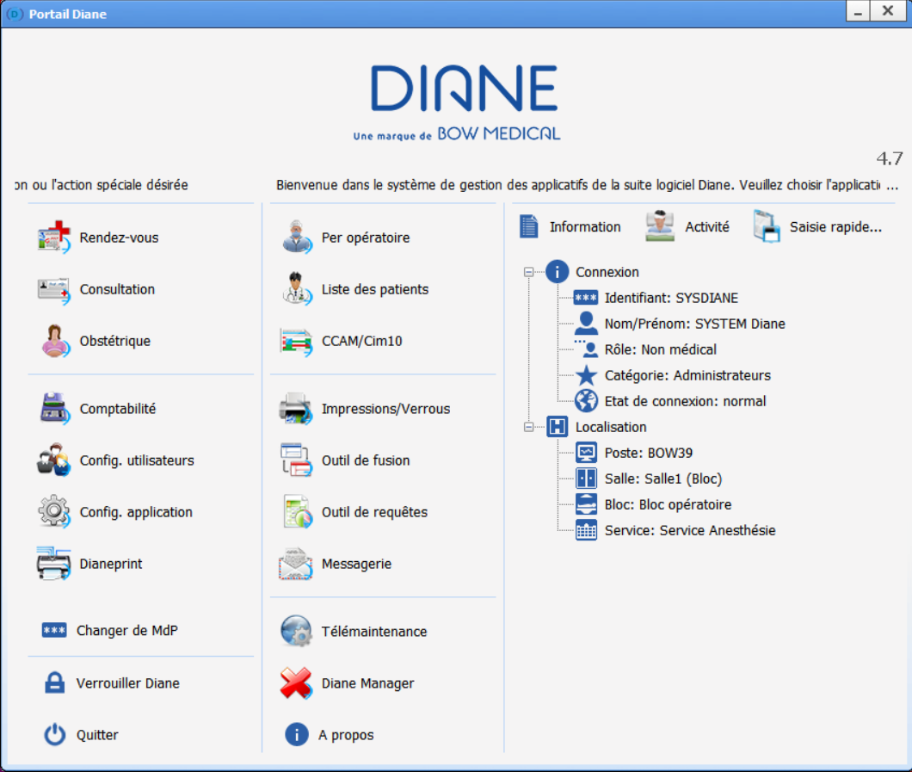
OT
STARTUP
‘Intraoperative’
Notes:
When starting up the software, you arrive on the home page.
We can see WHO is logged on and WHERE the computer is on the tree structure.

Slide 5
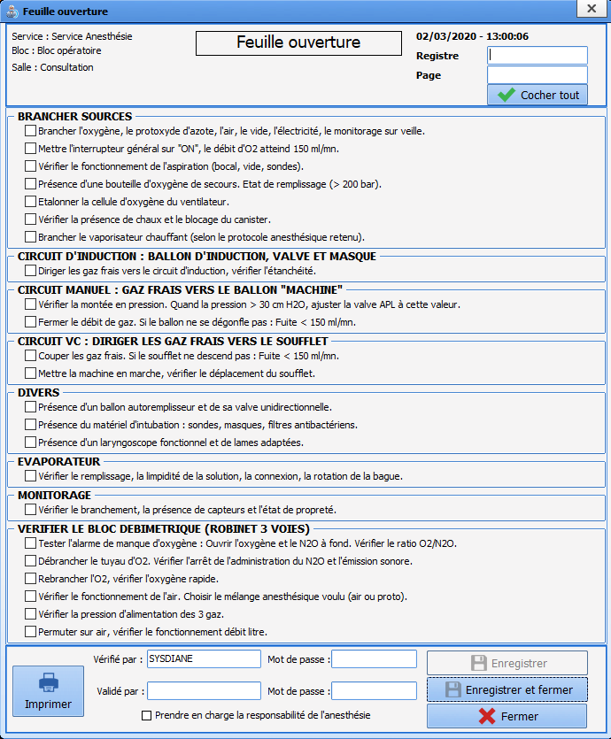
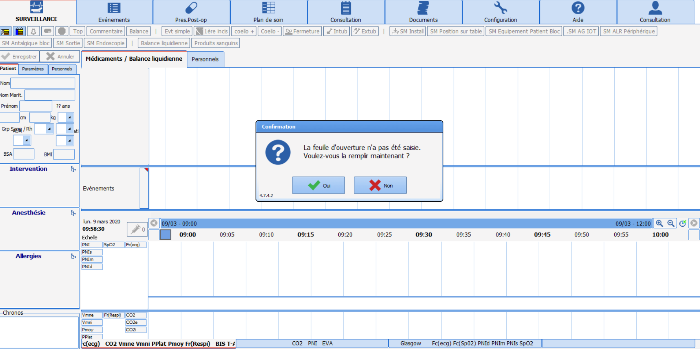
ROOM SAFETY CHECKLIST
OT
Prompt to complete room safety checklist
Notes:
First of all, you are prompted to complete the room safety checklist.
Sheet adapted to the facility.
To be completed and confirmed once every 24 hours.
It can be completed later in an emergency.

Slide 6
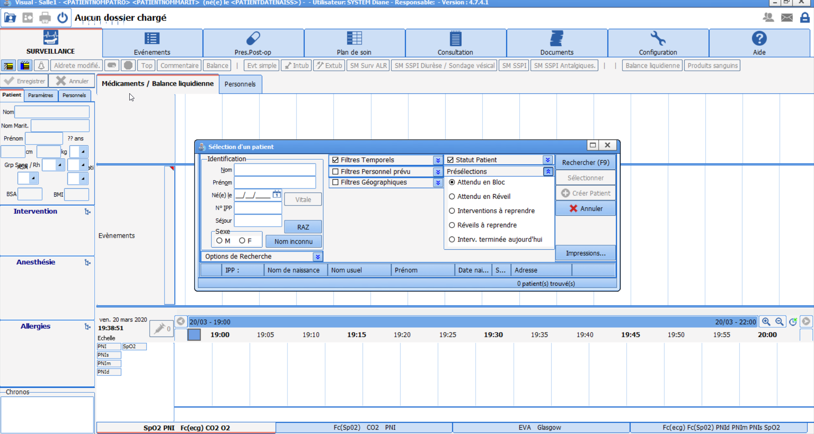
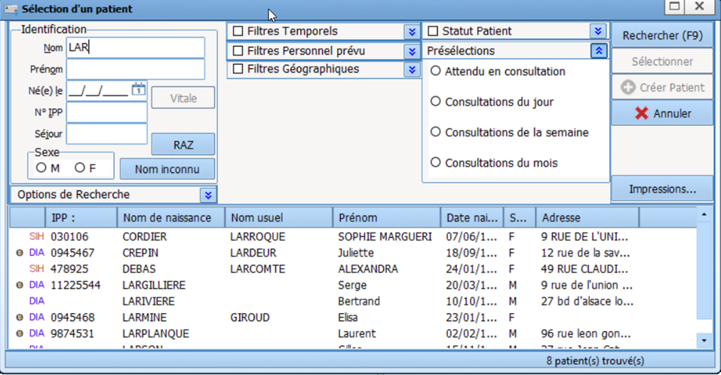
PATIENT SELECTION
OT
SEARCH using:
- Date of birth
or
- The UPI
or
- The first letters of the last name
Notes:
You are then prompted to select the patient.
This generates the corresponding list.
After selecting the patient, you will choose the relevant record.

Slide 7
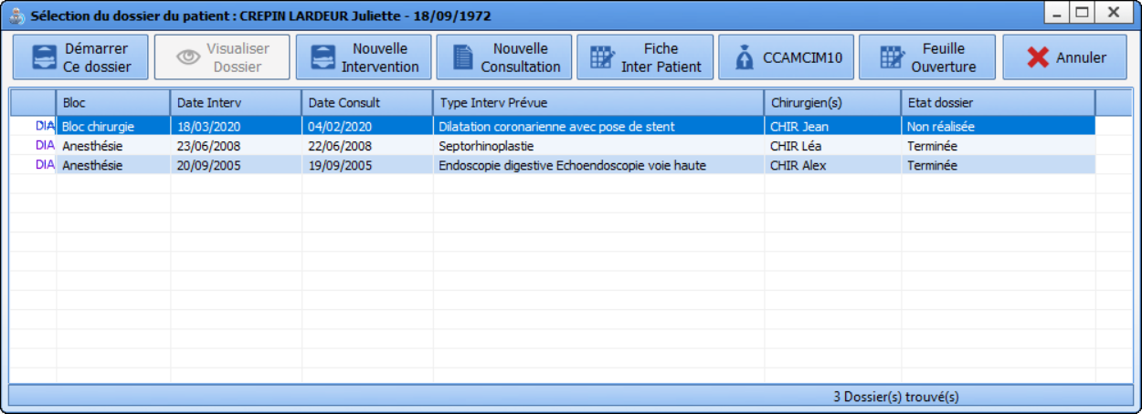
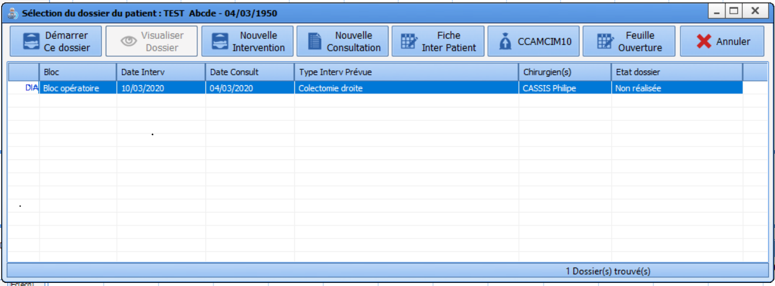
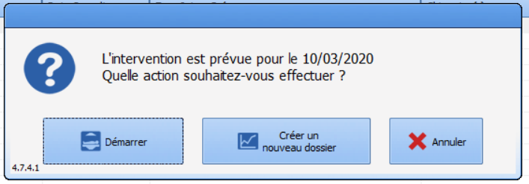
RECORD SELECTION
OT
Record status
Possible to open a record on a date different to the one scheduled
(operation postponed, etc.)
Notes:
You can see all the known records of the selected patient with different statuses (complete, not done, transferred to RR).
What you can do at this stage:
- Start up the record as planned
- Create a new operation
- Create a new consultation
Possible to open a record on a date different to the one initially scheduled
View a previous record (see next slide)

Slide 8
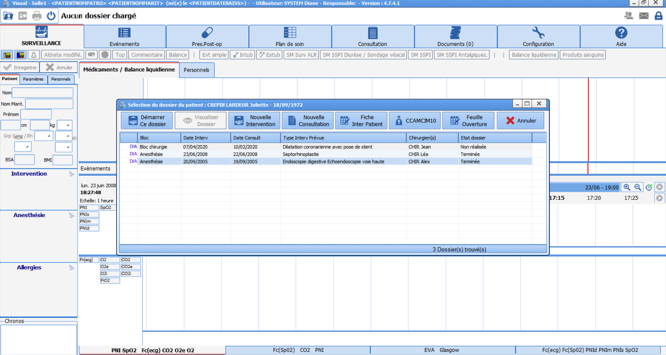
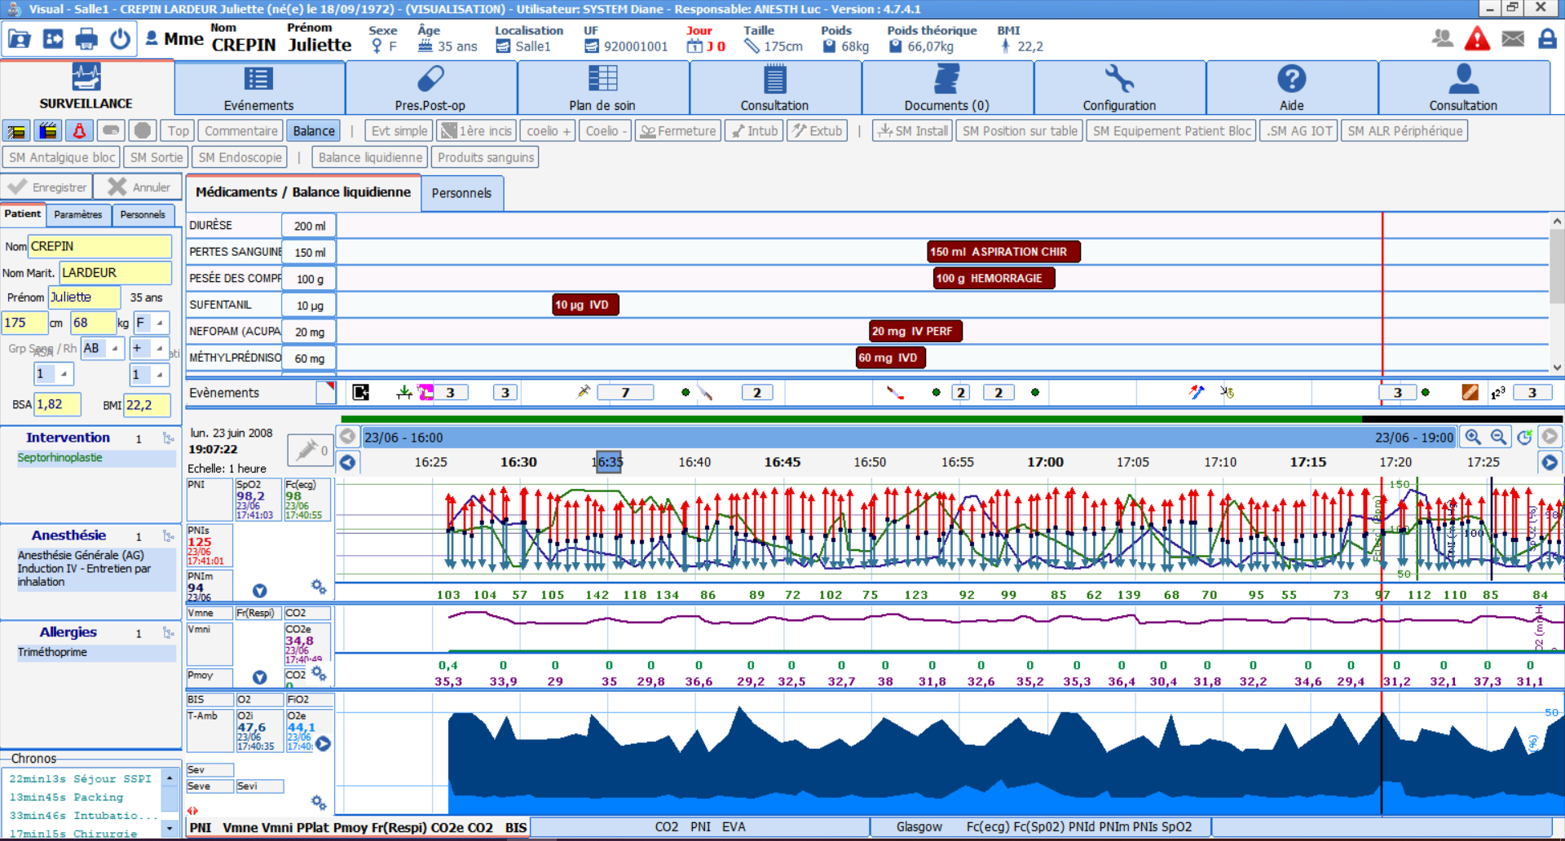
RECORD SELECTION
OT
Notes:
To view a previous record, just select it and you will have access to ALL the information for this operation.

Slide 9
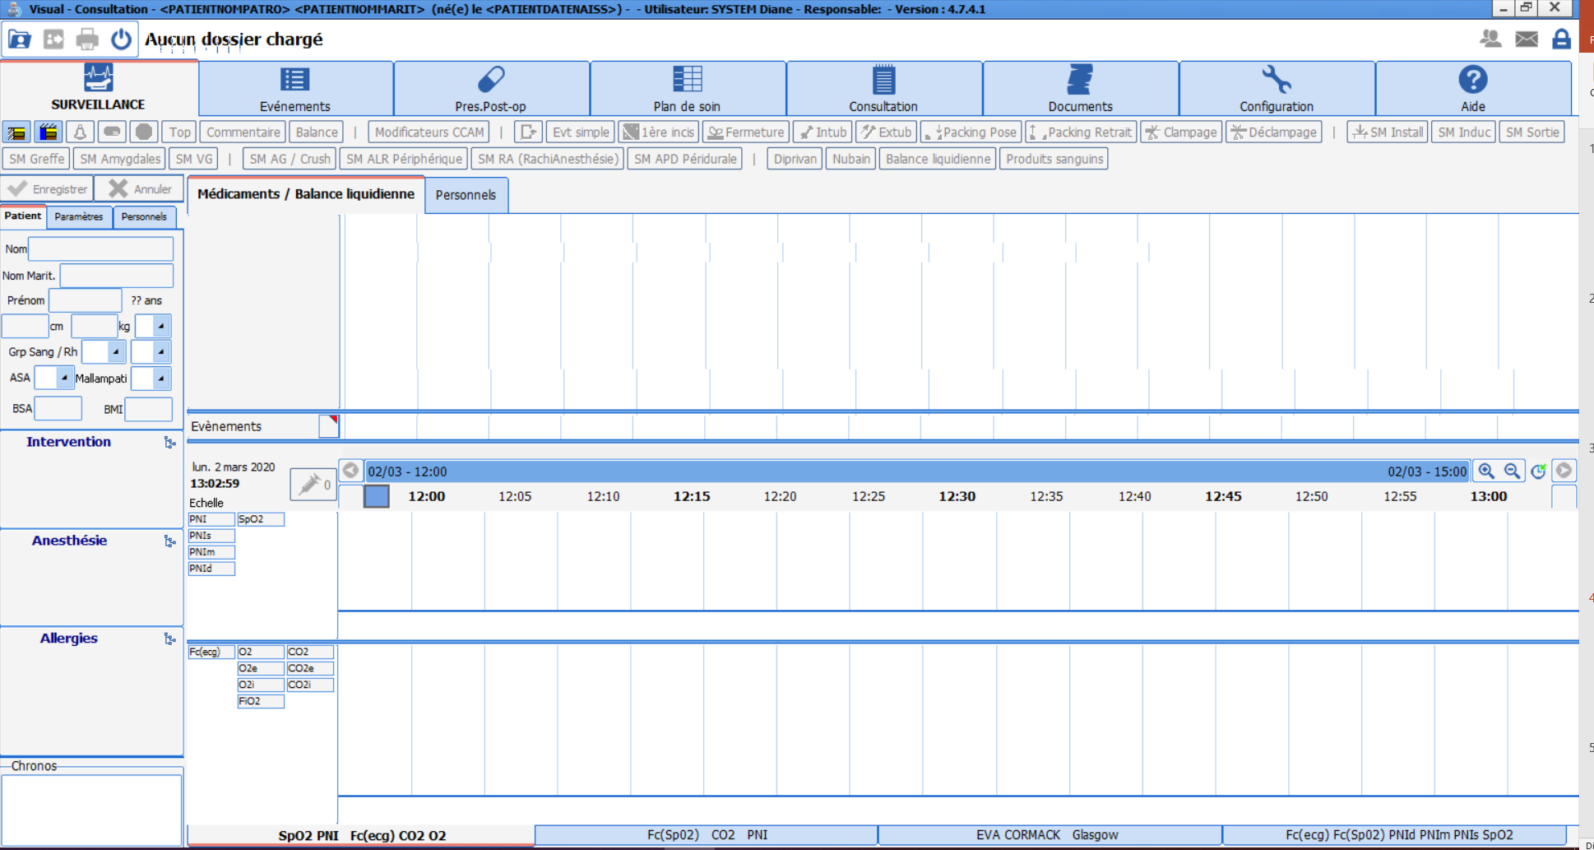
ANAESTHESIA RECORD: Presentation
OT
Information panes
Intake / Output (drugs, urine output, blood loss)
Button
pane
Chart pane (mainly data recovery)
Notes:
The actual anaesthesia record. Information panes / button pane / pane for intake – output / chart pane
We will look at each pane... starting with the information panes

Slide 10
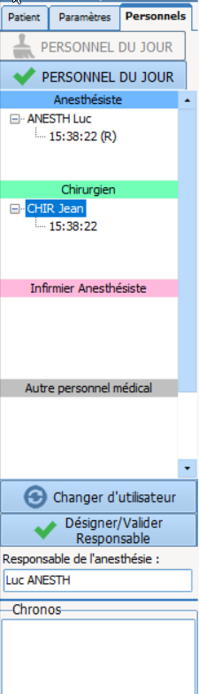
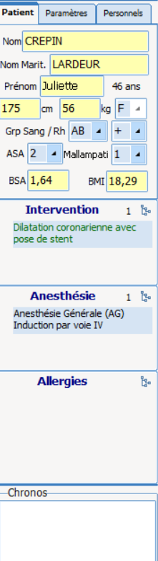
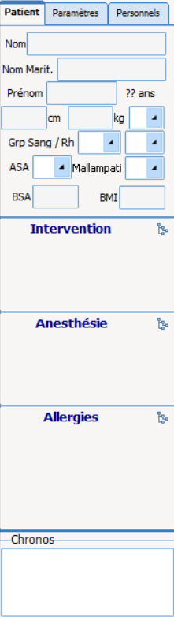
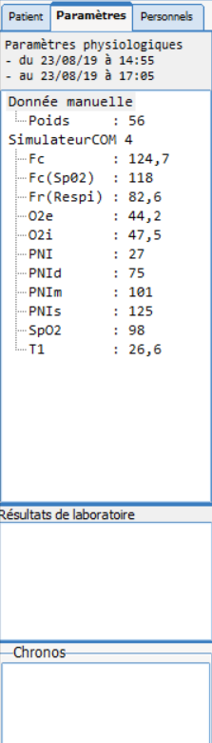
ANAESTHESIA RECORD - Presentation
OT
Patient information
from the
consultation
Staff present
in the room
Measured
patient
vitals
Timers
Lab
results
Notes:
The area on the left displays all kinds of information:
Patient info: from the consultation including weight / height / planned procedure and planned anaesthesia - these last pieces of info can be modified during the operation.
- view of timers
Next tab: vitals provided from connected devices
+ lab results provided
Next tab: staff present in the room (automatic if provided during consultation, or if defined as staff present on the day)

Slide 11
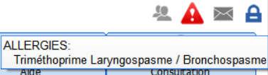
ANAESTHESIA RECORD - Presentation
OT
Permanent top ribbon stating ‘LAST NAME, FIRST NAME, age, weight, height,
theoretical weight and allergies (when you hover)
Notes:
The top ribbon is permanently displayed. It shows important information such as the patient’s name, age, weight, height and theoretical weight.
We can also see the patient's allergies.
Not configurable.

Slide 12
ANAESTHESIA RECORD - Presentation
OT
Button pane: provides quick access to the main interventions
Notes:
Button pane: configurable - adapted to the room’s activities

Slide 13
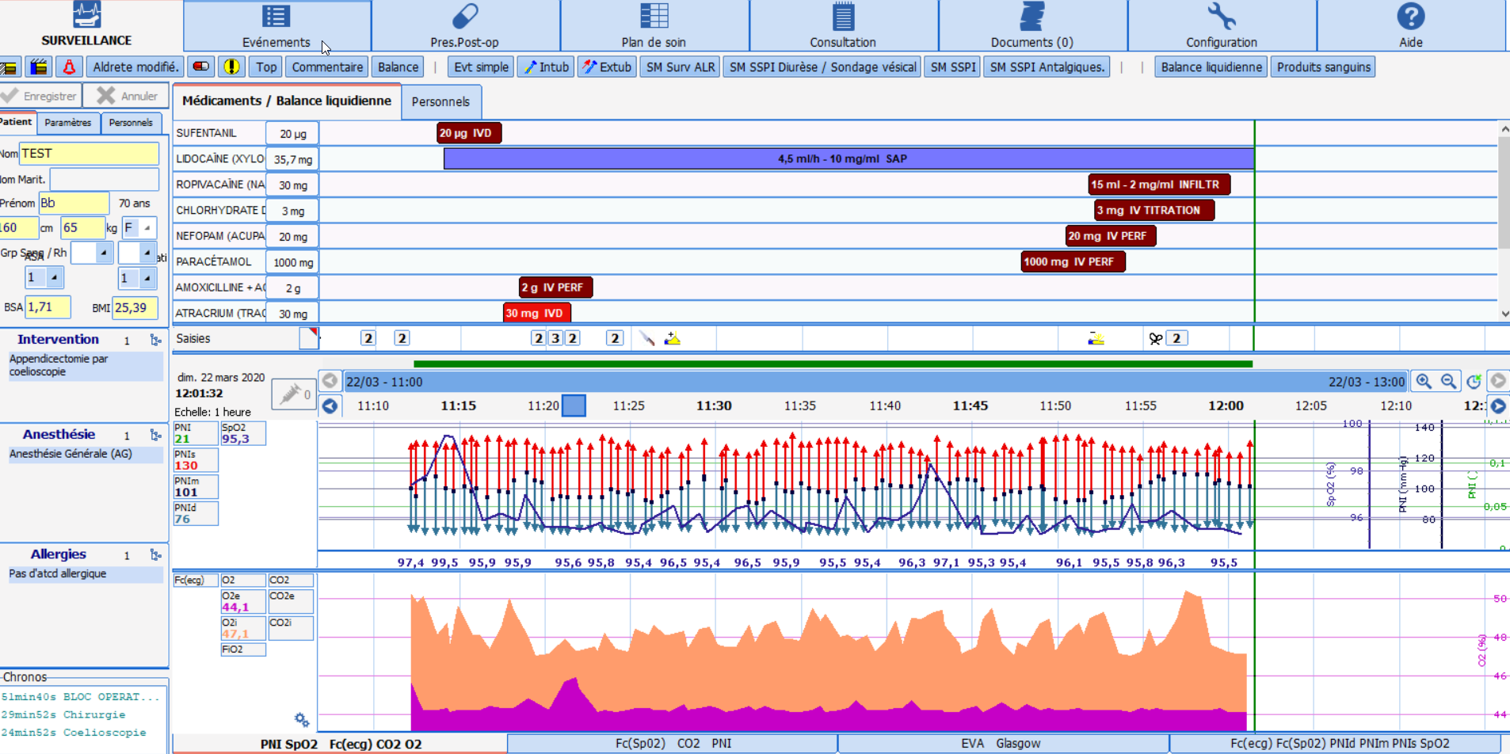
ANAESTHESIA RECORD - Presentation
OT
Chart pane: graphic and numerical view of the process of the operation
identical to paper version (configurable pane)
Notes:
Chart panes configured for the unit. Adaptable to the current situation and staff present without affecting the unit’s default configuration.
The green bar represents the current time.
You can decide what appears on the screen based on what you want to highlight.
Can be changed at a later time during care. All the information recorded will be saved in the record, even if the data does not appear on the screen.

Slide 14
ANAESTHESIA RECORD – Data entry
OT
Patient information panes
Intake / Output (drugs, urine output, blood loss)
Button
pane
Chart pane(mainly data recovery)
Notes:
We will now focus on the central part: how to enter patient data and events.

Slide 15

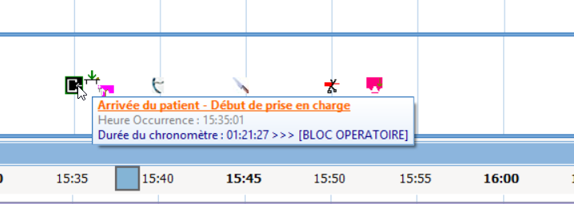
ANAESTHESIA RECORD – Data entry
OT
For recurring interventions: quick access button
Patient’s arrival
Notes:
Entering a procedure generates its incrementation on the entry line, symbolized by an icon. Example of patient arrival.

Slide 16
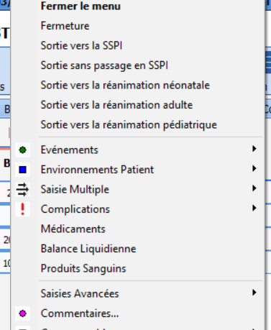
ANAESTHESIA RECORD – Data entry
OT
For recurring interventions: quick access button
Timer starts which
brings about the event closure
using the quick access
Notes:
Recurring interventions are configured using a button to enter data faster.
NB: a timer is started for interventions that have a start and an end. Here, entering an incision allows quick access to the closure.

Slide 17
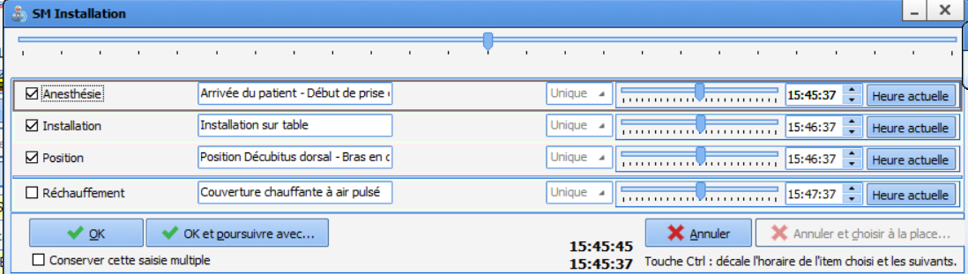
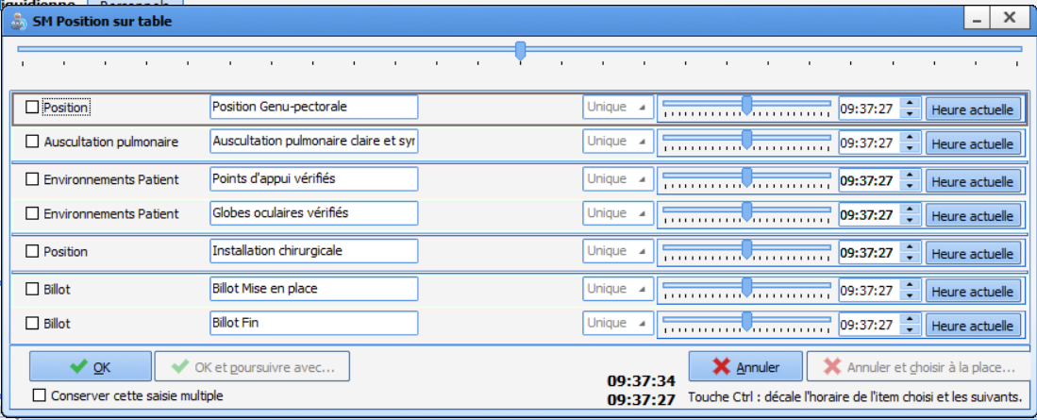
ANAESTHESIA RECORD
OT
For series of procedures: use ‘Multiple Entries’ i.e. for a complete sequence
Notes:
For ‘series of procedures’, it is better to use multiple entries.
Series of procedures can be broken down by type: patient’s arrival, positioning on the table, infusion insertion, analgesics, departure from the room… and sequenced like here. We have the ME with the patient’s arrival which then prompts us to proceed with the patient’s installation... we can continue with, for example, the infusion insertion then the induction phase.

Slide 18
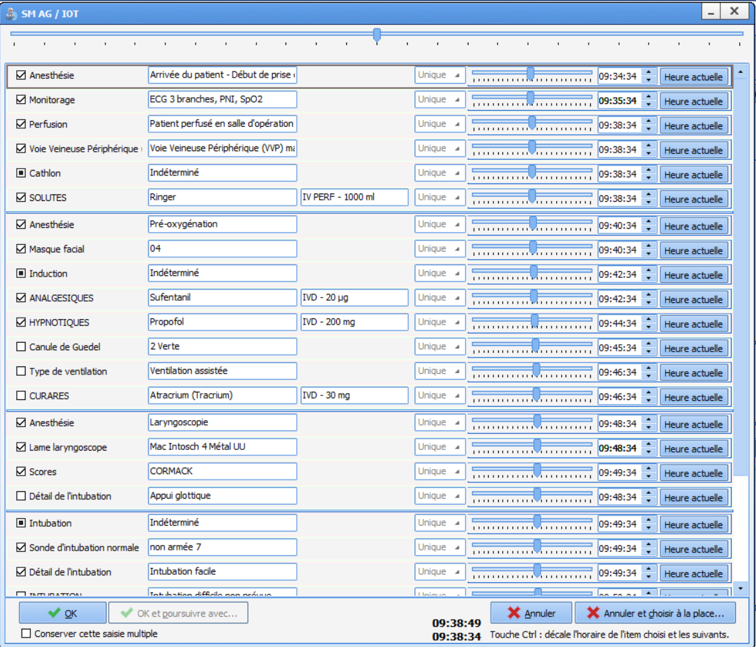
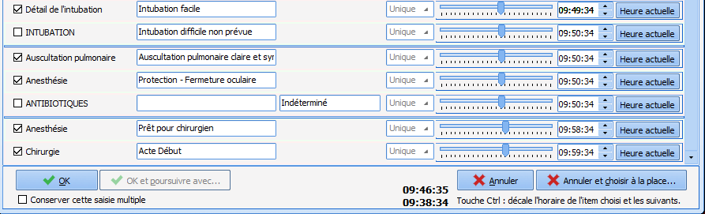
ANAESTHESIA RECORD – Data entry
OT
Cursor to choose
the departure time
Notes:
We can also have more comprehensive ME. Here is an entry that goes from the patient’s arrival until the start of the surgical procedure… it can be categorized for short surgeries (abortion, wisdom teeth, etc.), but also by type of anaesthesia (spinal, epidural, RSI, etc.).
By moving the cursor, you can adapt to the actual times (if data entered afterwards).
You can also open the ME at startup and click on ‘current time’ as the interventions are carried out.
ME: prefilled, configuration specific to the facility, all the information is entered in just a few clicks.

Slide 19
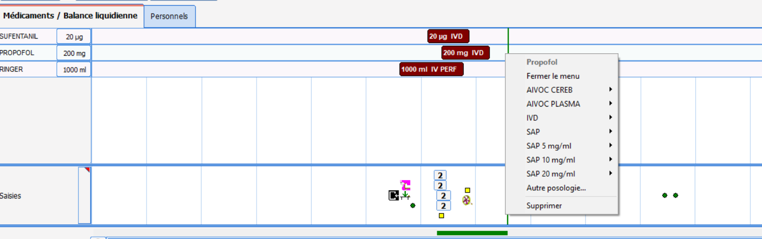
ANAESTHESIA RECORD – Data entry
OT
If you right-click on the line you can quickly enter repeat doses
Notes:
For drugs or output (blood loss, urine output, etc.), by right-clicking on a line already completed you can enter a new value.

Slide 20
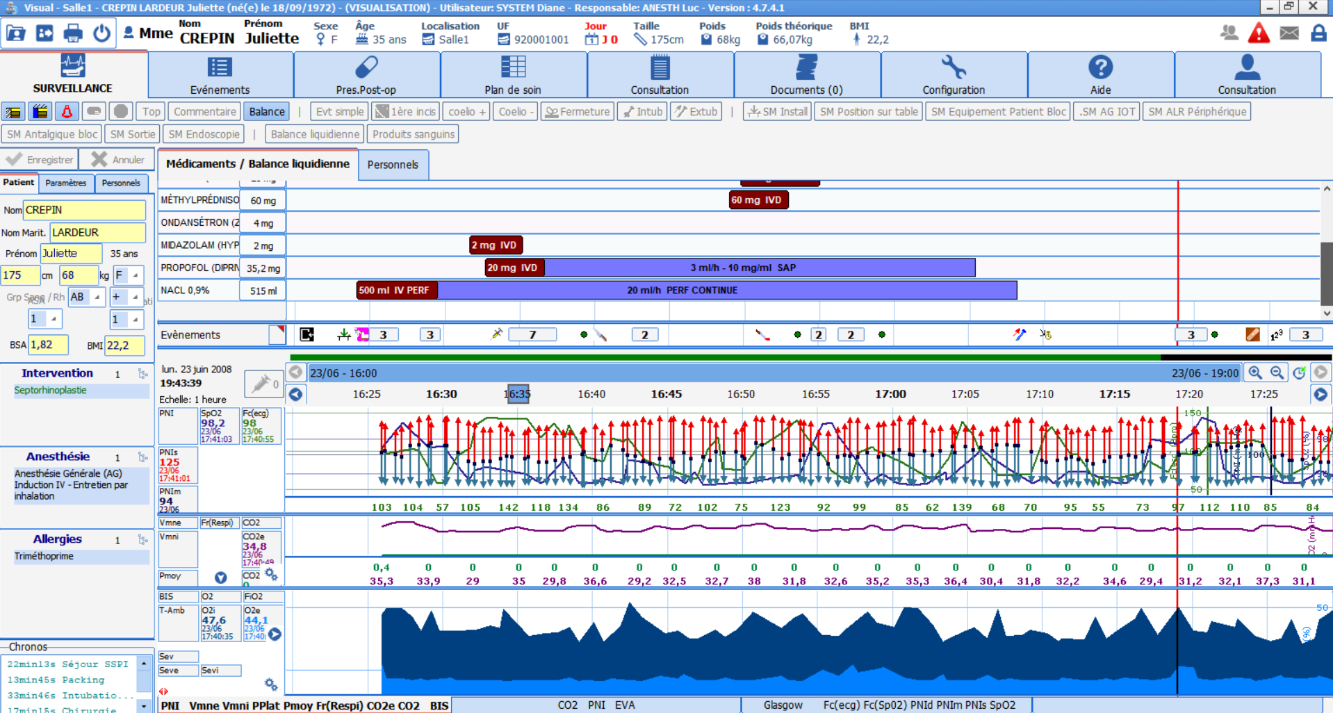
ANAESTHESIA RECORD – Data entry
OT
Data from connected syringe pumps (Primea, Alaris, etc.) will be
provided automatically
and flow rate changes will be incremented automatically.
Notes:
Data from connected syringe pumps (Primea, Alaris, etc.) will be
provided automatically and flow rate changes will be incremented automatically.

Slide 21
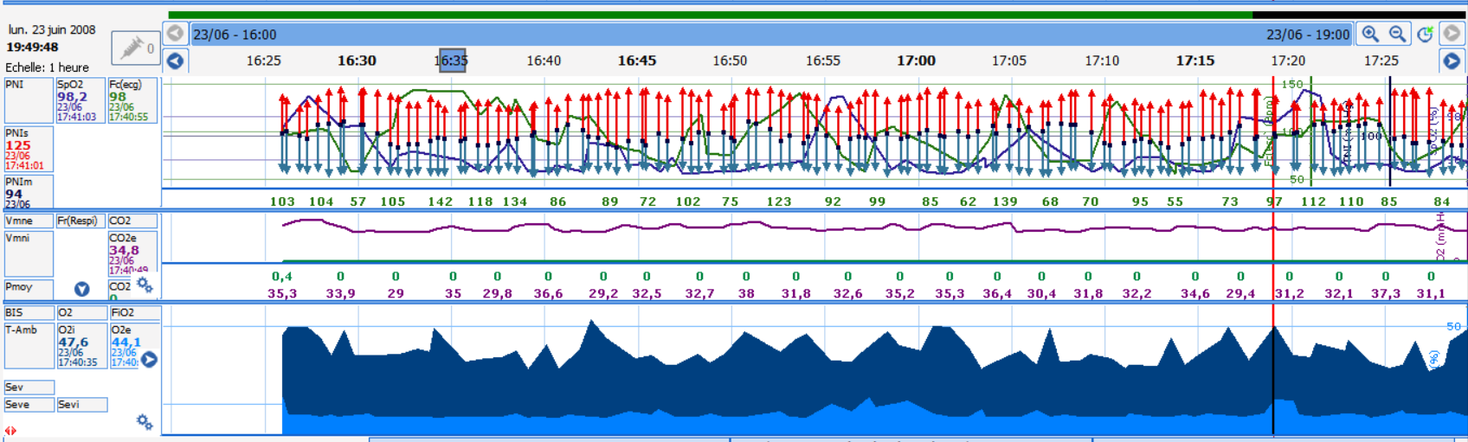
ANAESTHESIA RECORD – Data entry
OT
Data from biomedical devices (ventilator, scope, BIS,
ANI monitor, etc.)
is provided automatically
Notes:
The data is presented as chosen by key users. The room user can change the display for the day (curve, area, arrow, numerical… colour of curves, etc.)

Slide 22
ANAESTHESIA RECORD – Data entry
OT
Notes:
Here is the type of anaesthesia record we can have. The colours can be changed. Everything is configurable to have a ‘standard’ presentation for the unit, area, etc.
Each individual can choose the type of display... this will not affect the default display.
The data is recorded regardless of the choices displayed on the screen.

Slide 23
ANAESTHESIA RECORD: departure from room
OT
Departure from room
Patient information panes
Intake / Output (drugs, urine output, blood loss)
Button
pane
Chart pane (mainly data recovery)
Notes:
To exit the room, we will use the buttons at the top left

Slide 24

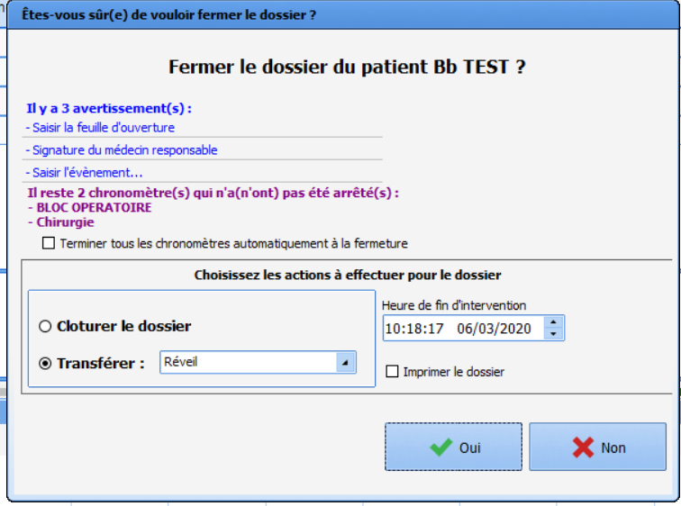
DEPARTURE FROM ROOM
OT
To trigger the record closure
Reminder of interventions not carried out (checklist, names of health professionals,
entering complications, closing
timers, etc.)
Notes:
The ‘close record’ button will make the record available for the RR.
Confirmation window: reminder of the interventions that should have been done before closing the record (exsufflation, closing patient ;-))
but also the safety checklist, the signature of the doctor in charge of anaesthesia, complications, etc.
We can make certain criteria mandatory for closing.
Indicators for improving the quality and safety of care are often asked to be mandatory = presence or absence of intraoperative complications -> accessible from this window = time saving.

Slide 25
POST-ANAESTHESIA
CARE UNIT
(RR)
Notes:
Commonly called ‘recovery room’

Slide 26
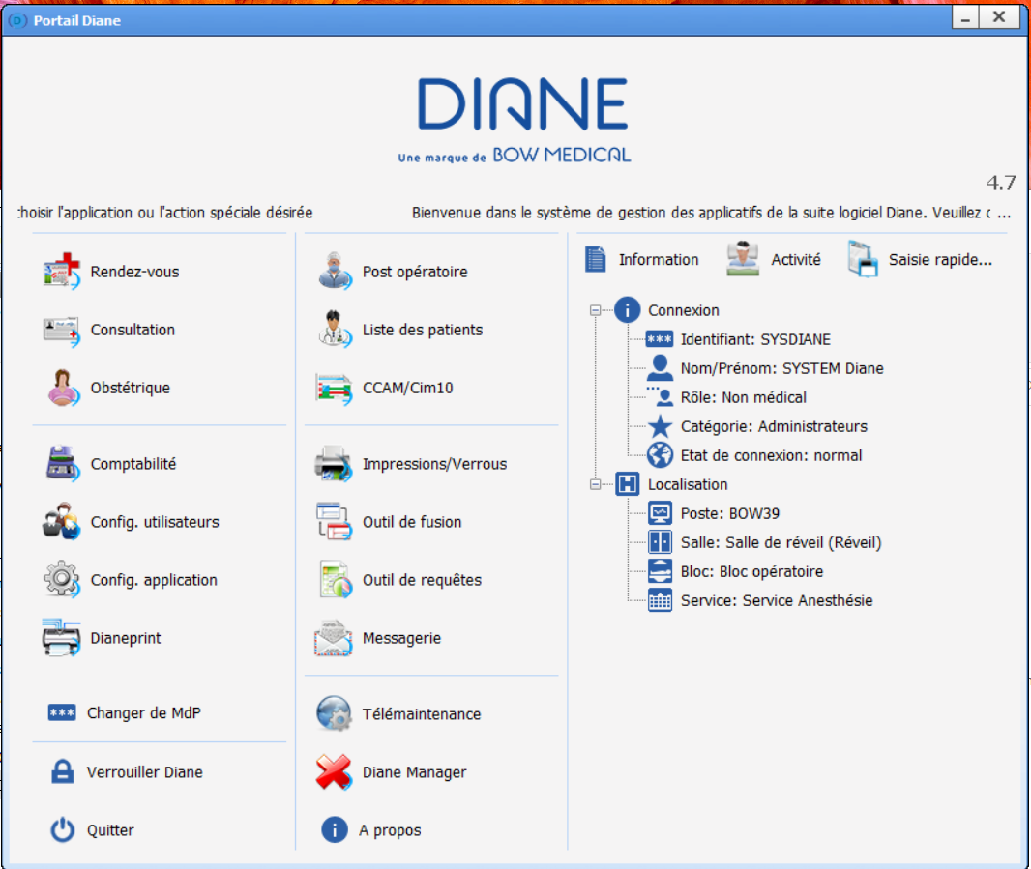
RR
STARTUP
‘Postoperative’
Notes:
We can see WHO is logged on and WHERE the computer is on the tree structure.

Slide 27
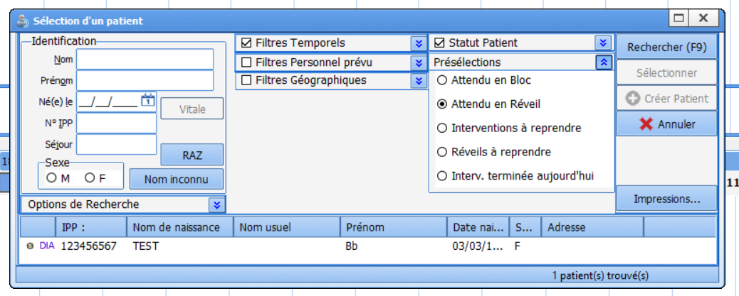
RR
PATIENT SELECTION
The preselection makes it possible to only show the records of patients ‘expected in the RR’
Notes:
To facilitate the search for the ‘expected’ patient, we will use the filter ‘expected in recovery’ -> displays only patients being transferred

Slide 28
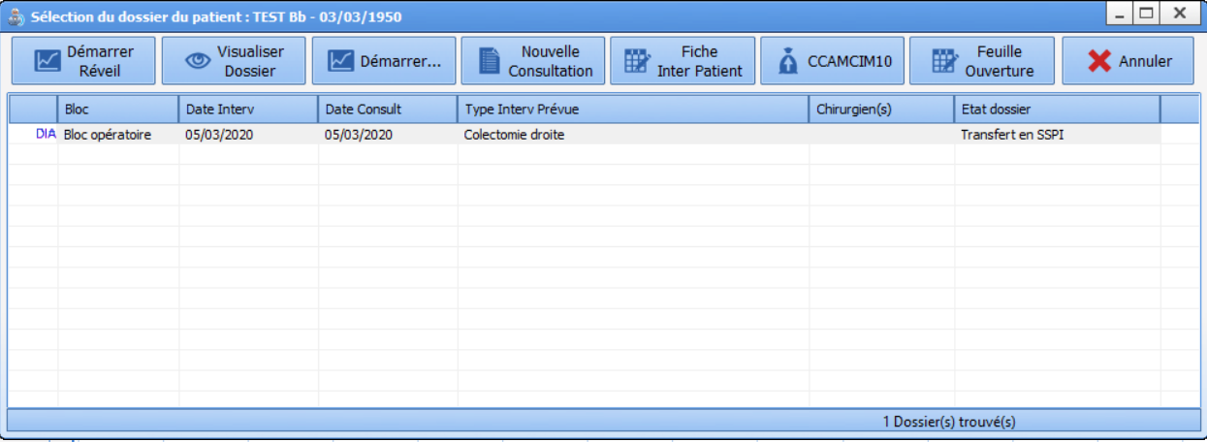
RR
RECORD SELECTION
Patient’s record and status confirmation
Notes:
After selecting the patient, we can see that the status of the record is ‘transferred to RR’

Slide 29
ANAESTHESIA RECORD: Presentation
RR
Information panes
Intake / Output (drugs, urine output, blood loss)
Button
pane
Chart pane (mainly data recovery)
Notes:
The actual anaesthesia record. Information panes / button pane / pane for intake - output / chart pane.
We will look at each pane... starting with the information panes.

Slide 30
ANAESTHESIA RECORD - Presentation
RR
Patient information
from the
consultation
Staff present
in the room
Measured
patient
vitals
Timers
Lab
results
Notes:
The area on the left displays all kinds of information:
Patient info: from the consultation including weight / height / planned procedure and planned anaesthesia - these last pieces of info may have been modified and still can be.
- view of timers
Next tab: vitals provided from connected devices
+ lab results provided
Next tab: staff present in the room (automatic if provided during consultation, or if defined as staff present on the day)

Slide 31
ANAESTHESIA RECORD - Presentation
RR
Permanent top ribbon stating ‘LAST NAME, FIRST NAME, age, weight, height,
theoretical weight and allergies (when you hover)
Notes:
The top ribbon is permanently displayed. It shows important information such as the patient’s name, age, weight, height and theoretical weight.
We can also see the patient's allergies.

Slide 32
ANAESTHESIA RECORD - Presentation
RR
Button pane: provides quick access to the main interventions
Notes:
Button pane: configurable. We will install buttons corresponding to the activity of that location.

Slide 33
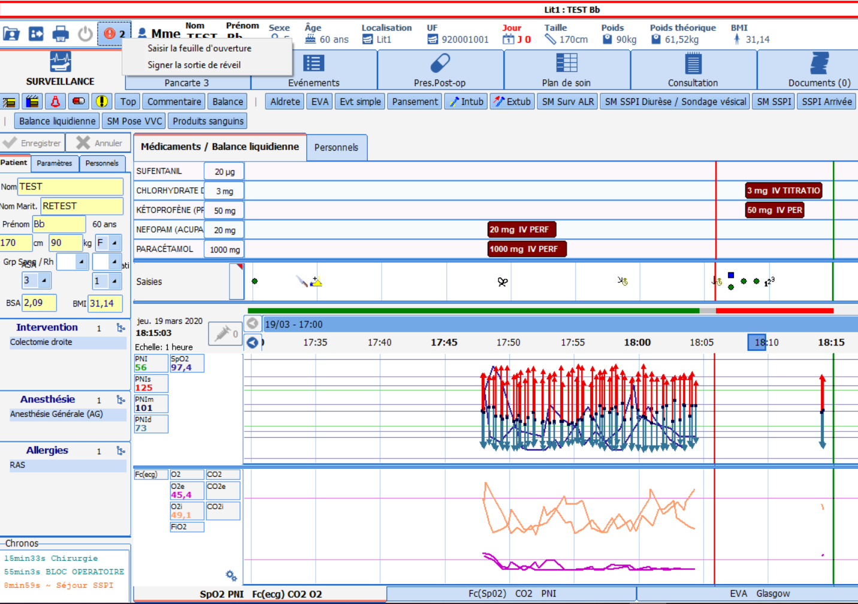
ANAESTHESIA RECORD: Presentation
RR
Chart pane: graphic and numerical view of the
process of the operation identical to paper version.
Notes:
Important: the green line represents the current time.
The red line represents the time when the record is closed in the operating theatre.
Line showing the unit of space: here the entire part underlined in green: operating theatre // underlined in red: recovery room // grey: time during which the record was closed.
We can therefore see everything that happened in the operating theatre. We can have an overview or a more detailed view. The information in this part can no longer be modified (possible to add but NOT delete).

Slide 34
ANAESTHESIA RECORD: Data entry
RR
Patient information panes
Intake / Output (drugs, urine output, blood loss)
Button
pane
Chart pane (mainly data recovery)
Notes:
We will now focus on the central part: the button pane and the charts... and on how to enter the information.

Slide 35

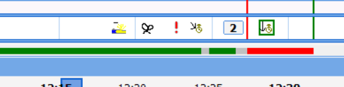
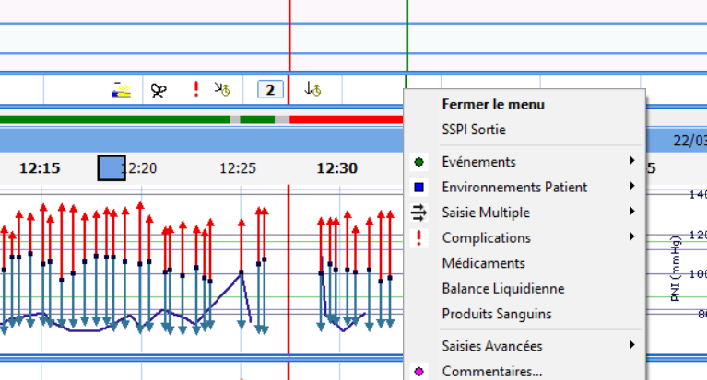
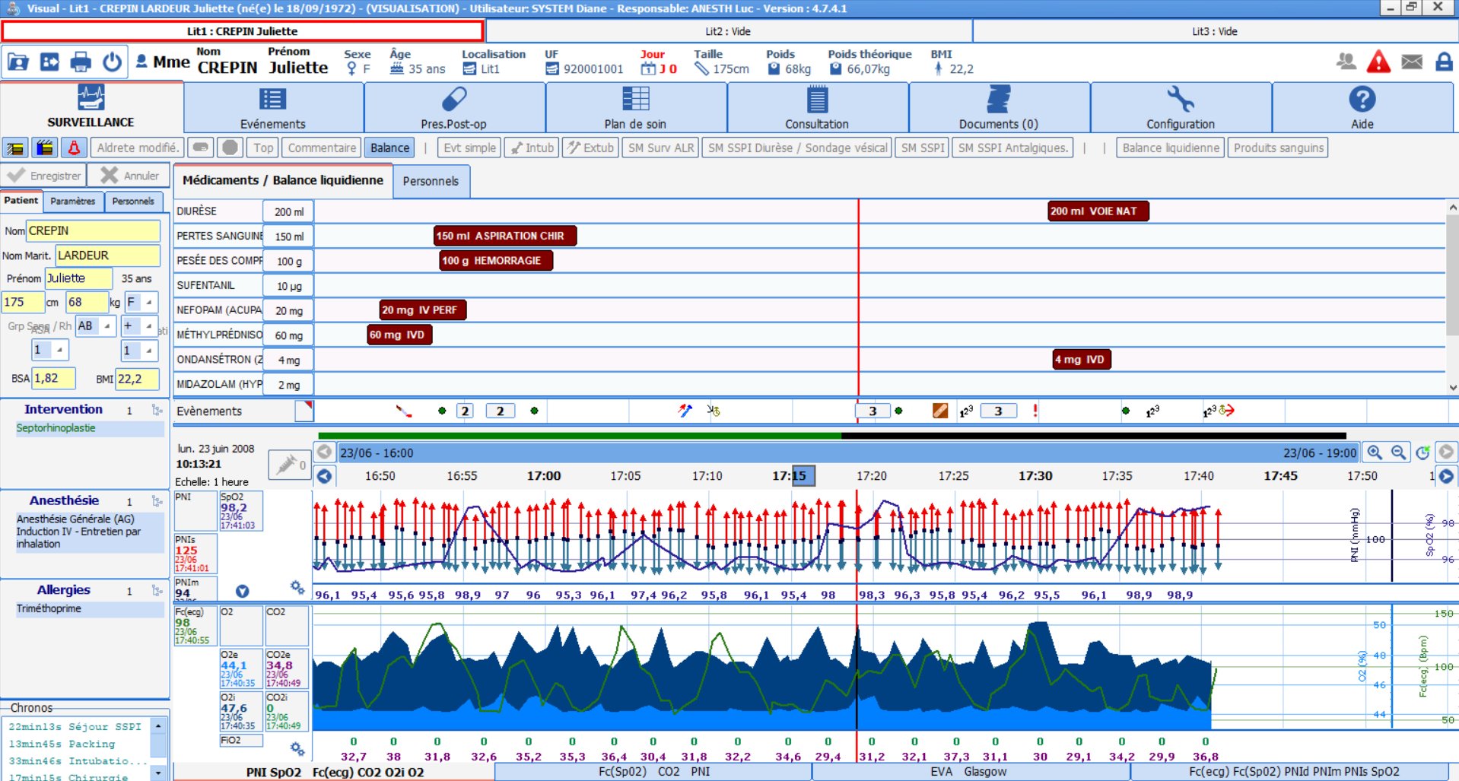
ANAESTHESIA RECORD – Data entry
RR
For recurring interventions: quick access button
Patient’s arrival
Event closure started
by a simple right click
Notes:
For simple and recurrent procedures we will put buttons in place.
Entering a procedure generates its incrementation on the entry line, symbolized by an icon. Example of patient arrival.
This starts a timer, which lets you close the event easily.

Slide 36
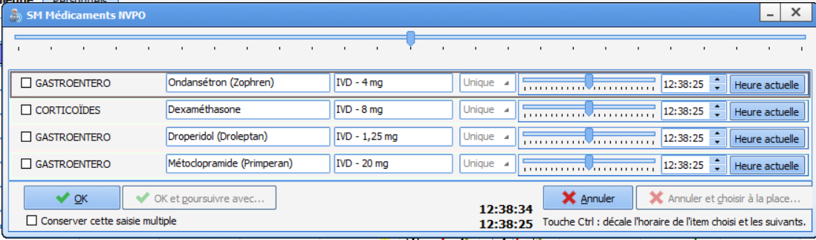
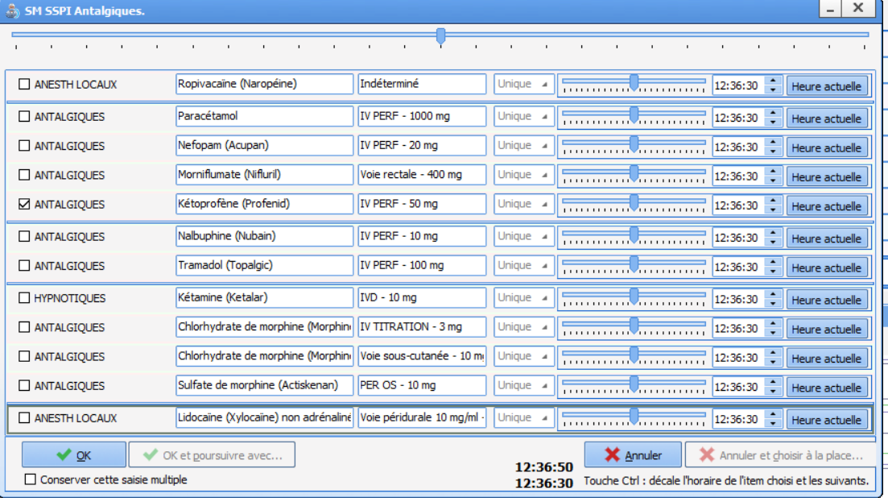
ANAESTHESIA RECORD – Data entry
RR
For series of procedures: use ‘Multiple Entries’
Notes:
You can create multiple entries based on recurrent site activities.
For example, we could create an ME with all types of drain... or recurrent interventions upon arrival in the RR, etc.

Slide 37
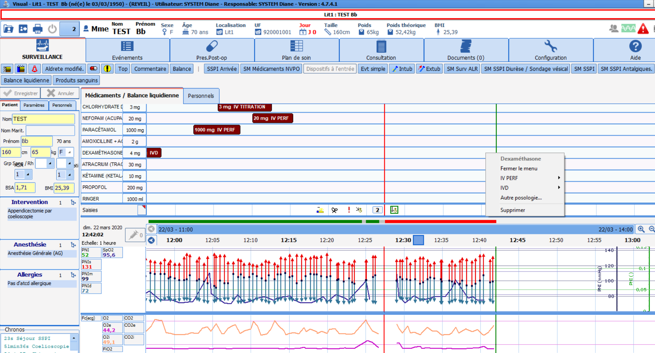
ANAESTHESIA RECORD – Data entry
RR
If you right-click on the line you can record a repeat dose
Notes:
For drugs or output (blood loss, urine output, etc.), by right-clicking on a line already completed you can enter a new value.

Slide 38
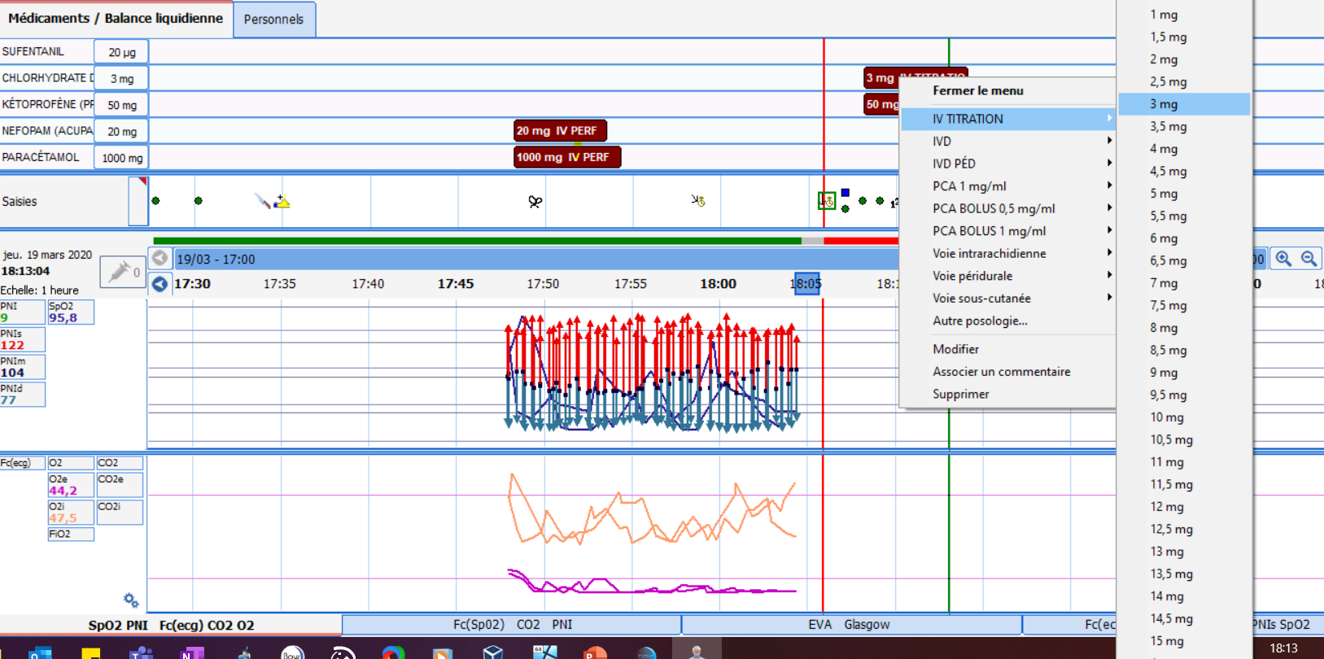
ANAESTHESIA RECORD – Data entry
RR
If you right-click on the line you can quickly enter repeat doses
Notes:
For drugs or output (blood loss, urine output, Redon drain monitoring etc.): by right-clicking on a line already completed you can enter a new value.

Slide 39
ANAESTHESIA RECORD: Departure from room
RR
Departure from room
Patient information panes
Intake / Output (drugs, urine output, blood loss)
Button
pane
Chart pane (mainly data recovery)
Notes:
To exit the room, we will use the buttons at the top left.

Slide 40
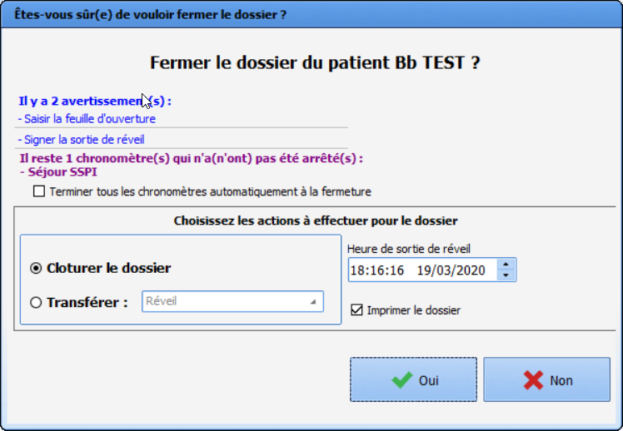
DEPARTURE FROM ROOM
RR
To trigger the record closure
Reminder of interventions not carried out
(checklist, RR departure signature,
VAS entry, departure score, etc.)
Notes:
The ‘close record’ button will close the record. It can be modifiable for a configurable period, usually 24 hours.
Confirmation window: reminder of the interventions that should have been done before closing the record (checklist, departure score, pain assessment, etc.)
but also the safety checklist, RR departure signature, etc.
We can make certain criteria mandatory for closing.
Indicators for improving the quality and safety of care are often asked to be mandatory = presence or absence of postoperative complications, RR departure score (Aldrete score, pain assessment)

Slide 41
ANAESTHESIA
REPORT
Notes:
Closing a record generates an anaesthesia report.

Slide 42
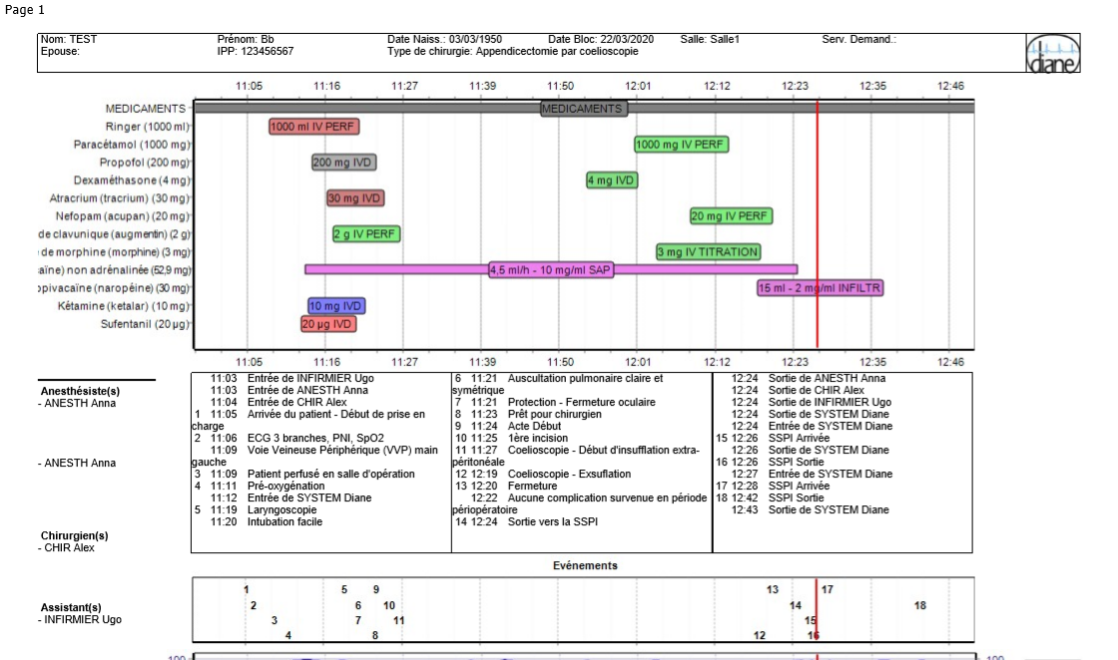

ANAESTHESIA REPORT
Notes:
This standard report is tailored to the facility.
In some cases, it is also possible and easy to add printout criteria.

Slide 43
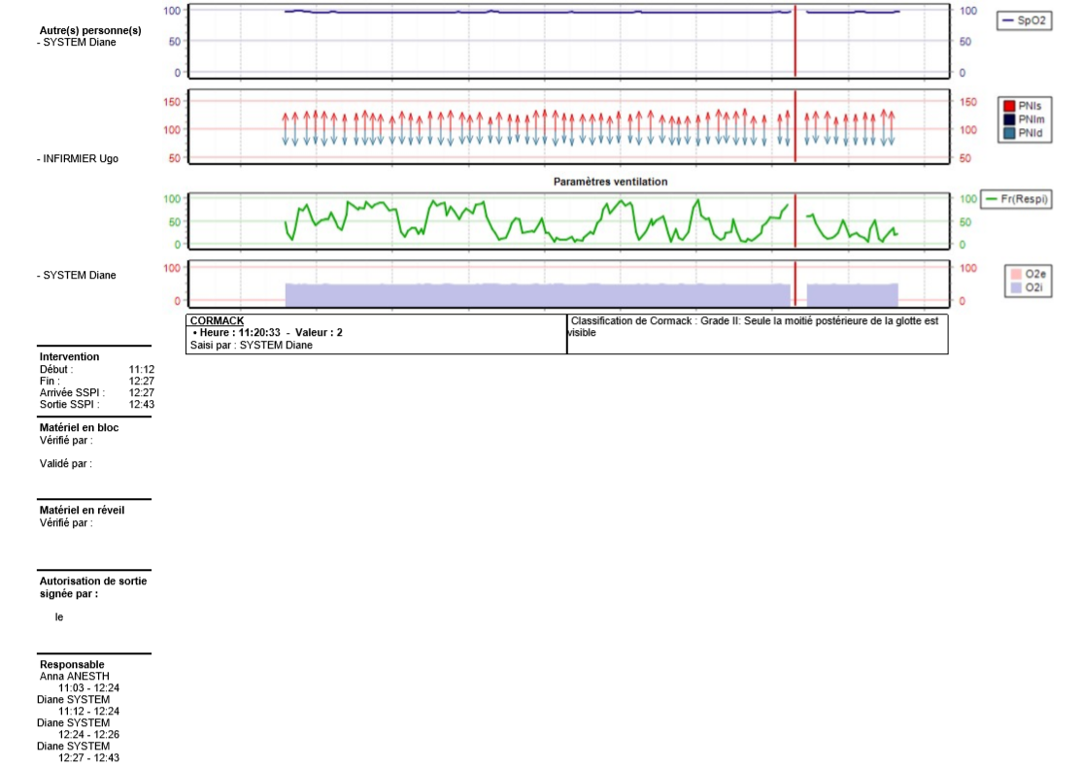
ANAESTHESIA REPORT

Slide 44
THANK YOU for your ATTENTION

Slide 45
CONTENTS
    OPERATING THEATRE – (OT)
      Startup
      Room Safety Checklist
      Patient selection
      Record selection
      Anaesthesia record: presentation
      Anaesthesia record: entering procedures / events
      Departure from room
  POST-ANAESTHESIA CARE UNIT (Recovery room) - (RR)
      Startup
      Room Safety Checklist
      Patient selection
      Record selection
      Anaesthesia record: presentation
      Anaesthesia record: entering procedures / events
      Closing the record
          Generating an ANAESTHESIA REPORT
Notes:
Presentation of the DIANE Anaesthesia software: the process runs from the start of the operating theatre until the record is closed. We will see the general view of the patient’s record but also the different types of data entry

Slide 46
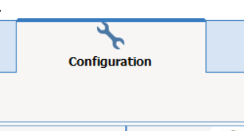
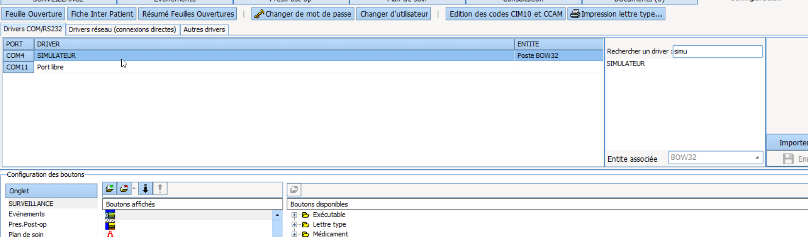
Intraoperative – Anaesthesia record
Before your demonstration, start up the simulator
Click on the configuration tab
Search for the ‘simu’ driver
Drag it to a free com port

